Slide 1
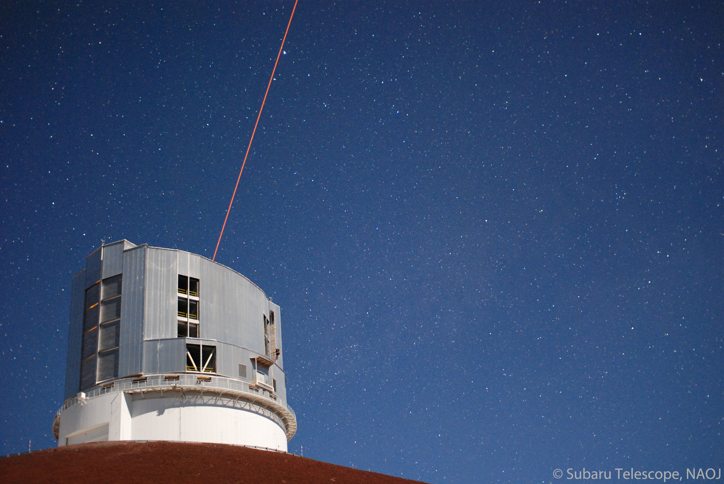

Science Operation of Subaru Telescope
Tae-Soo Pyo
2014.Feb.25

Slide 2
Agenda
What is Science Operation
Proposal System
Evaluation of Proposal
Scheduling of Proposal
Execution of Program

Slide 3
What is Science Operation

Slide 4
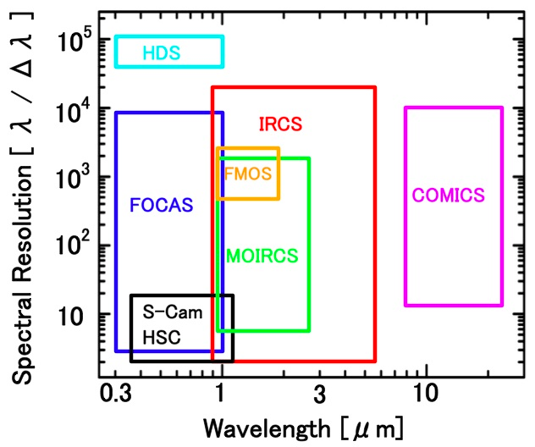
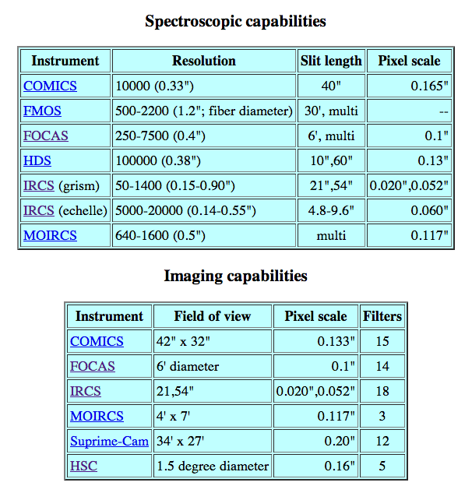
Instruments of Subaru Telescope
+ PI Instruments in S14B : HiCIAO, Kyoto3DII, RAVEN, SCExAO,

Slide 5
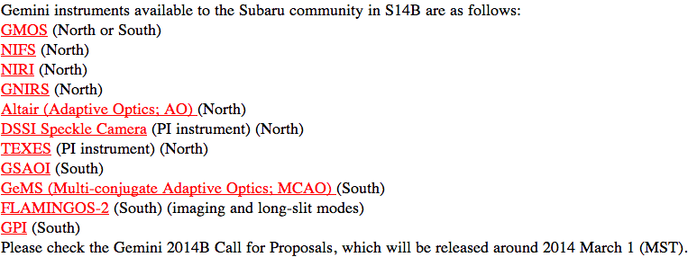
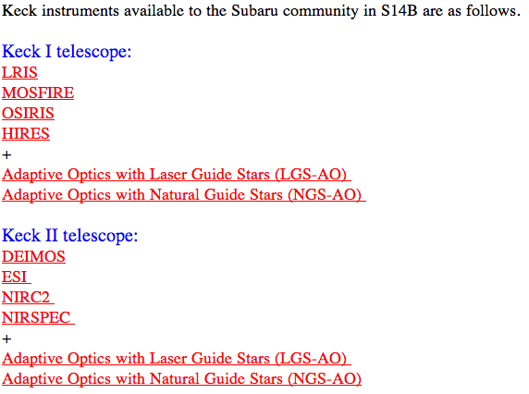
Time Exchange with Gemini/Keck
http://www.naoj.org/Observing/Proposals/Submit/Subaru_Gemini.html
http://www.naoj.org/Observing/Proposals/Submit/Subaru_Keck.html

Slide 6
Time Allocation

Slide 7
OPEN USE and DDT

Slide 8
From CfP to Observation

Slide 9
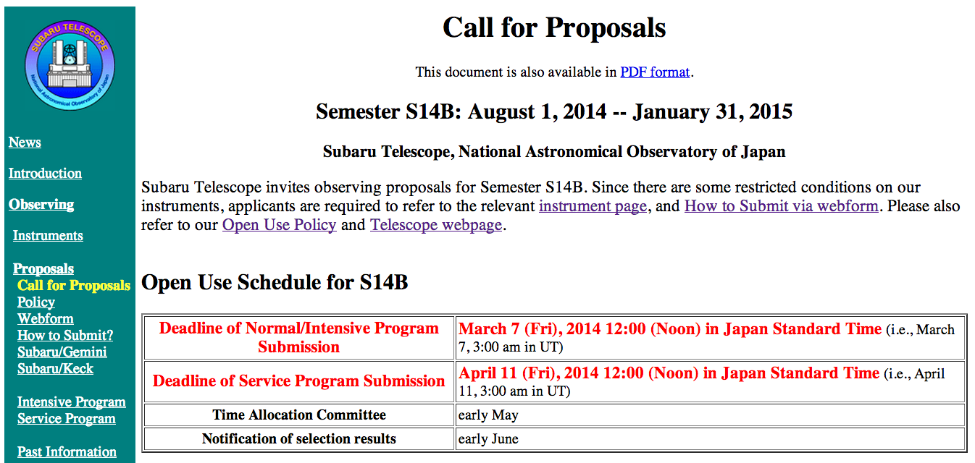
http://www.naoj.org/Observing/Proposals/Submit/call.html

Slide 10
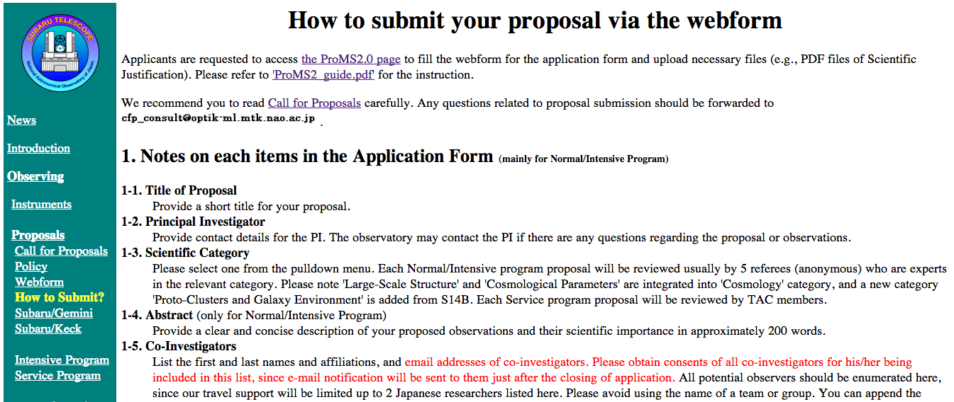
http://www.naoj.org/Observing/Proposals/Submit/howto.html

Slide 11
Call for Proposals (OPEN-USE)
http://www.naoj.org/Observing/Proposals/Submit/call.html

Slide 12
Normal Program

Slide 13
Service Program

Slide 14
Intensive Program

Slide 15
Subaru Strategic Program (SSP)

Slide 16
Proposal Evaluation

Slide 17
Proposal Evaluation
Oversubscription Rate = 0.35 ~ 7.5

Slide 18
Proposal Evaluation
Accept
1 month
+ 2 months
+ 2 days

Slide 19
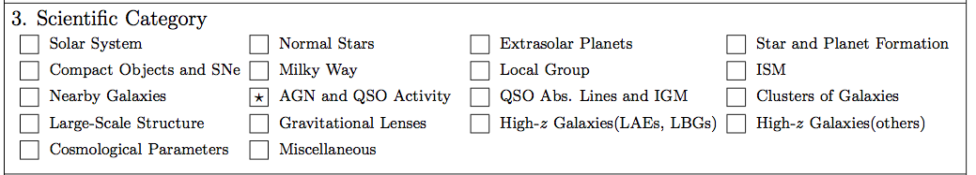
Subaru Scientific Category
18 Categories

Slide 21
Scheduling of Accepted Proposal

Slide 22
Many Rules and Restrictions….

Slide 23
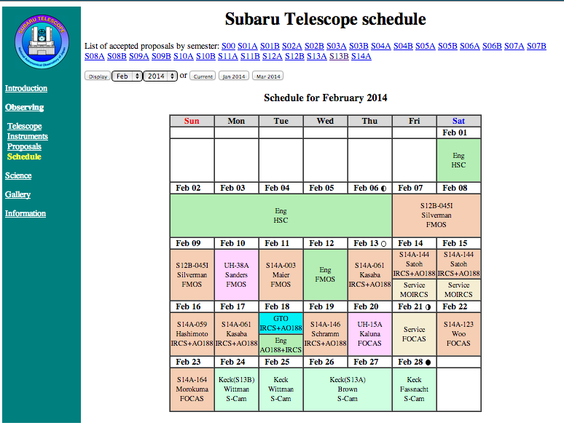
Schedule Table
http://www.naoj.org/cgi-bin/opecenter/schedule.cgi

Slide 24
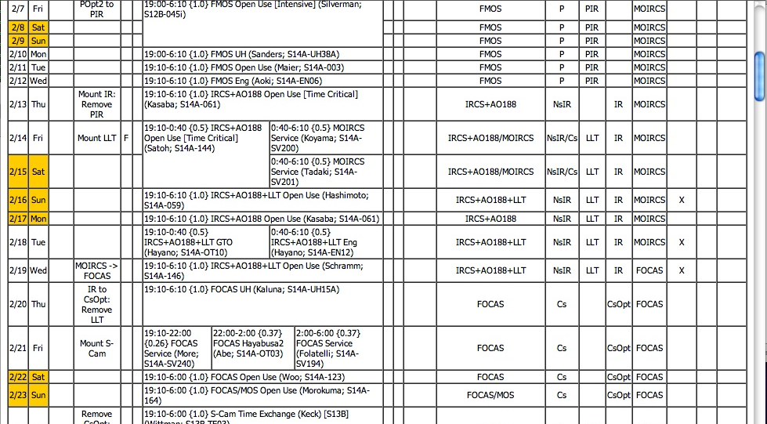
Schedule Management (Internal)

Slide 25
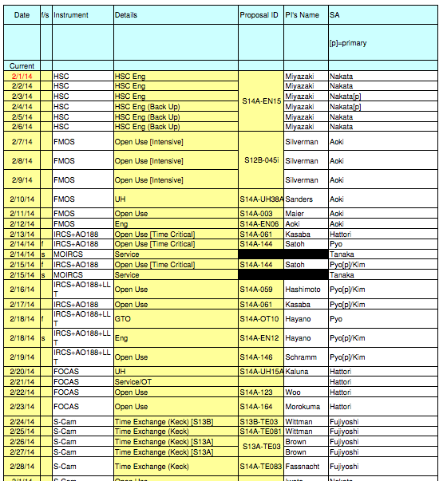
SAs Assignment
http://www.naoj.org/Observing/Proposals/Visit/SA_assignmentS14A.pdf

Slide 26
Execution of Program

Slide 27
Program Execution
Classical Observation

Slide 28
Subaru Operation Statics

Slide 30
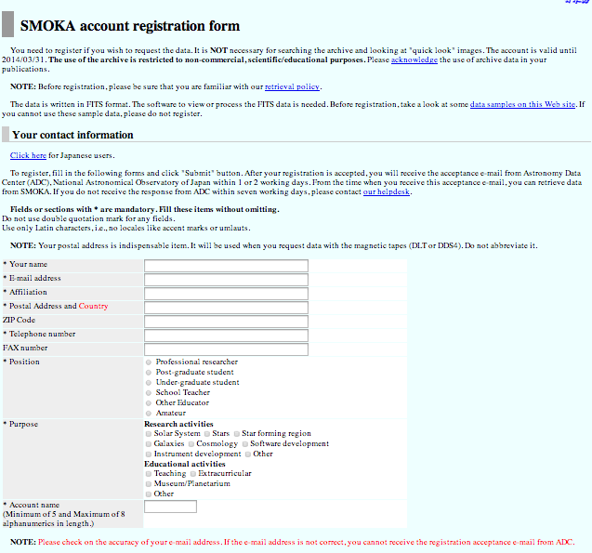
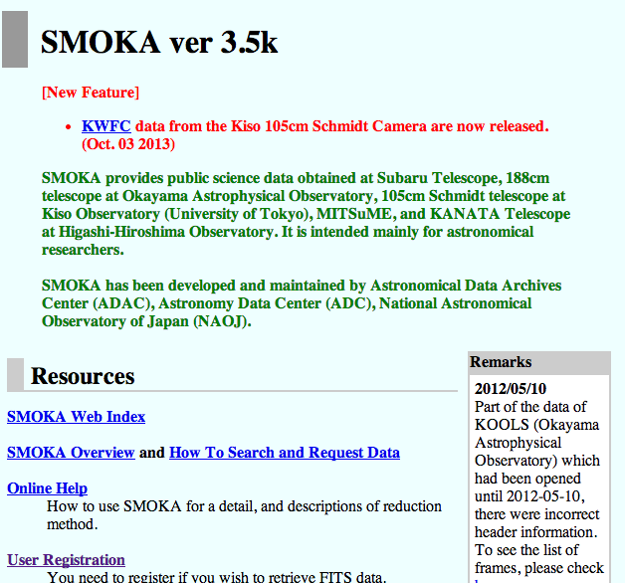
Archive: SMOKA
http://smoka.nao.ac.jp/
http://smoka.nao.ac.jp/register.jsp
Registration

