Slide 1
Subaru/Gemini MIR Observations of
Warm Debris Disks
Hideaki Fujiwara (Subaru Telescope)
Collaborators: T. Onaka (U. Tokyo), D. Ishihara (Nagoya U.), T. Yamashita (NAOJ), M. Fukagawa (Osaka U.) H. Kataza, H, Murakami (ISAS/JAXA) and AKARI/VEGAD team

Slide 2
Outline
Introduction: Debris Disks
AKARI/IRC 18 μm Survey of Warm Debris Disks
Subaru/Gemini Follow-up Observations
Summary and Future Prospects

Slide 3
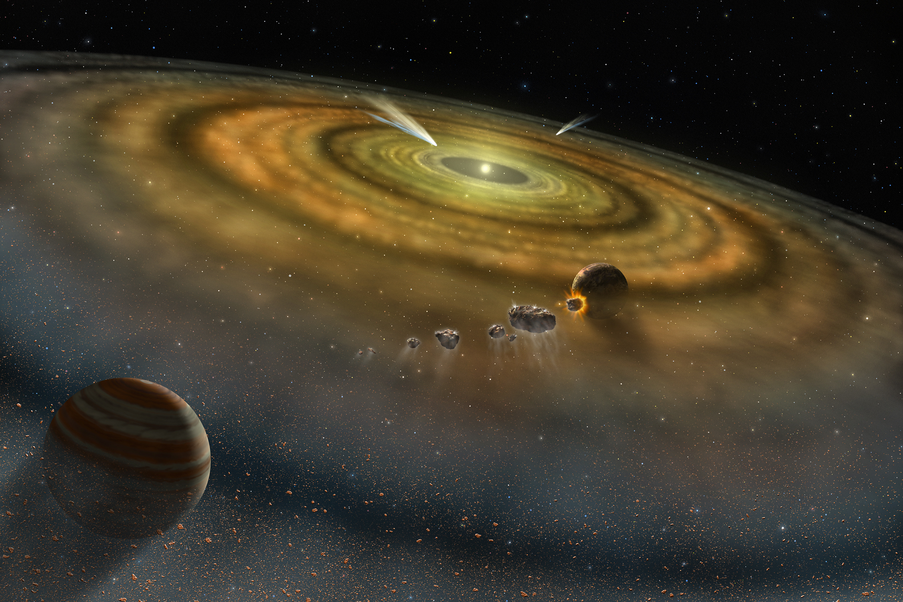
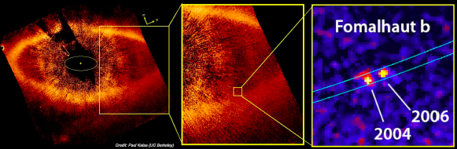
Debris Disk = Extrasolar Zodiacal Light
Debris Disk
  Dust Disks around MS stars
  More than 100 samples
Infrared Excess
  Thermal emission from circumstellar heated by central star
  Infrared excess over photospheric emission
  1st sample – Vega with IR Excess at λ > 25μm by IRAS (Aumann+ 84)
  Possible connection with planets
Spectral Energy Distribution
Flux
IR Emission from Dust
Stellar Emission
1 100 λ(μm)
Planet in Debris Disk System Fomalhaut (Kalas+ 2008)

Slide 4
Warm Debris Disks
Main stream after IRAS
  Far-infrared observations that can trace low-temperature dust (~100K)
  Outer region of debris disk (~100AU)
  Kuiper-belt analog
More interesting thing (for me) is …
  Situation in planet forming region
  Traced by “Warm Debris Disk” at ~1-10AU from star (Asteroid analog)
  MIR excess emission from warm dust
AKARI, Spitzer
  MIR observations with high sensitivity
  Studies of warm debris disks have begun in earnest
~10AU
~100AU
Planet Forming Region
Outer Cool Region
AKARI, Spitzer
MIR obs.
IRAS
FIR obs.

Slide 5
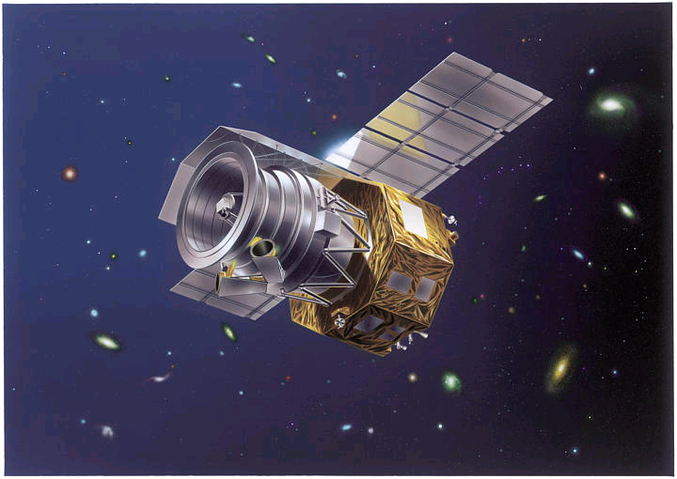
AKARI MIR All-Sky Survey
AKARI：a Japanese IR satellite (surveyor)
  IRC: Near~Mid-IR & FIS: Far-IR
  All-sky survey with higher sensitivity and spatial resolution than IRAS
  MIR IRC survey (9&18μm) is useful for warm debris disk search
  Warm debris disk survey by comparing AKARI, 2MASS and Tycho-2 Spc catalog
Band | S9W | L18W
Wavelength | 6-12 micron | 14-26 micron
Sensitivity | 50 mJy | 120 mJy
Resolution | 9.4”
BG：AKARI IRC MIR All-Sky Survey
(Ishihara+ 2010, submitted to A&A)

Slide 6
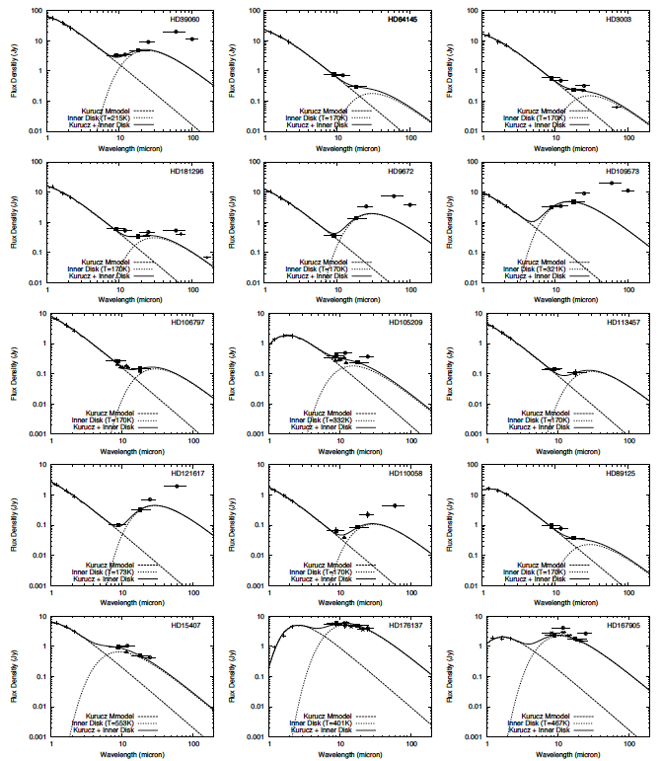
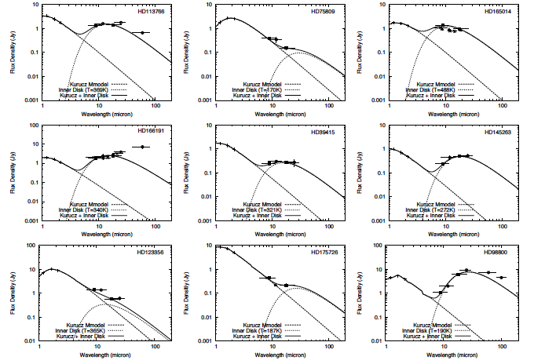
AKARI-identified Debris
Red: AKARI-discovered
Yellow: 1st confirmation after IRAS (Oudmaijer+ 92)

Slide 7
Follow-up Observations
Observations from space
  Limited spatial resolution of observation from space
  Suspicious of of contamination/mis-identification
Ground-based follow-up observations
  Higher spatial resolution
  Confirmation of excess emission
High spectral resolution/multiple bands
  Hints for properties (dust temperature and species)
Availability of MIR capability in both of Northern and Southern Hemisphere
  AKARI candidates distribute in all sky
  Subaru/COMICS + Gemini-S/T-ReCS

Slide 8
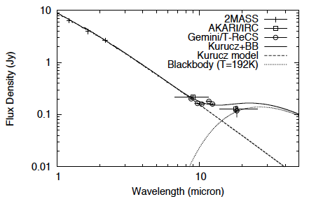
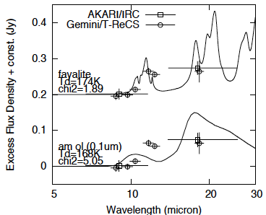
HD106797 by Gemini/T-ReCS
A-type dwarf star
  18μm excess by AKARI
Gemini/T-ReCS
  Si2-6 and Qa
  Excess at λ>11μm
  Dust T~200K
Feature Shape
  Crystalline silciate?
  Not sub-μm amorphous (ISM-like) silicate

Slide 9
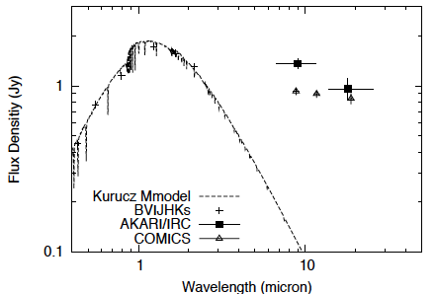
HD165014 by Subaru/COMICS
A-type dwarf star
  9&18μm excess by AKARI
Subaru/COMICS
  8.8, 11.7, 18.8μm
  Large Excess at λ>8μm
  Dust T>200K (500K?)
  L_{dust}/L_{star} ~ 5x10⁻³
    Comparable to b Pic
Dust Feature by Spitzer
  Crystalline silicate

Slide 10
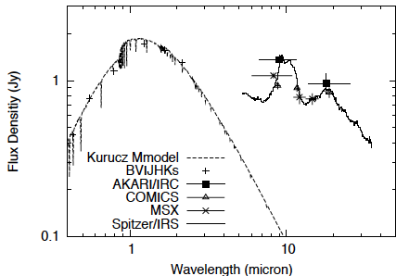
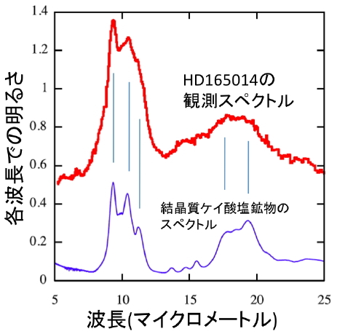
HD165014 by Subaru/COMICS
A-type dwarf star
  9&18μm excess by AKARI
Subaru/COMICS
  8.8, 11.7, 18.8μm
  Large Excess at λ>8μm
  Dust T>200K (500K?)
  L_{dust}/L_{star} ~ 5x10⁻³
    Comparable to β Pic
Dust Feature by Spitzer
  Crystalline silicate
Excess Spectrum of HD165014
Excess Spectrum (Jy)
Crystalline Silicate
(Enstatite)
Wavelength (micron)

Slide 11
Summary
AKARI identified 24 warm debris disk candidates
6 candidates confirmed by Subaru/Gemini follow-up observations so far
Crystalline silicate towards 2 candidates
  Dust evolution during planetesimal formation?

Slide 12
Future Prospects
MIR follow-up observations of18 candidates
MIR spectroscopy for dust property examination
Coronagraph observations for direct detection of disks (HiCIAO/NICI)
Availability of MIR capability in N/S hemisphere
  important for follow-up observations of sources discovered by all-sky survey (AKARI/WISE/Planck)

