Slide 1
Status of Existing Instruments
Subaru Users’ Meeting 2010
Hiroshi TERADA
(Science Operation Division)

Slide 2
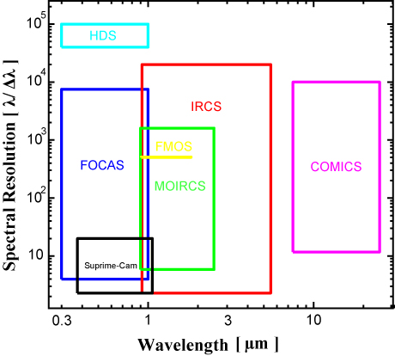
Highlight (2010-2011)
Instruments Lineup
2010 May
  FMOS joined in the lineup
  IRS1 low-resolution only
  IRS2 will come in S11A.
PF
FMOS
S-Cam
2011 May
  LGS AO188 will start open use.
  Evaluation on-going
NsIR
NsOpt
AO188
IRCS
HiCIAO
HDS
MOIRCS
COMICS
FOCAS
Cs
Subaru 2010UM
Hiroshi TERADA @ Subaru Telescope

Slide 3
Highlight (Downtime)
To keep functional,
(%)
Instrument Downtime
In 2009 UM
■ Instrument trouble time
Less
trouble!!
Operating Efficiency
Still functioning well
Semester
Subaru 2010UM
Hiroshi TERADA @ Subaru Telescope

Slide 4
Executive Summary
To keep operational and competitive,
MOIRCS
  Channel-1 trouble and recovery, and New NBF and ND
FOCAS
  FDCCD upgrade
HDS
  Image-slicer => Tajitsu-san’s Poster
Suprime-Cam
  1-Channel signal anomaly, on-site DA system, and New NBFs Grisms
AO188+IRCS
  DM failure and recovery, and NGS resumed.
  LGS development (=> Hayano-san’s Talk) and Open in S11A.
FMOS
  IRS1(LR) open use and HR, IRS2 development => Tamura-san’s talk
Gen2
  Most of the operations (except for S-Cam) are conducted using Gen2.
Subaru 2010UM
Hiroshi TERADA @ Subaru Telescope

Slide 5
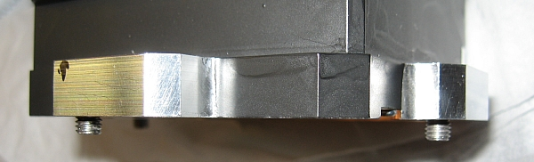
MOIRCS (Channel-1 turret-rotation trouble)
Recognized on Sep. 28, 2010 (before the first S10B obs.).
Channel-2 side only Operation during the whole S10B.
  2 N (Keck[te]), 2 N (Gemini[te]), 1 N (UH), 4 N (Subaru OpenUse[ip])
    [te]: Time Exchange Program, [ip]: Intensive Program
One month troubleshooting went fairly well.
  Fixed within Dec., 2010, and will be verified in Jan., 2011.
Cause – stack of bad screws used in one holder for new grism.
Good guy.
BAD guy (longer by just 1mm…).
Subaru 2010UM
Hiroshi TERADA @ Subaru Telescope

Slide 6
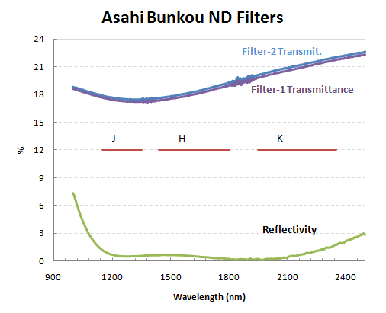
MOIRCS (New Filters)
Br γ (cw/bw = 2.163/0.025 μm) now available.
ND filter become available.
  Main purpose is to provide good-quality Ks-band Dome flats
  (but can be used to scientific data acquisition).
Subaru 2010UM
Hiroshi TERADA @ Subaru Telescope

Slide 7
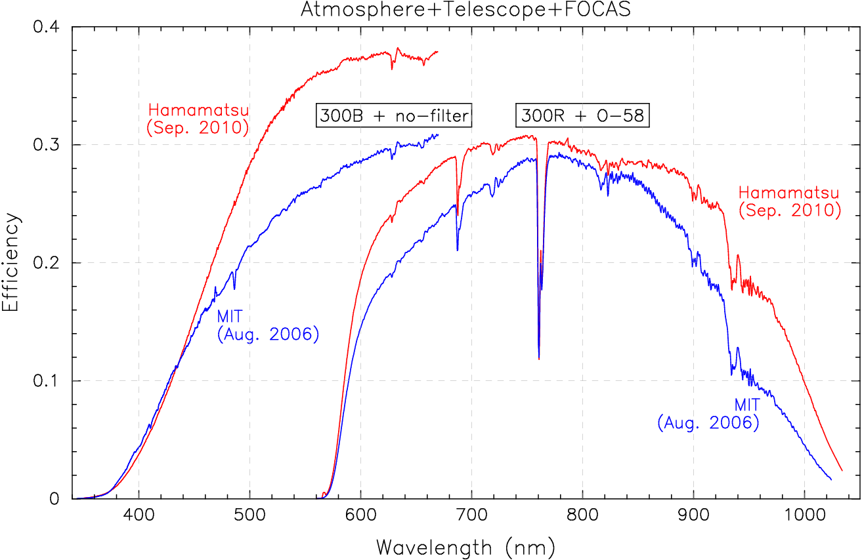
FOCAS (CCD Upgrade)
Engineering Obs: June 2010
Open use : from Oct. 2010
Improvements on
  higher efficiency,
  less fringing,
  faster readout,
  better cosmetics
    (only 1 dead column in 2 CCDs)
However, please note..
  extensive cosmicrays
  wider CCD gap (50→70pixel)
Total Efficiency (compared to the MIT CCD)
~0.9@400nm, ~1.3@500nm, ~2@1000nm
Subaru 2010UM
Hiroshi TERADA @ Subaru Telescope

Slide 8
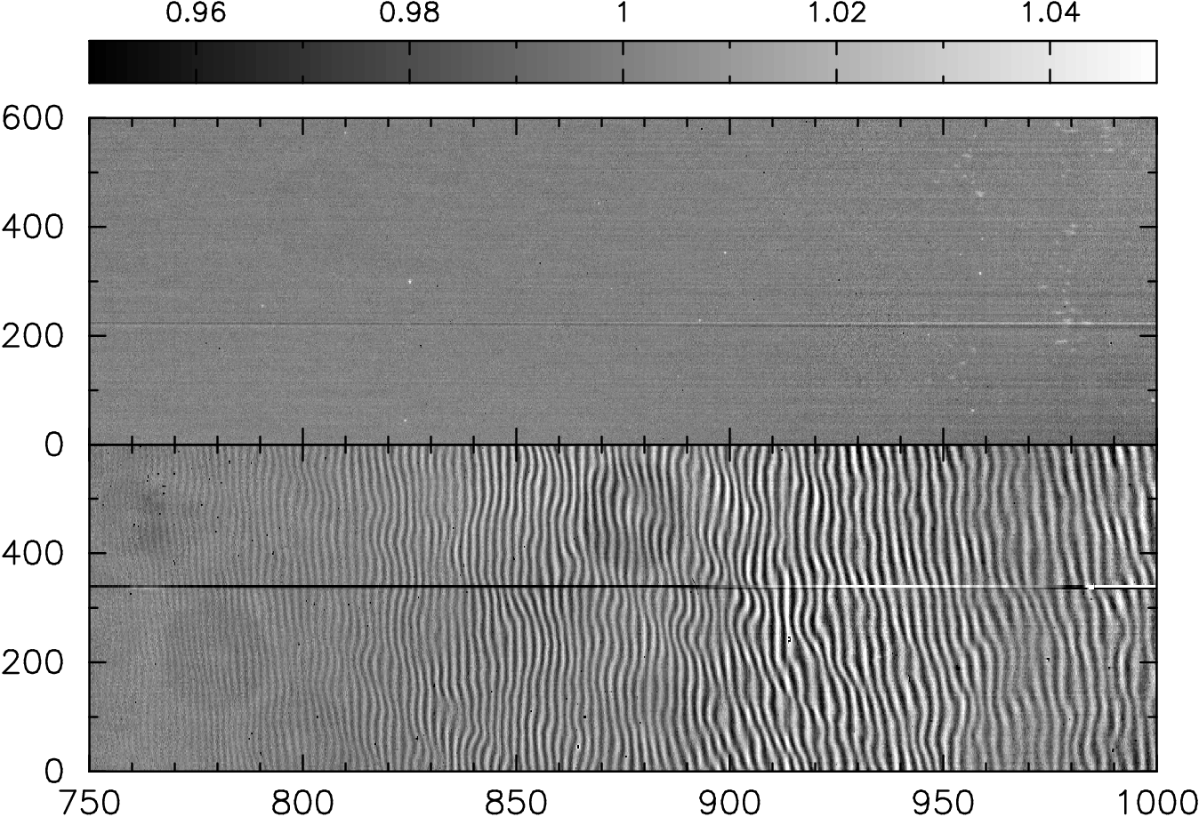
FOCAS (CCD Upgrade)
Less fringing
domeflat with 0".8+300R+O58
Hamamatsu
MIT
Wavelength (nm)
Subaru 2010UM
Hiroshi TERADA @ Subaru Telescope

Slide 9
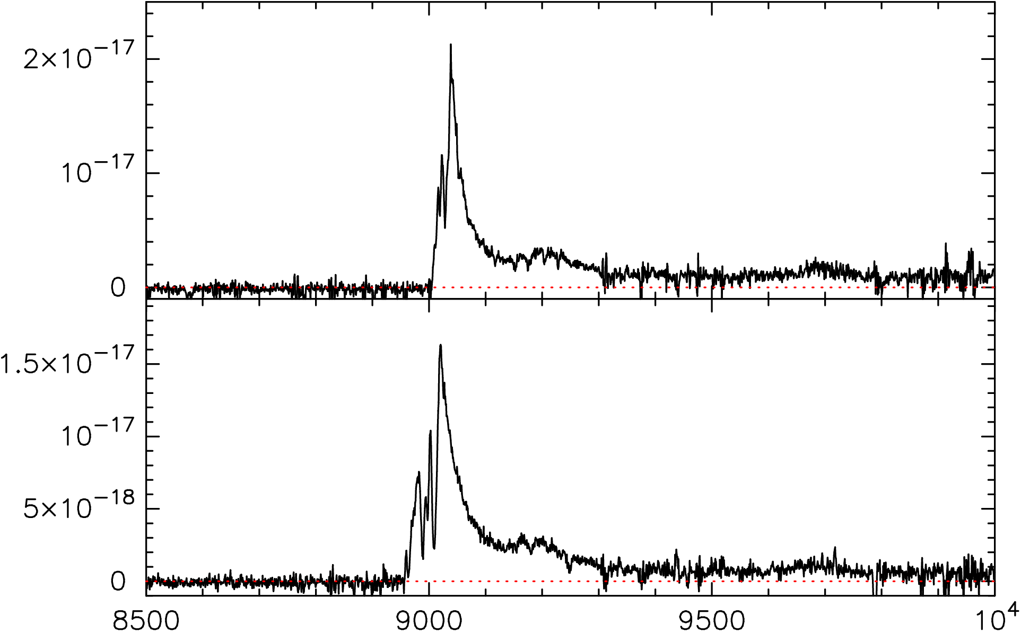
FOCAS (CCD Upgrade)
Performance Demonstration (high-z QSOs)
VPH900 (7500-10500Å, R~2000, ~2hours)
Lyα
CFHQS J0210-0456 (z=6.44)
NV
OI/SiII
Flux (erg s⁻¹ cm⁻² Å⁻¹)
CFHQS J2329-0301 (z=6.42)
Wavelength (Å)
Subaru 2010UM
Hiroshi TERADA @ Subaru Telescope

Slide 10
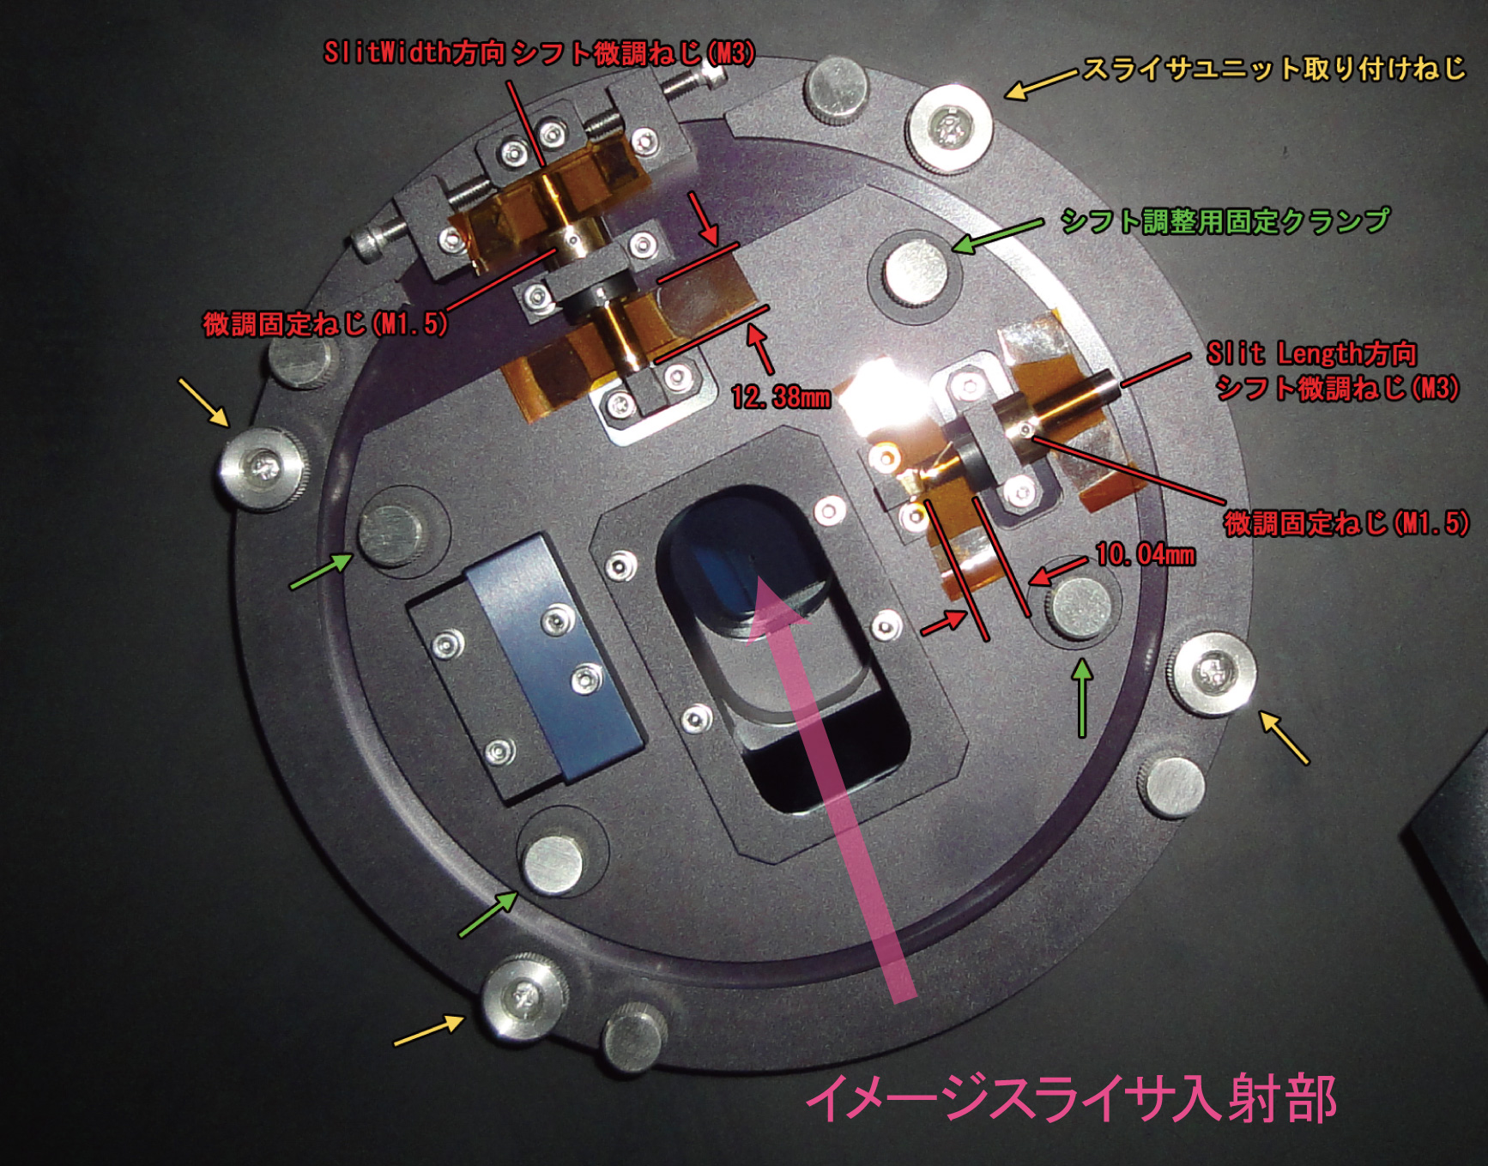
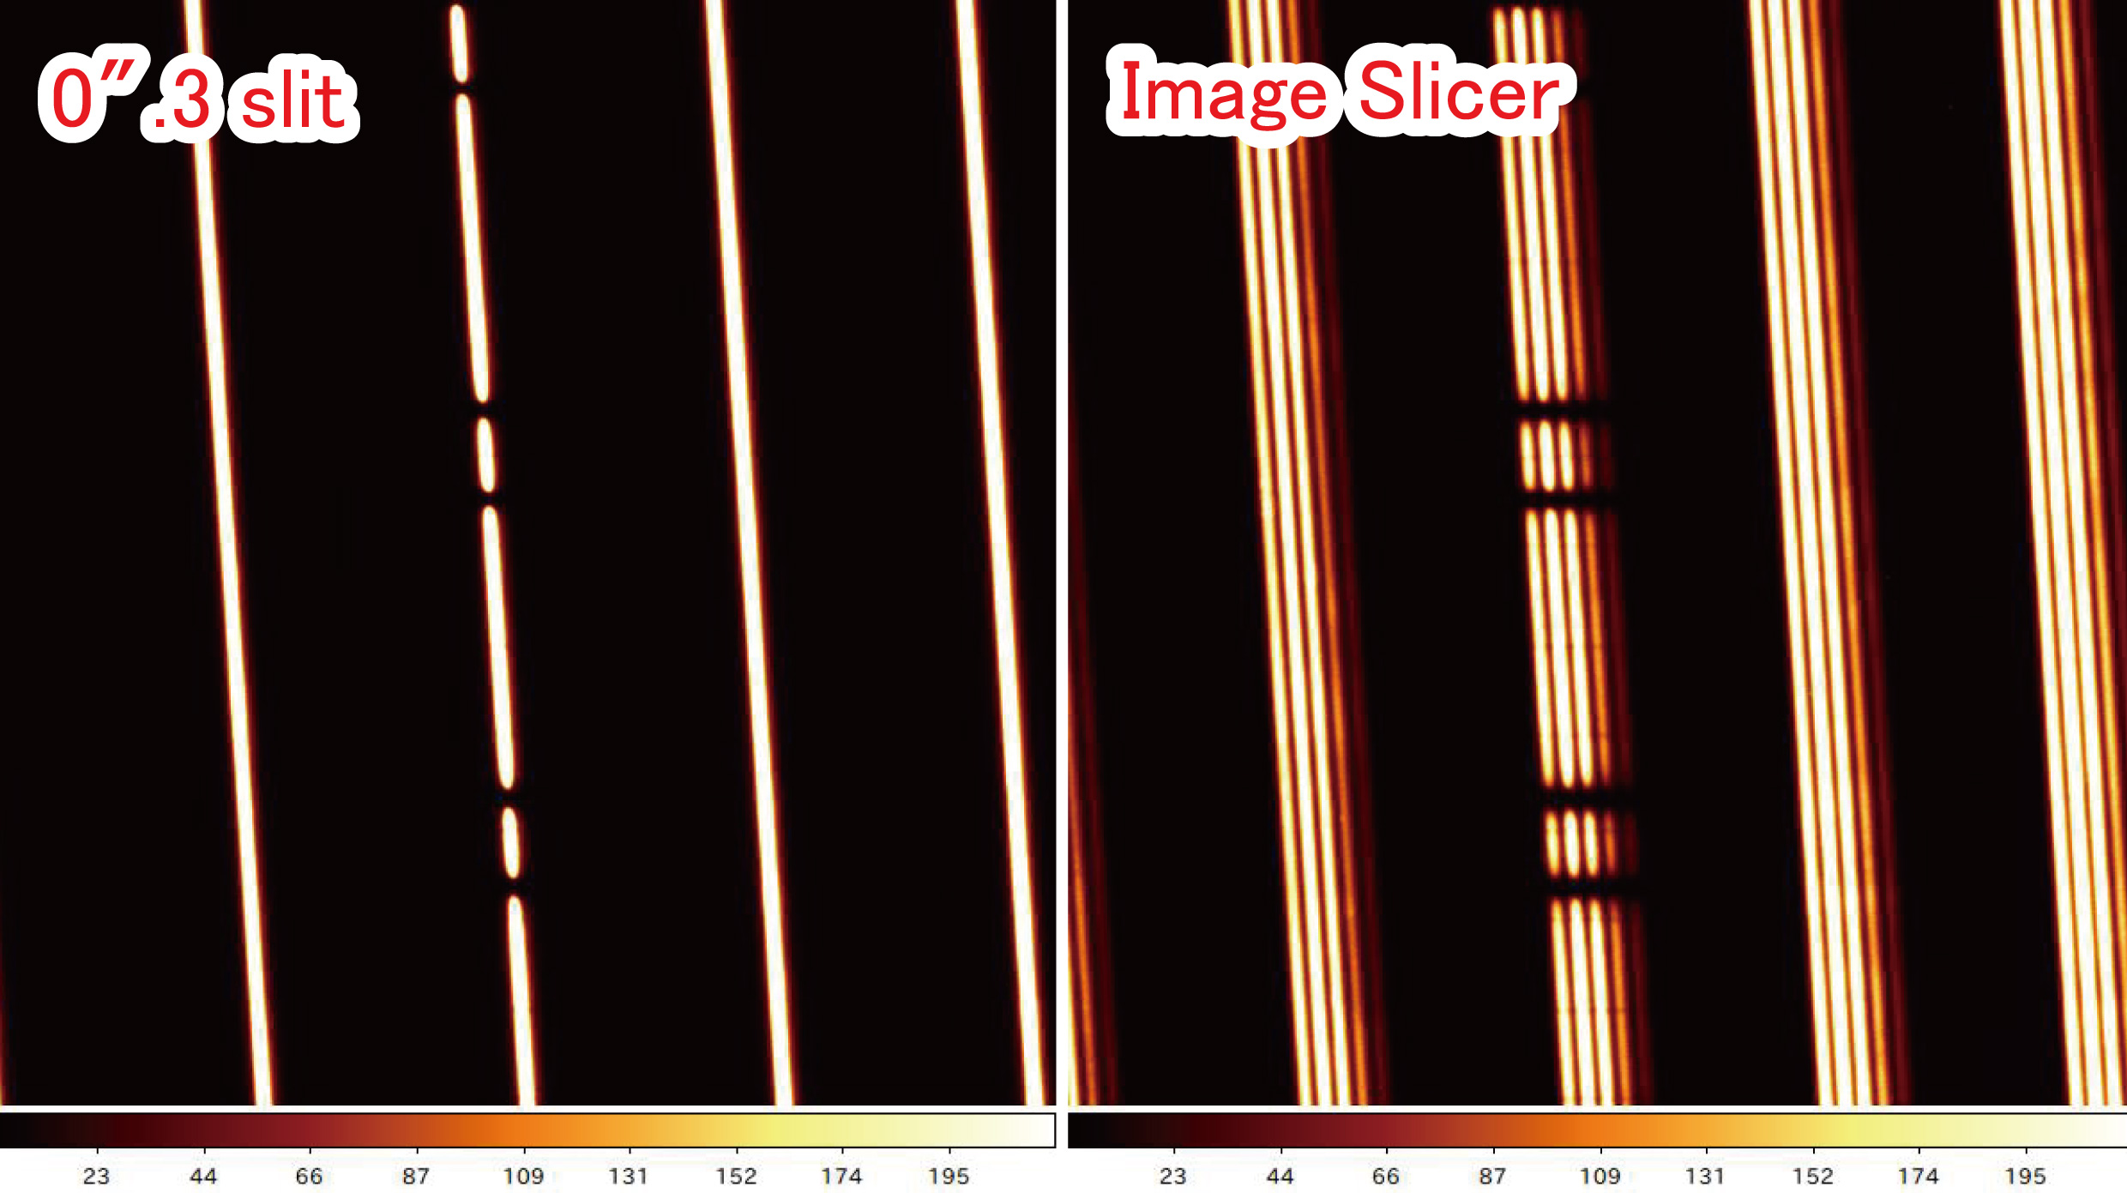
HDS (Image-Slicer upgrade)
Engineering Obs:
  Jun. and Dec., 2010
1.8 times higher efficiency confirmed!
  (under 0”.68 seeing)
Slicing Φ1”.5 image into
  0”.3 x 5 spectra
R=110,000
  (slit width of 0”.3)
=> Please see Tajitsu-san’s poster for details.
Subaru 2010UM
Hiroshi TERADA @ Subaru Telescope

Slide 11


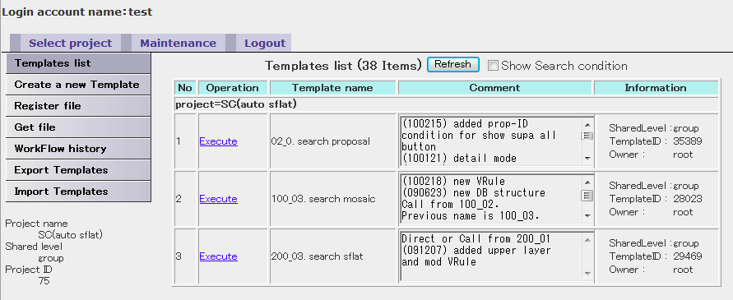
Suprime-Cam
DET-ID:9
g’-band domeflat
Signal at 1-channel of 1 CCD (DET-ID:9)
  Found on Sep. 17, 2010
  After adjusting offset voltage,
    operation has been okay (since Oct., 2010)
  Please note that gain was changed
    on the channel.
On-site data analysis system available
  Operation since Mar., 2010
    Data assurance can be done on site
    (Seeing, sky level,… etc.)
Analysis pipeline (SDFRED2) released
  For the data obtained after 2008/07.
  (http://www.naoj.org/Observing/Instruments/SCam/sdfred/)
Jun.,2010
Oct.,2010
Screenshot of On-site data analysis
Subaru 2010UM
Hiroshi TERADA @ Subaru Telescope

Slide 12
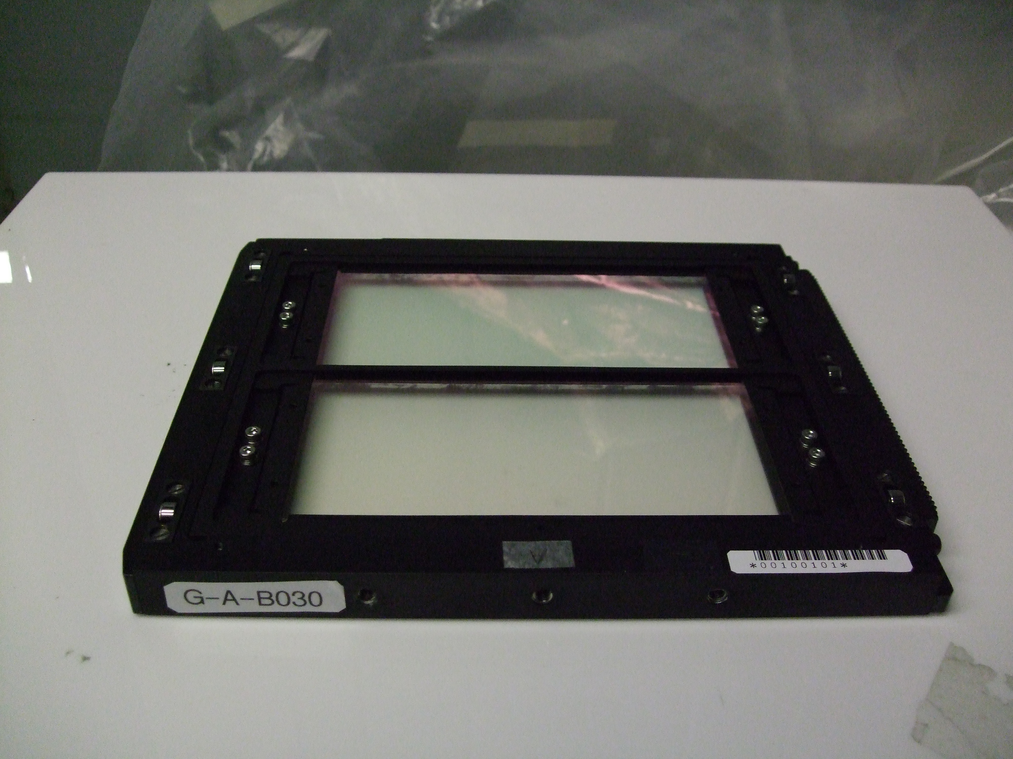
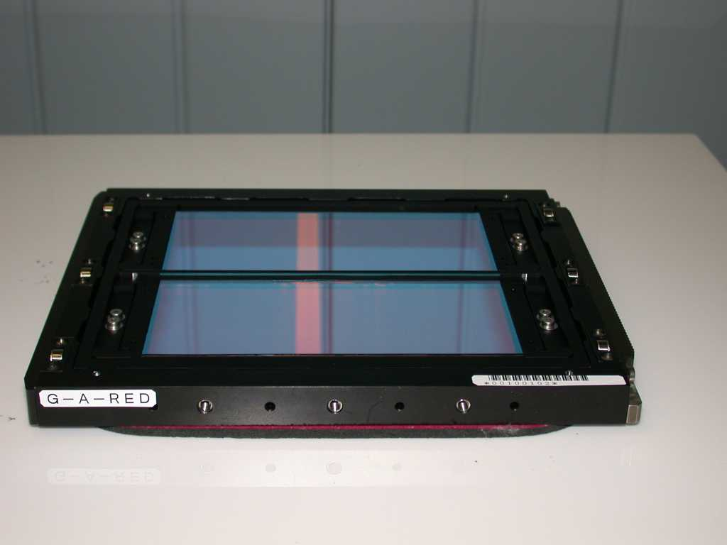
Suprime-Cam (New Filters and Grisms)
Narrow band filter Open
  N-A-L656 (Hα): S10B~
  W-A-Y (Y-band): S11A~
Grisms will be Open
  Planning in 2011
N-A-L656
W-A-Y
GrismB
GrismR
Subaru 2010UM
Hiroshi TERADA @ Subaru Telescope
Notes:
1. N-A-L656 filter (Halpha filter) の公開 2009 年 8 月に試験観測データを取得済み。S10B から公開する予定。 有効波長 6568A, FWHM 約140A。
res_na656.pdf : NA656 filter の透過率
N6820NE2.png : 試験観測で撮られた散光星雲 NGC6820 北東部領域の画像 赤いところが Hαで明るいところ (B, R, NA656 の合成)
M27s0.png : 試験観測で撮られた亜鈴星雲 M27 の画像 赤いところが Hαで明るいところ (B, R, NA656 の合成) 合成画像は八木さんにより作成されたもの。
2. Suprime-Cam 観測支援用オンサイトデータ解析システム の本格運用 古澤さん及び天文データセンター研究員の大倉さんが中心に開発を進めている。
ハワイ側では SS の仲田が参加し、Suprime-Cam 観測の運用効率向上を 目指している。
このシステムにより、Suprime-Cam 観測データ取得後ただちに1次解析が行われ、 データの品質を評価するための基本的な情報 (Seeing, sky level など) が 得られる。

Slide 13
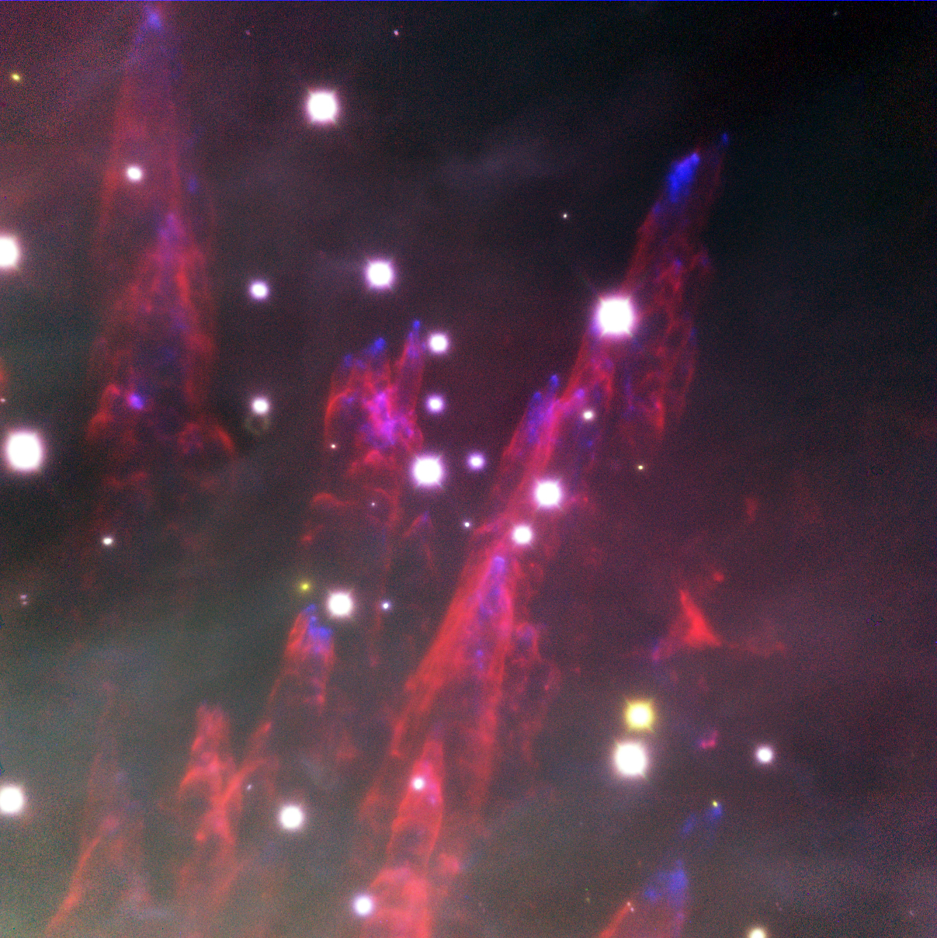
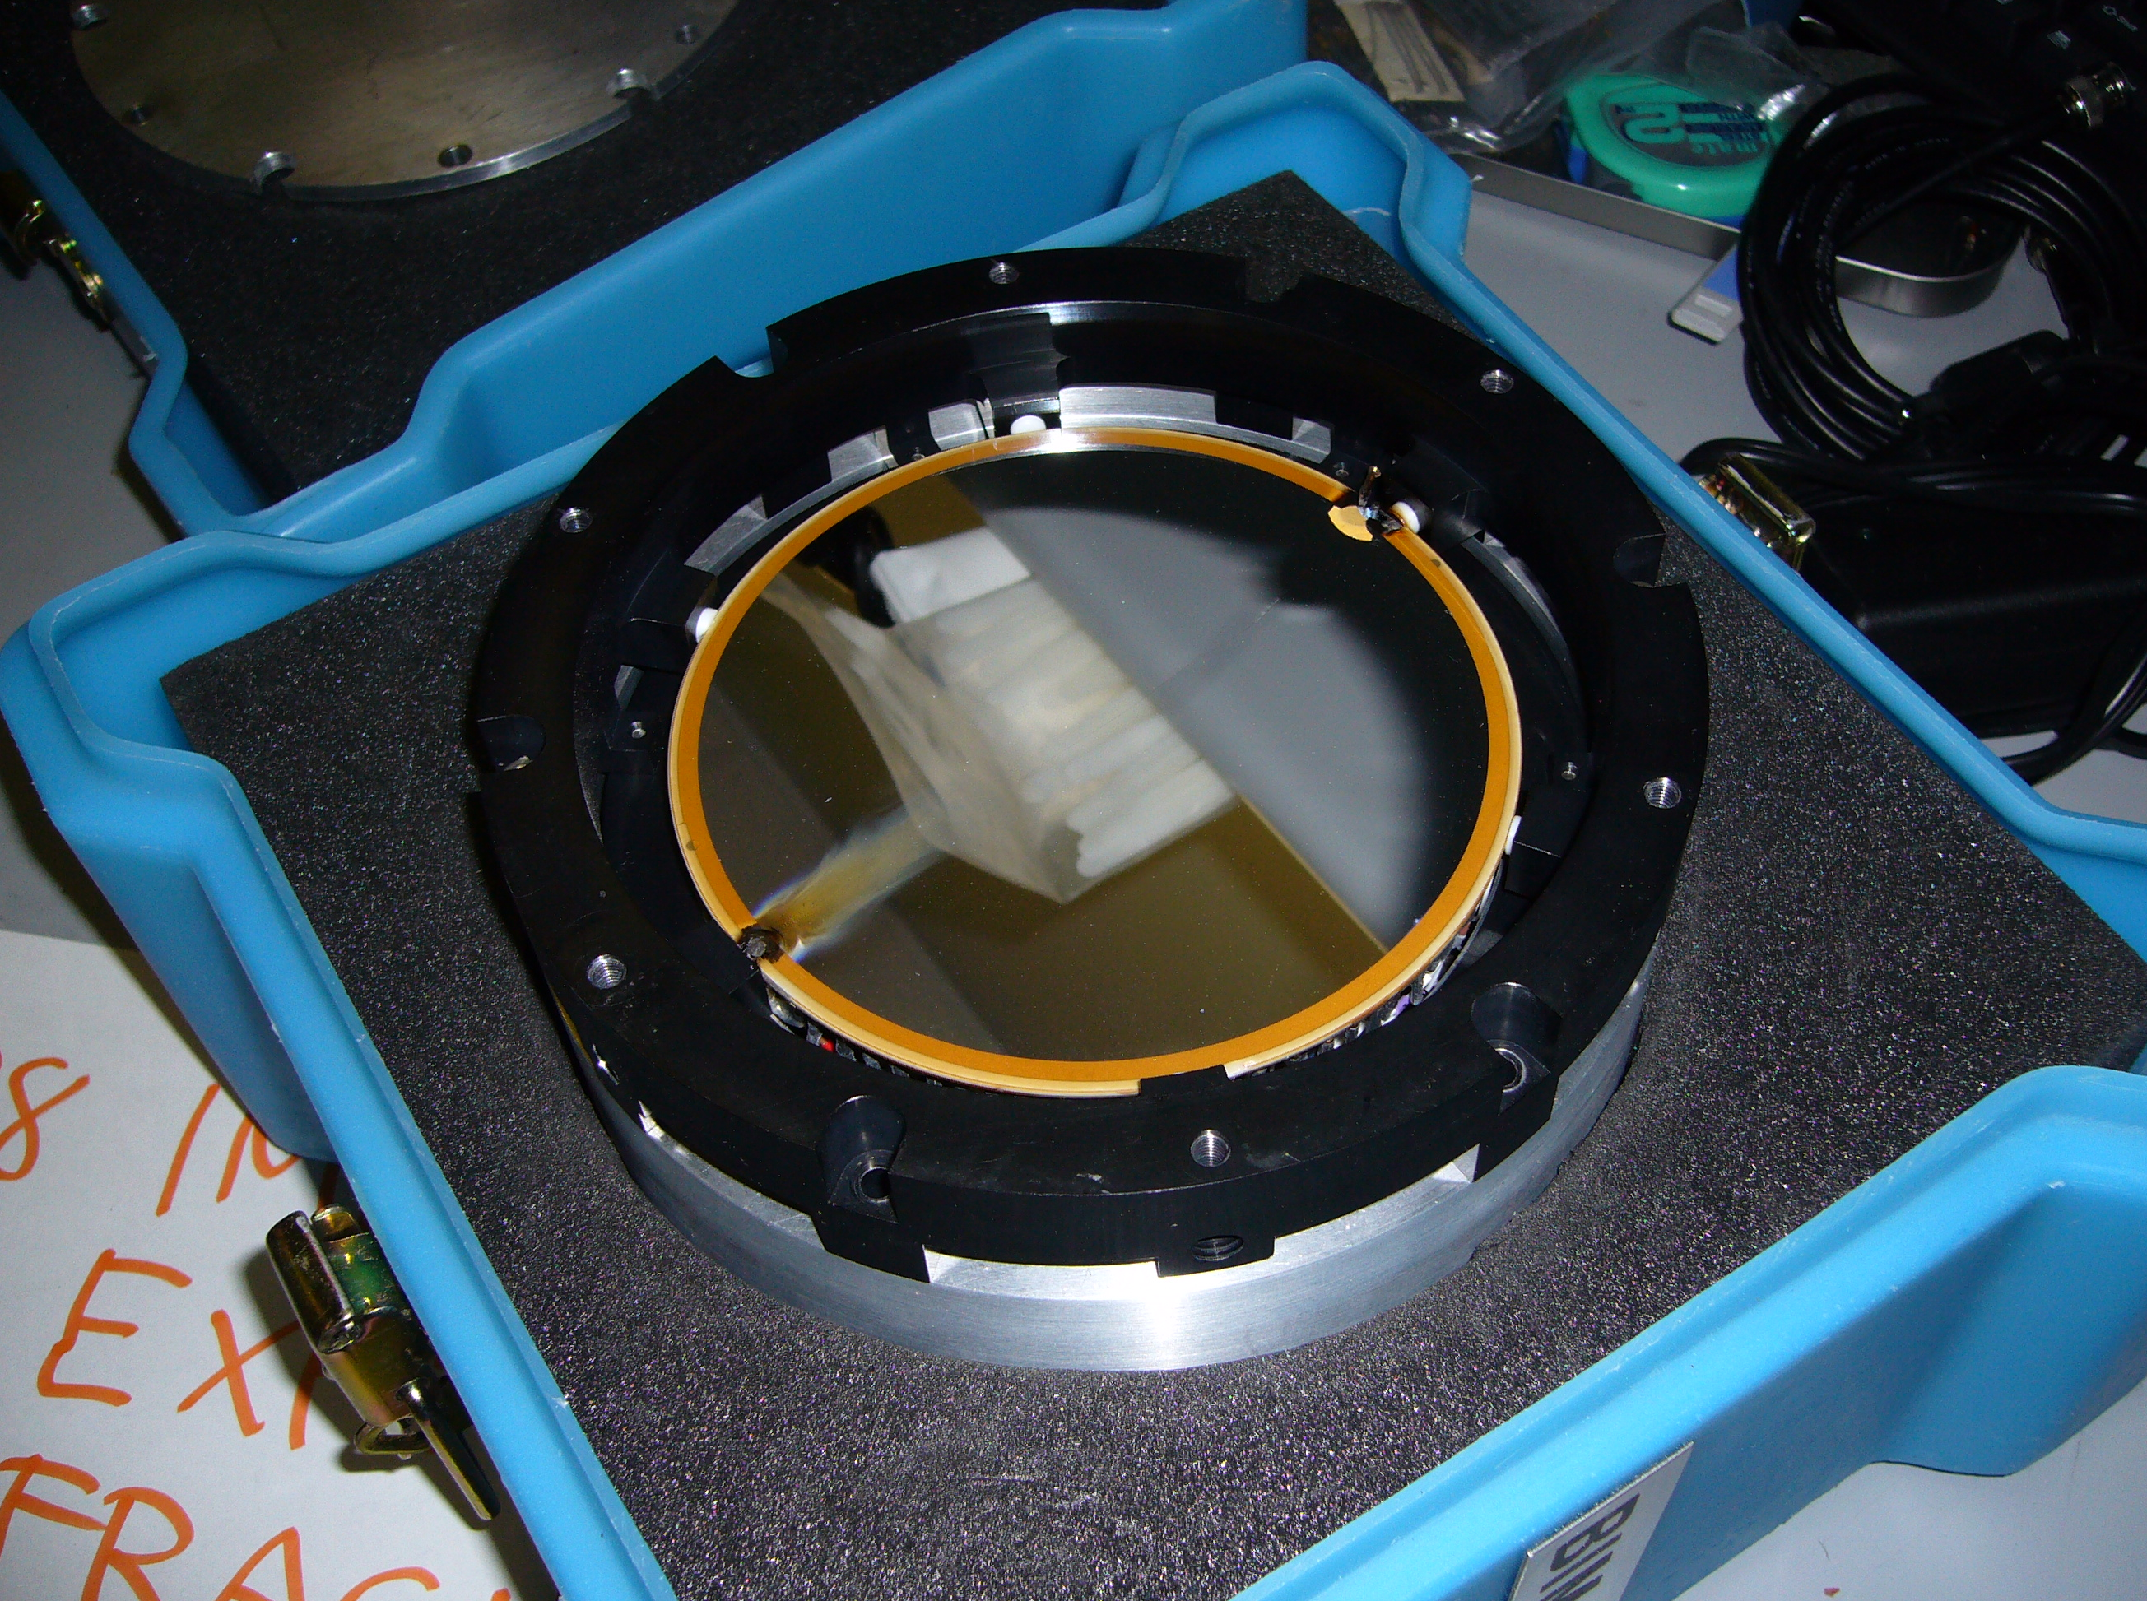
Failure and Recovery of DM
AO188+IRCS (NGS mode)
Recovered in late Oct., 2011
Occurred on Jan. 27, 2010
  (during LGS Engineering run)
IRCS 52mas Camera
13N Backup Programs selected by TAC
4N → IRCS (w/o AO188) Obs.
Red: H2(1-0) 2.122μm, Green: Brγ 2.167μm, Blue: [FeII] 1.644μm
50”x 63”
Subaru 2010UM
Hiroshi TERADA @ Subaru Telescope

Slide 14
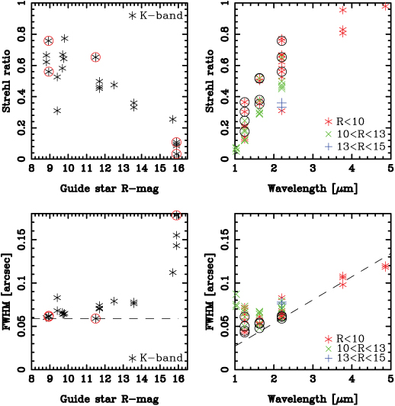
Performance w/ New DM
AO188+IRCS (NGS mode)
Confirmed that AO188 performance with new DM is almost same as before its failure.
Resumed OpenUse since Nov., 2010.
Points w/o circle: before DM failure
Points w/ circle: after DM replacement
Subaru 2010UM
Hiroshi TERADA @ Subaru Telescope

Slide 15
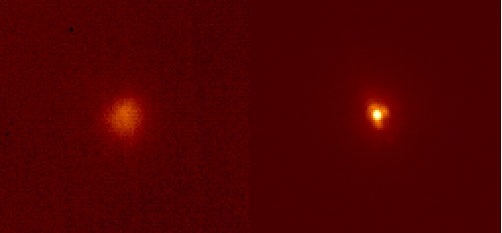
Successful Closed Loop using Laser Guide Star
AO188+IRCS (LGS mode)
Seeing (FWHM ~ 0”.3)
LGS mode w/R14mag TT GS (SR~0.2 FWHM ~ 0”.08)
IRCS 20mas Camera
Obtained diffraction-limited PSF w/ LGS
Will start OpenUse from May 2011.
  Testing is underway..
=> Please tune in Hayano-san’s talk
Subaru 2010UM
Hiroshi TERADA @ Subaru Telescope

Slide 16
Operations of Existing Instruments
First generation instrument: (>10yrs old)
  Some parts: ~15 yrs old…
Still succeeding in keeping in good shape
  Thanks to dedicated works by support staff
  Once serious trouble occurs, huge resources are required.
Serious investigation required for the “future” of “Existing instruments” upon ‘Users’’ demands.
  Especially in consideration of the future instrumentation in Subaru.
We appreciate your kind cooperation about
  Pre-imaging (30min; FOCAS and 1hour; MOIRCS), and
  Clear information on MOIRCS MOS masks and S-Cam filters
  We look forward to your continued support for these.
Subaru 2010UM
Hiroshi TERADA @ Subaru Telescope

Slide 18
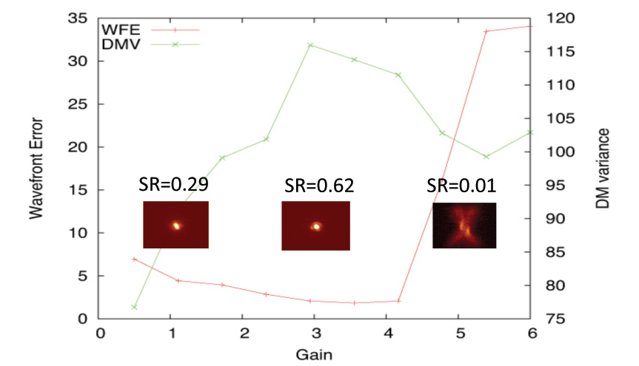
(Complex) Operation Progress
AO188+IRCS (NGS mode)
Most of NGS commands can be executed from OCS side
Efficient parameter tuning realized
ADI, Non-sidereal, Parallactic angle spec. ready.
NGS parameter tuning (gain scanning)
=> LGS operation could be even more complicated…
Subaru 2010UM
Hiroshi TERADA @ Subaru Telescope

Slide 19
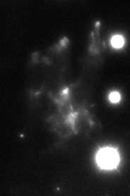
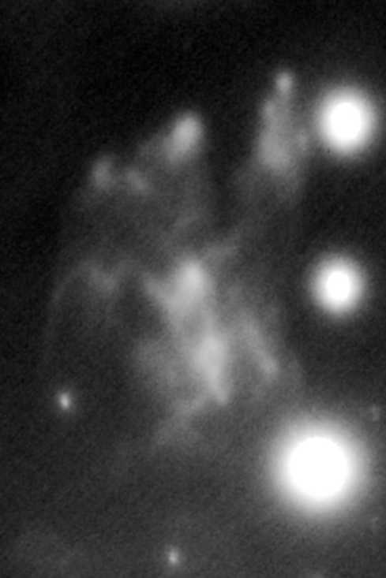
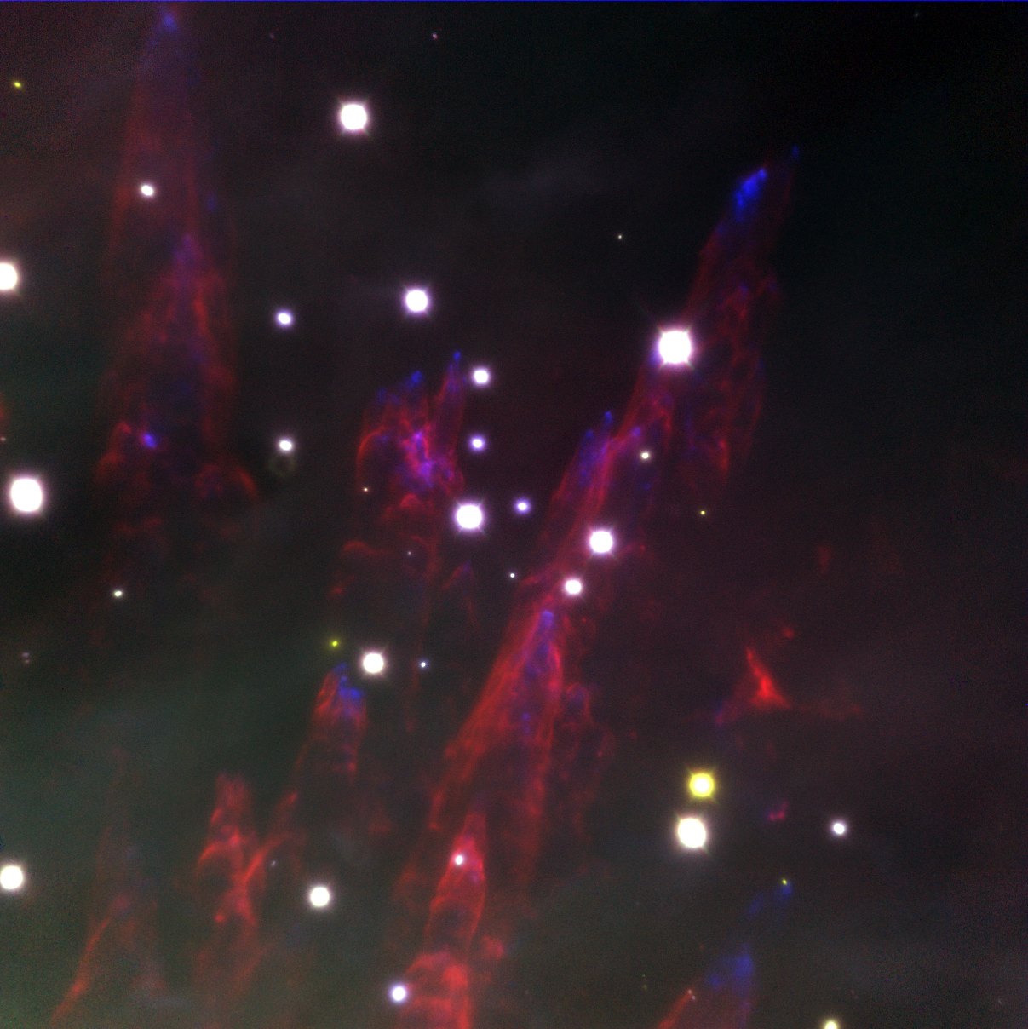
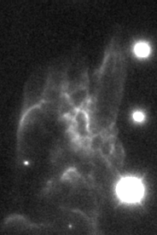
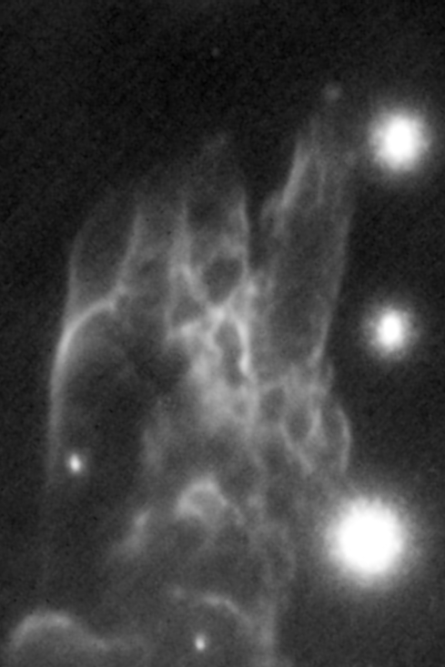
AO188+IRCS (DM resume)
Gemini
LGS Altair+NIRI
[FeII]
[FeII]
9”.6x 14”.5
H₂(1-0)
H₂(1-0)
IRCS 52mas Camera
Red: H2(1-0) 2.122μm, Green: Brγ 2.167μm, Blue: [FeII] 1.644μm
63”x 63”
Subaru 2010UM
Hiroshi TERADA @ Subaru Telescope

