Slide 2
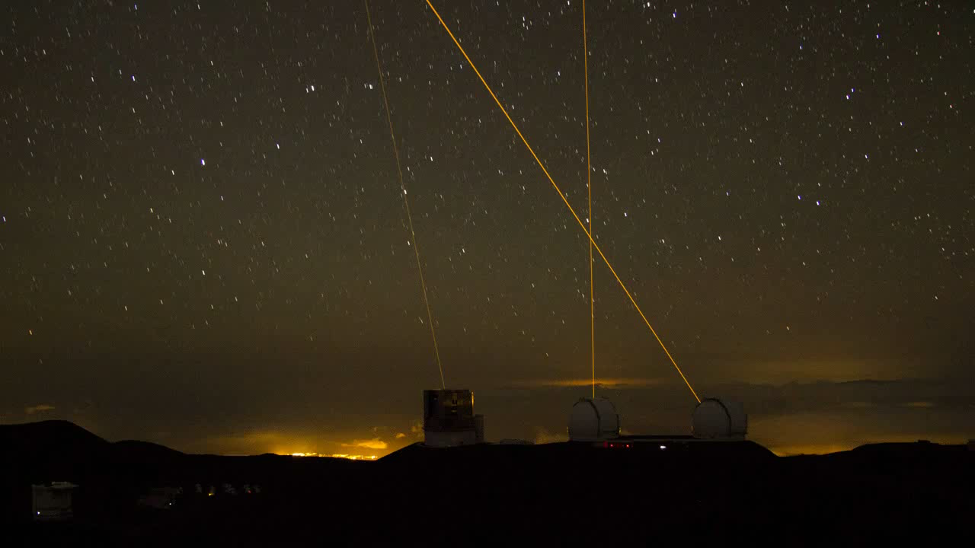
Gemini Observatory AO Program Update
A Decade of AO Evolution at Gemini
Recent AO Program Highlights
Gemini’s Future
AO Program
Doug Simons
Gemini Observatory

Slide 3
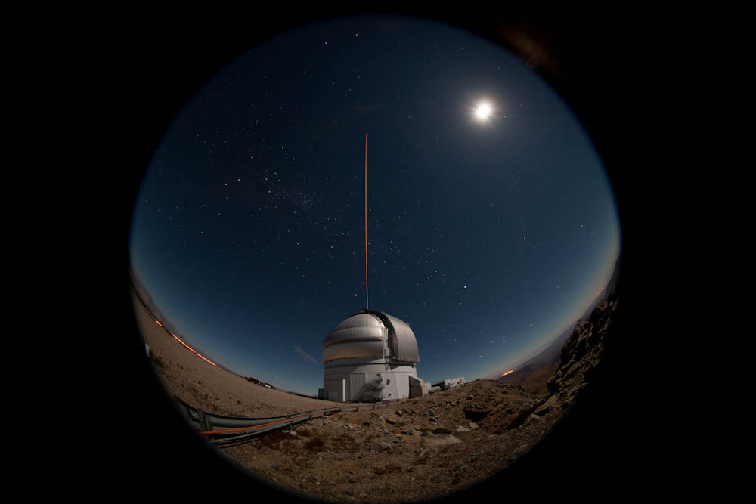
Recent AO Program Highlights

Slide 4
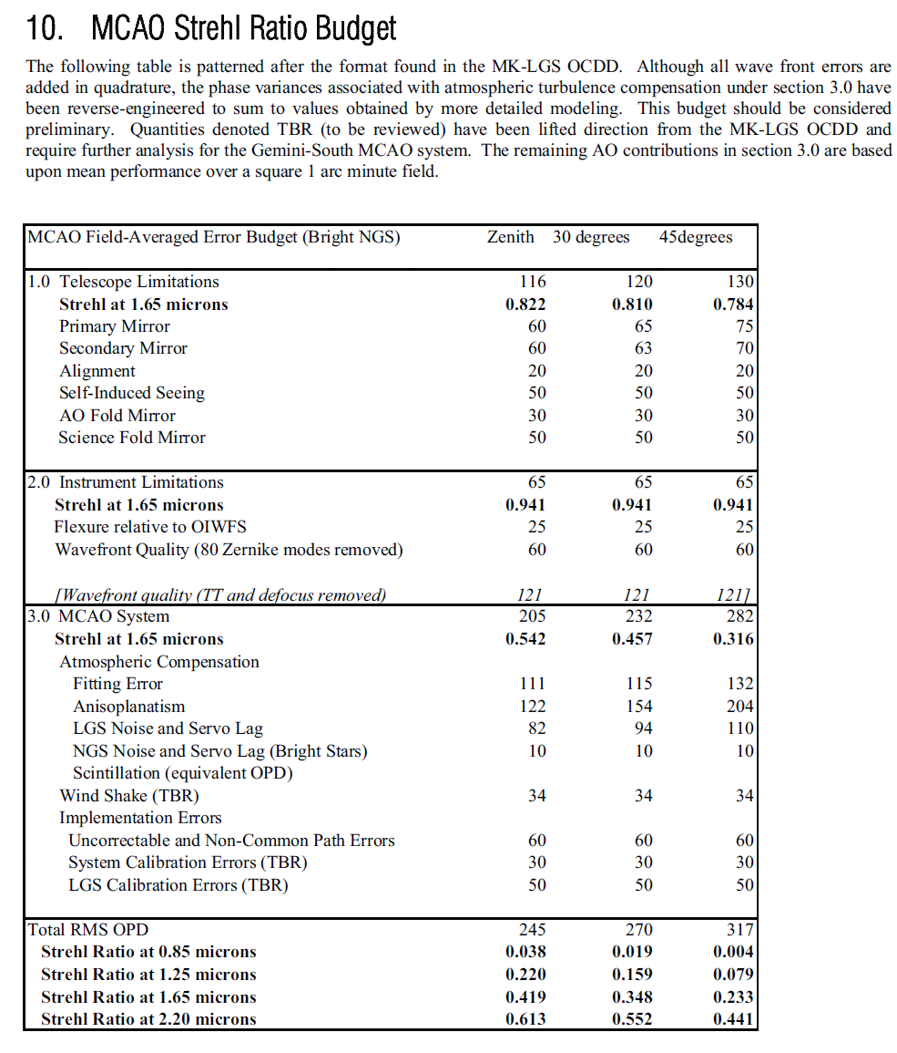
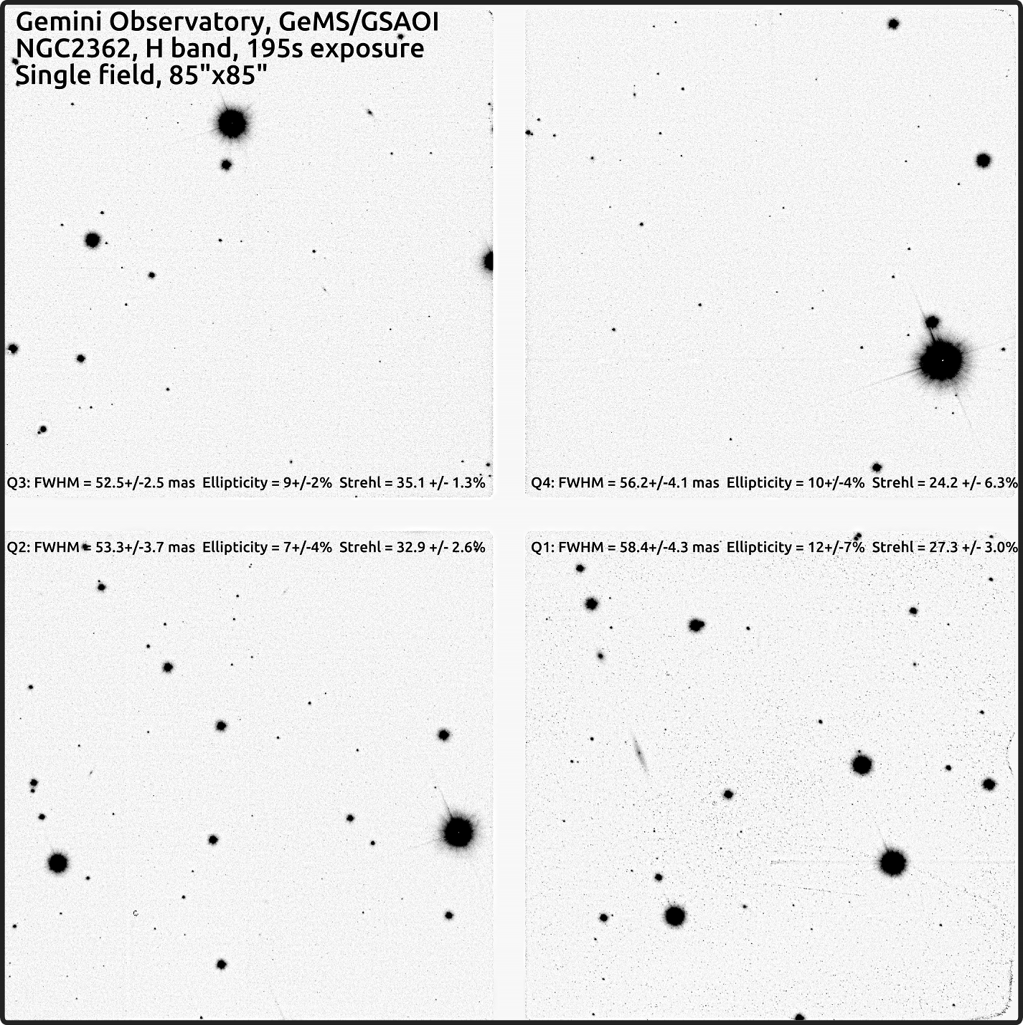
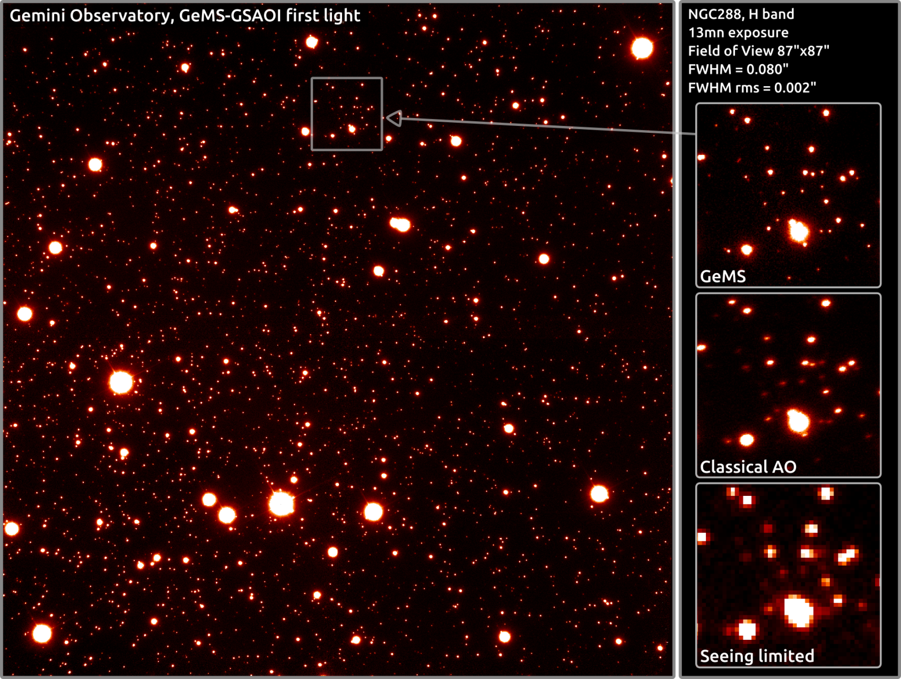
GeMS Proceeding Well…
From Francois Rigaut –
“The Strehl is quite high and the FWHM is much closer to the diffraction limit. In fact, I'm not even sure anyone has ever got 35% strehl in H band with a LGS system, notwithstanding on a field of 85 arcsec...”

Slide 5
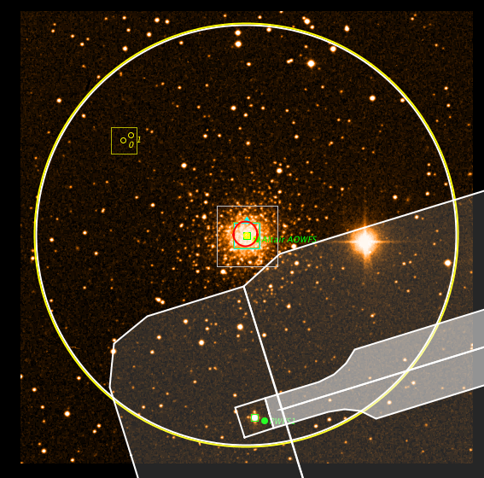
New NIFS LGS AO Mode
New LGS AO mode being developed is intended to address sky coverage limitations that are intrinsic to the current system
Instead of using limited field of tip/tilt sensor in ALTAIR, measure tip/tilt with existing 2x2 SH sensor in A&G unit
  14 arcmin patrol field diameter of this sensor greatly increases sky coverage
Key question – can we get adequate tip/tilt information for laser AO correction with the NGS reference up to ~7 arcmin from the science target?
14 arcmin
Tip/tilt sensor shadow in Field of View
Tip/tilt sensor
Peripheral Guide Probe Field

Slide 6
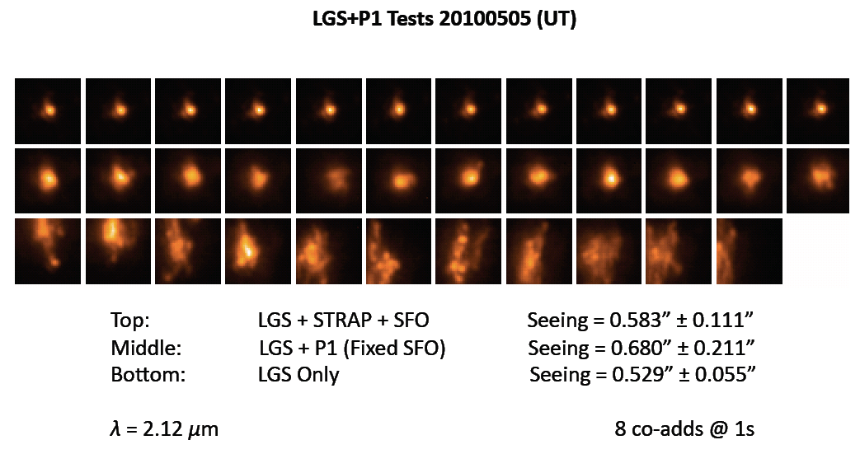
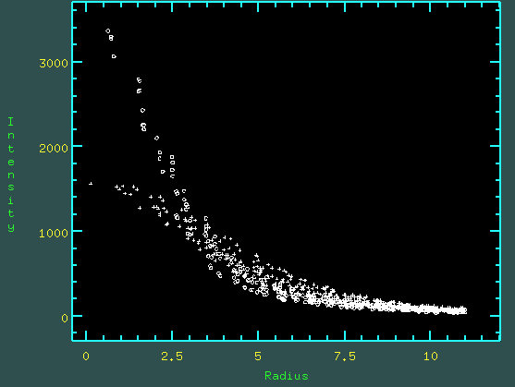
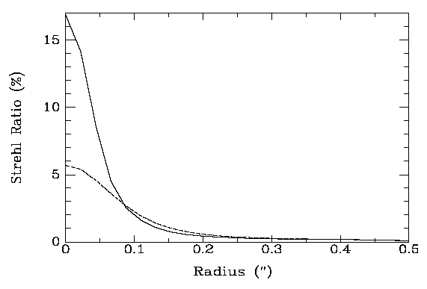
New NIFS LGS AO Mode
The practical implication of this new mode is that NIFS, when fed by the Gemini-N laser AO system, will achieve nearly 100% sky coverage
Shared risk use of this new mode likely in 2012B
Will also explore feeding GNIRS with this new LGS AO mode
Off-axis guiding on
Standard AO-LGS
NIFS Spatial Resolution
New
Mode
Non-AO
K-band radial profiles comparing PSFs produced by this new AO LGS mode vs. non-AO images. The peak signal gain is ~ 2×.

Slide 7
A Decade of AO Evolution at Gemini

Slide 8
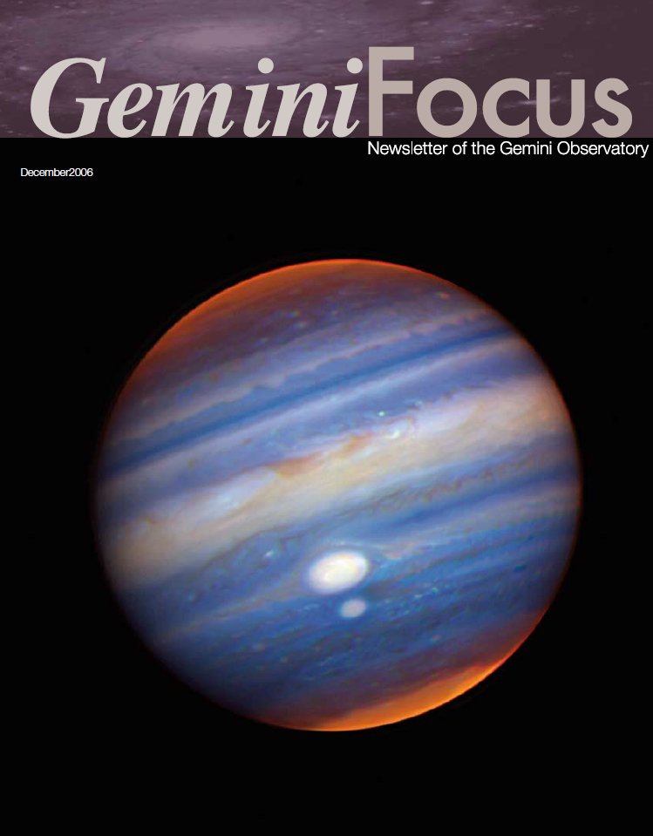
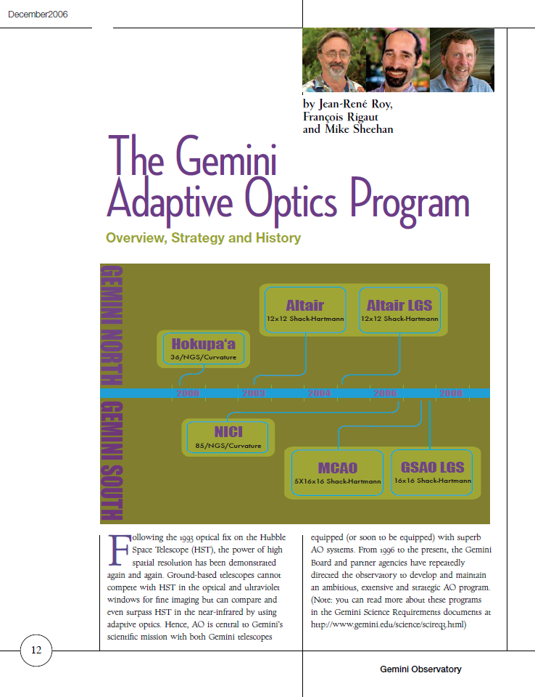
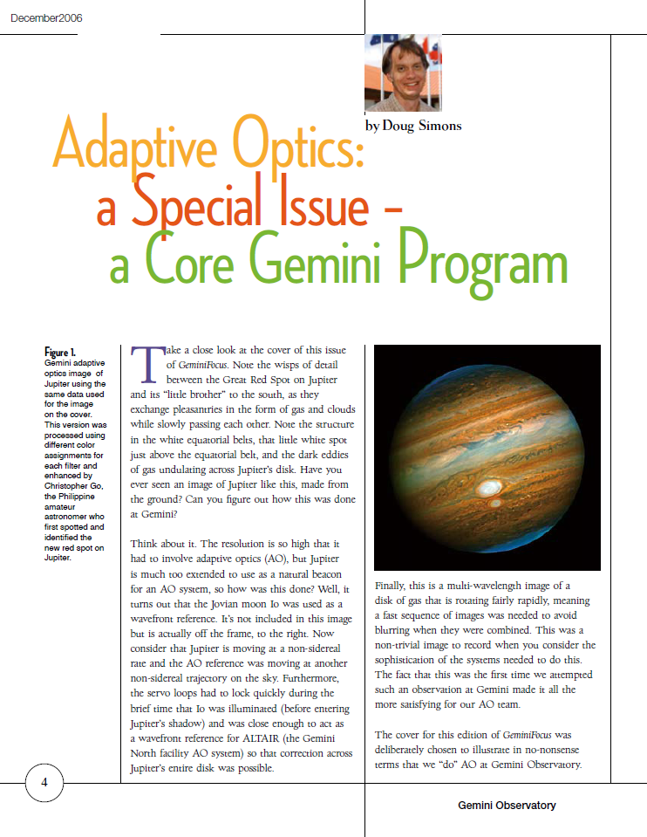
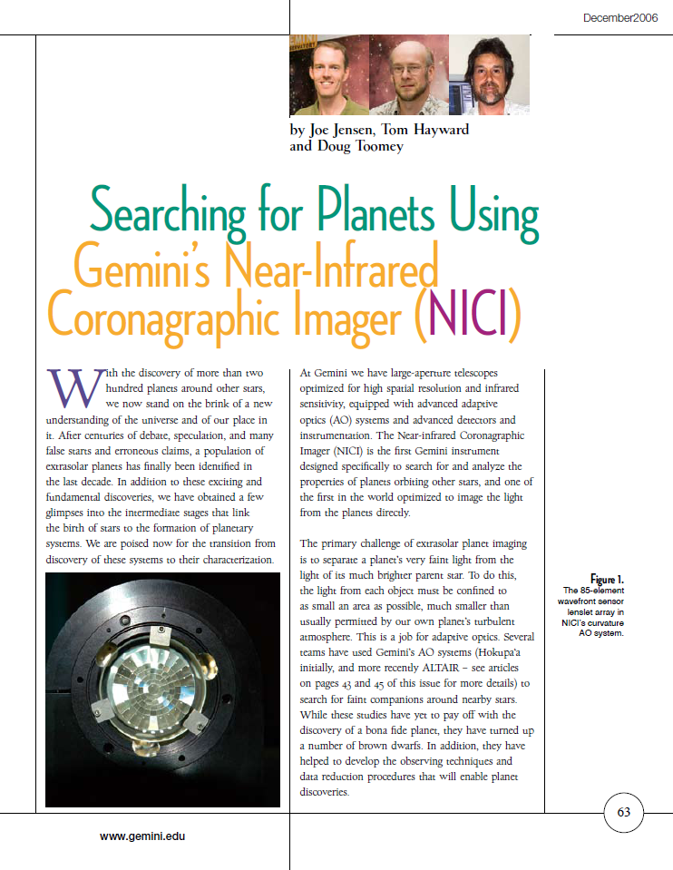
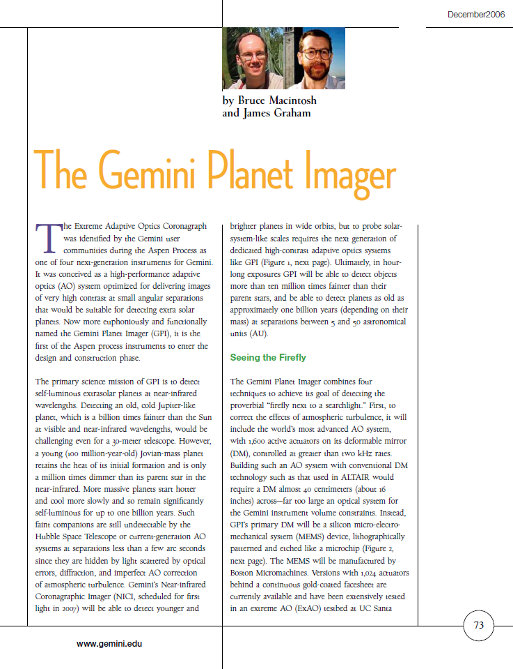
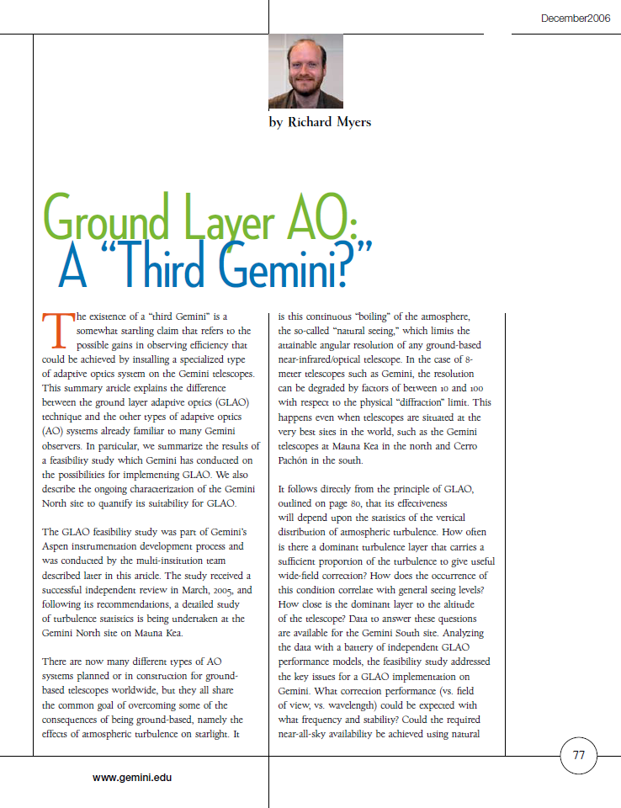
AO’s Many Forms at Gemini

Slide 9
Gemini AO Publications
First LGS AO Pub’s Appear
UH Hokupa’a-36
(47 papers)

Slide 10
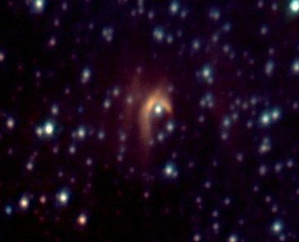
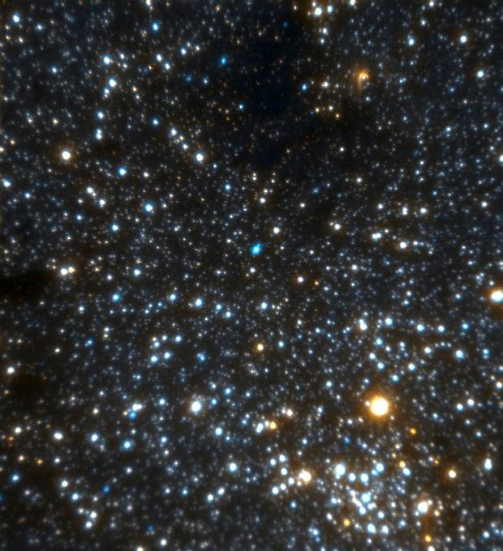
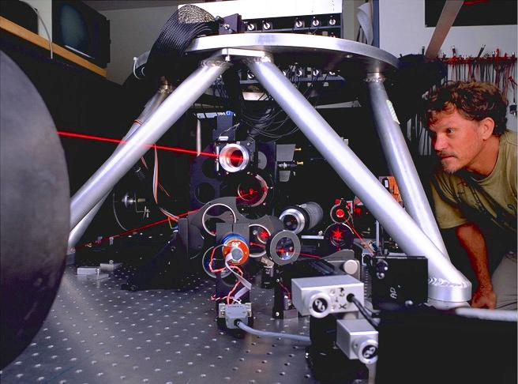
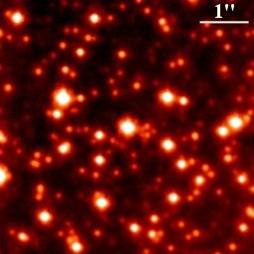
AO Program Starts with Univ. of Hawaii Hokupa’a-36
40 arcsec
IRS8 (bow shock)
A Decade Later…
>220 stars in 5”x5”

Slide 11
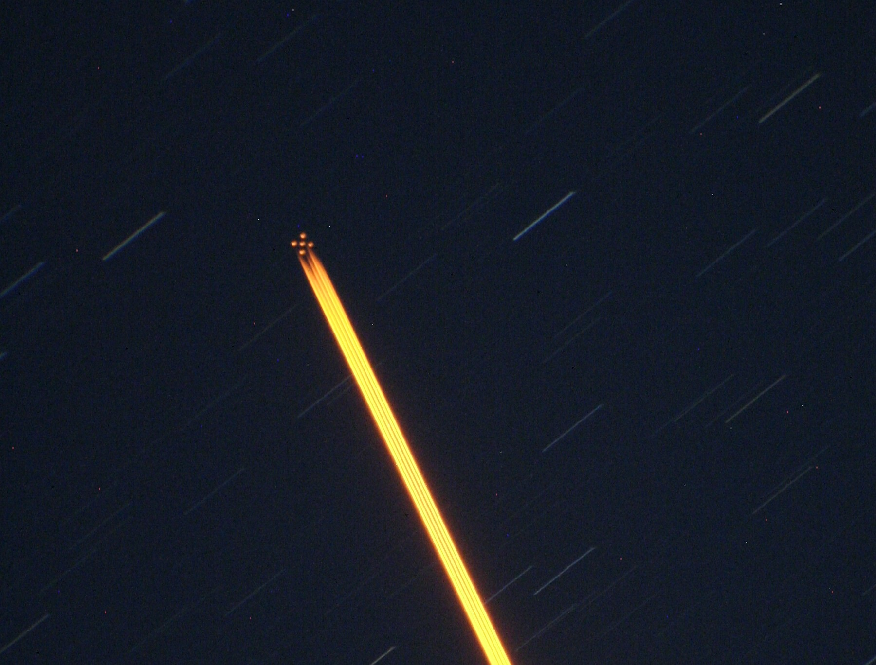
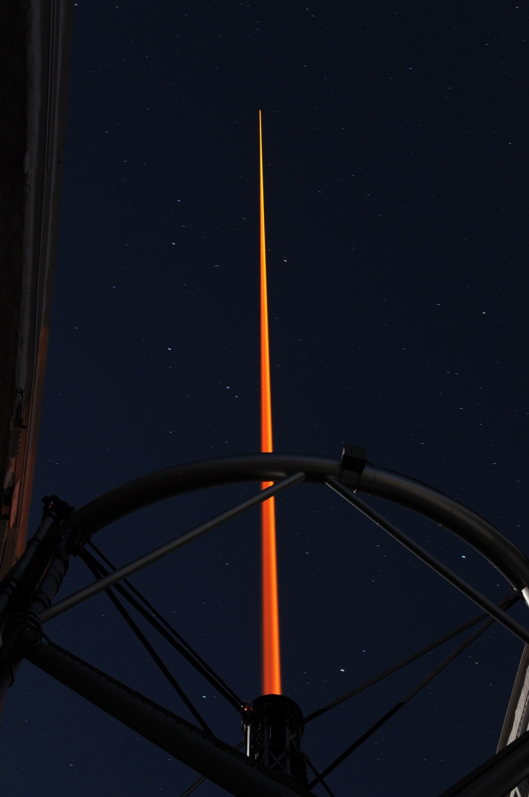
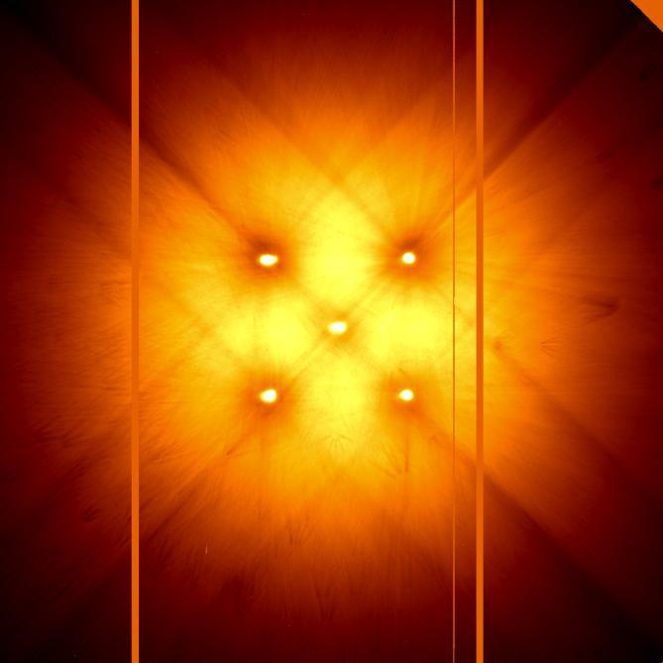
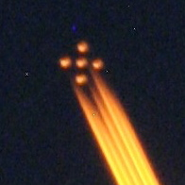
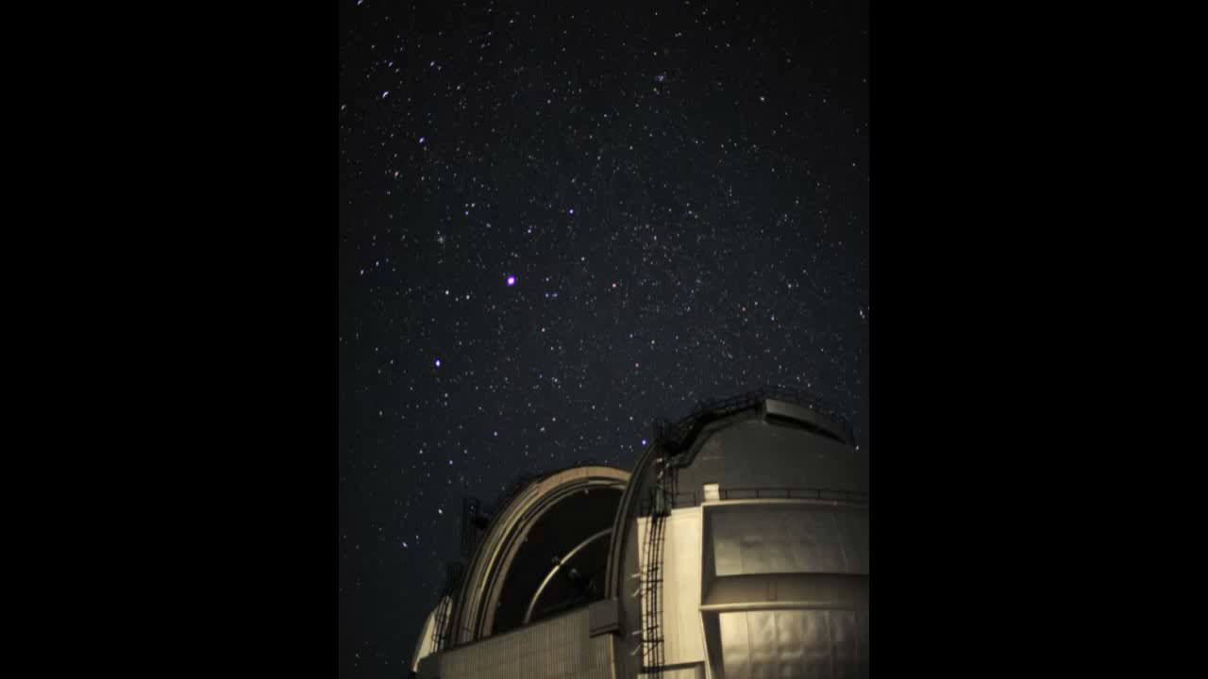
January 22 – Laser System First Light at Gemini-South
GMOS Image of GeMS Constellation

Slide 12
GeMS Layout
Sodium Layer
In-House
Integration
Beam
Transfer
Optics
In-House
50W LASER
Contract
Canopus
Infrastructure
In-House
Contracts
+ In-House
GSAOI
Contract

Slide 13
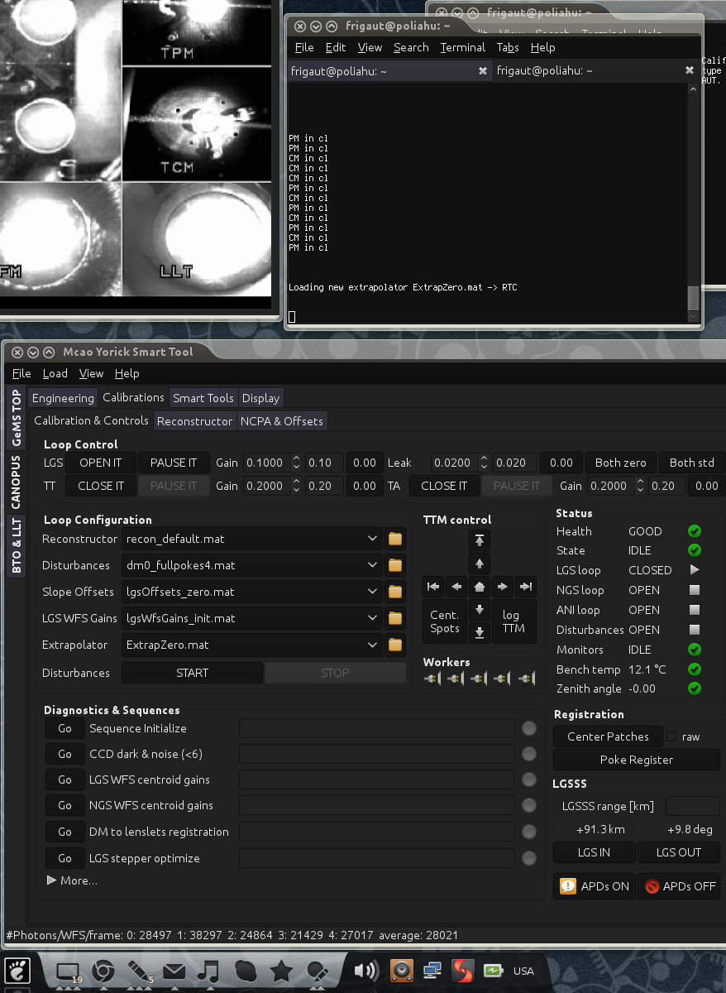
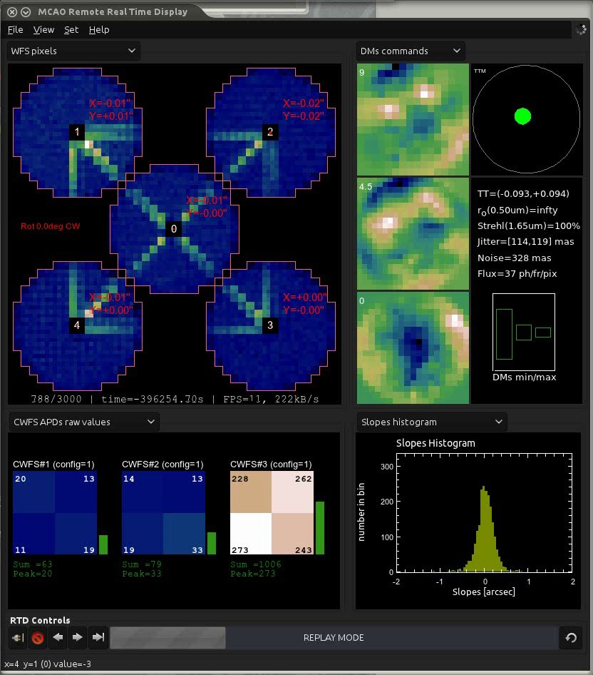
GeMS Control Console
Remote alignment cameras along laser beam transfer optics (BTO)
Real Time LGS Wavefront Sensor Readout
Real Time DM0, DM4.5, DM9 Shape Readout
System Control Screens
Real Time APD/Zernike Correction Readout
Real Time DM Actuator Tilt Readout

Slide 14
AO Program Design Flow
Altair
Altair LGS
MCAO
GLAO?
General & LGS AO Path
Wide field
AO path
UH36
Curvature
path
Extreme
AO path
UH85
NICI
GPI
?

Slide 15
AO Parameter Space Coverage
90%
GPI
Strehl
50%
NICI
MCAO
Altair
GLAO?
10%
20”
80”
300”
Field of View

Slide 16
Gemini’s Future Adaptive Optics Program

Slide 17
Future Gemini-N AO
With GeMS development closing this year, Gemini is evaluating options for updating the Gemini-N AO system, the core of which (ALTAIR) is fairly old
A range of options are under consideration and will be discussed at several meetings over the course of 2012…
  ALTAIR Upgrade
  MCAO
  LTAO
  GLAO
  MOAO
  Etc.

Slide 18


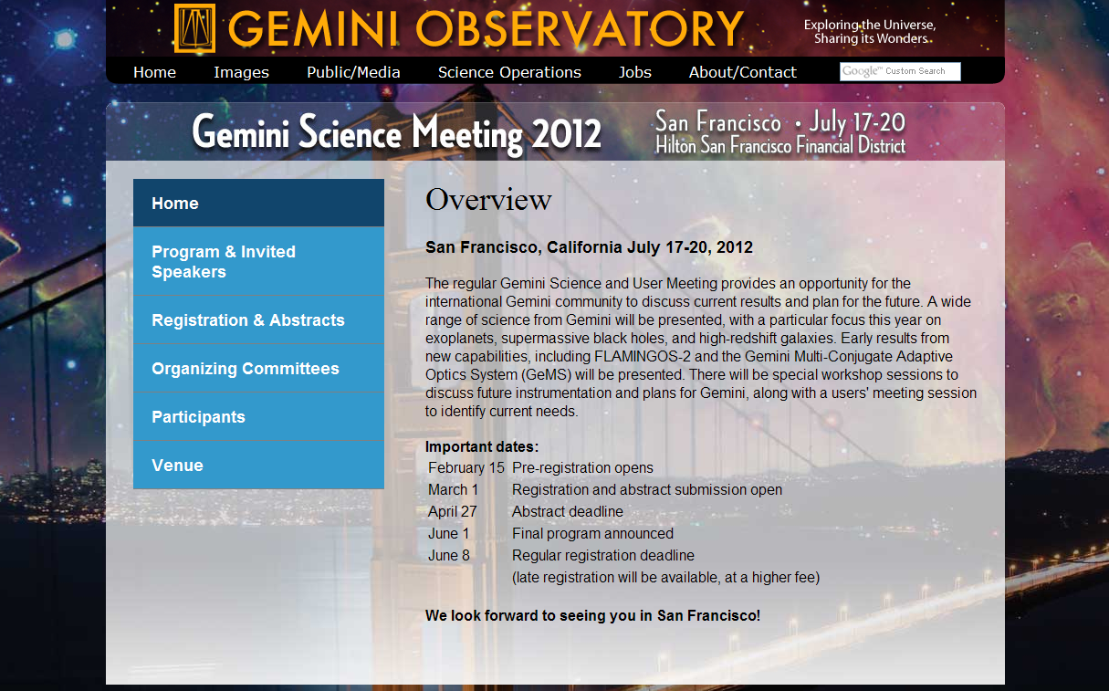
Important Future Opportunities to Explore Collaboration
AO Workshop
Victoria
June 2012
Science Conference
Kyoto - 2009
Science Conference
San Francisco - July 2012

Slide 19
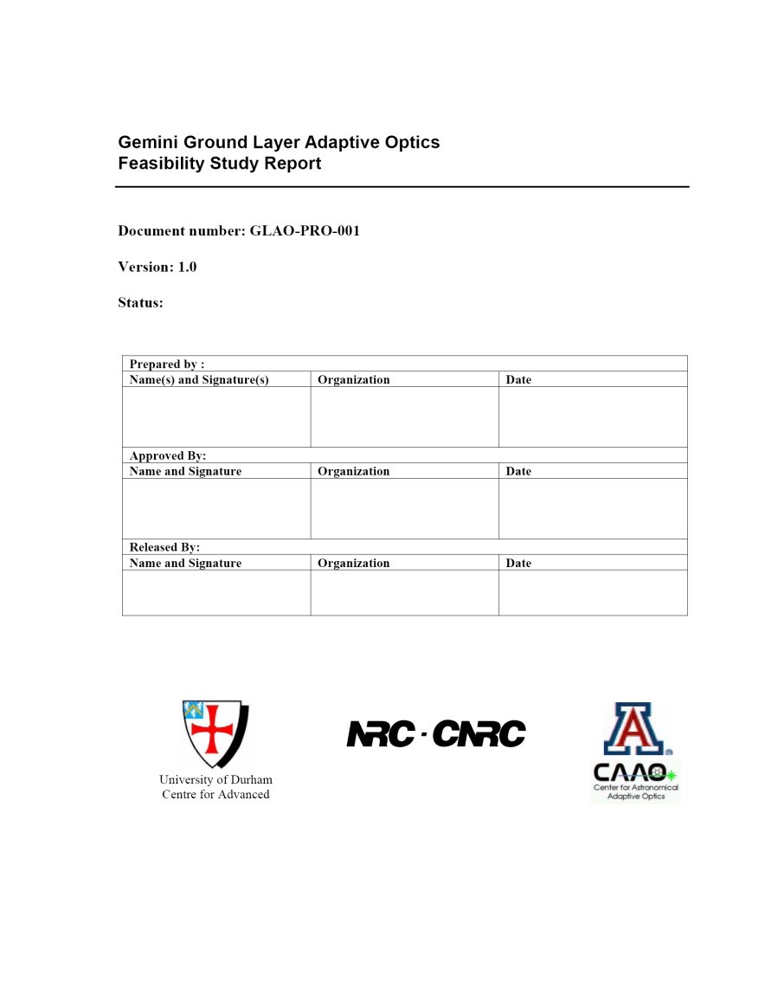
GLAO
Among these options, the GLAO concept at Gemini-N is among the more developed through a 2005 feasibility study conducted by a combination of HIA, Univ. of Arizona, and Univ. of Durham
Since the time of this study, a number of important breakthroughs have occurred in AO technology…
“Our studies indicate that, in terms of observing efficiency (especially for many top ranked proposals), an upgrade of Gemini to full GLAO operation will be equivalent to adding another telescope.”

Slide 20
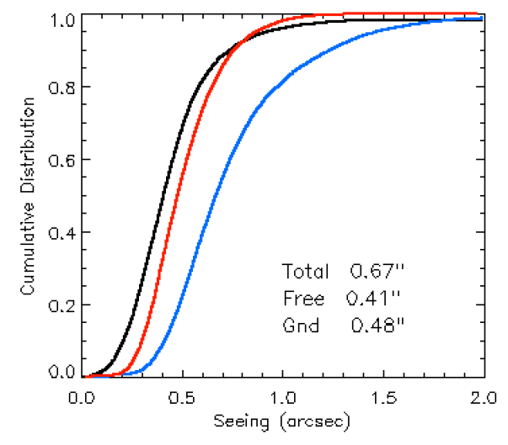
Breakthroughs Since Gemini’s GLAO Feasibility Study (2005)
Important result from Gemini sponsored Mauna Kea site testing (led my Mark Chun et al.)
  A strong, persistent, and remarkably thin ground layer exists on the upper summit ridge of Mauna Kea
MK Seeing on Upper Ridge

Slide 21
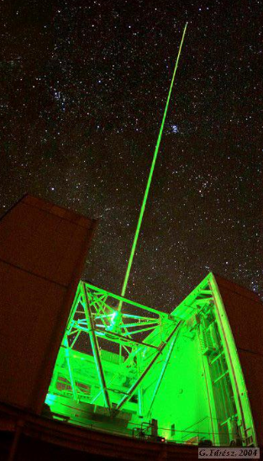
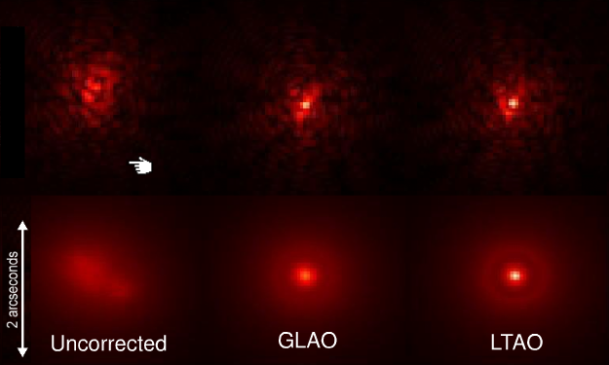
Breakthroughs Since Gemini’s GLAO Feasibility Study (2005)
Important result from Gemini sponsored Mauna Kea site testing (led my Mark Chun et al.)
  A strong, persistent, and remarkably thin ground layer exists on the upper summit ridge of Mauna Kea
Demonstration of GLAO at Steward
K-band

Slide 22
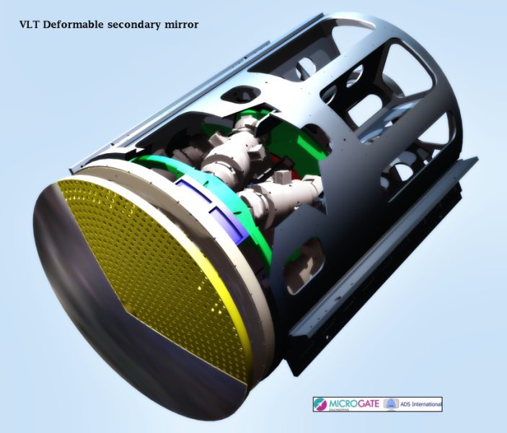
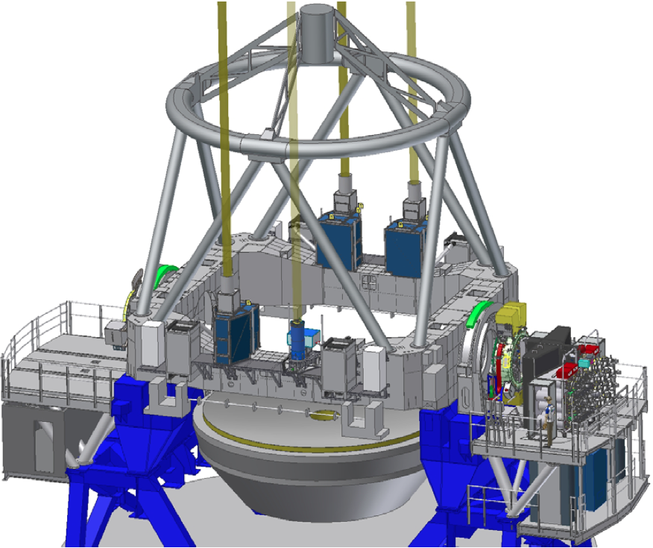
Breakthroughs Since Gemini’s GLAO Feasibility Study (2005)
Important result from Gemini sponsored Mauna Kea site testing (led my Mark Chun et al.)
  A strong, persistent, and remarkably thin ground layer exists on the upper summit ridge of Mauna Kea
Demonstration of GLAO at Steward
Commercial opportunities for the manufacture of adaptive secondary mirrors (ASM)
  Microgate/ADS now building ASM’s for LBT, Magellan, ESO/VLT
VLT/AO Facility

Slide 23
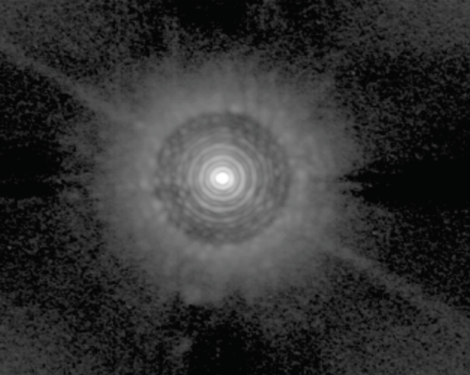
Breakthroughs Since Gemini’s GLAO Feasibility Study (2006)
Important result from Gemini sponsored Mauna Kea site testing (led my Mark Chun et al.)
  A strong, persistent, and remarkably thin ground layer exists on the upper summit ridge of Mauna Kea
Demonstration of GLAO at Steward
Commercial opportunities for the manufacture of adaptive secondary mirrors (ASM)
  Microgate/ADS now building ASM’s for LBT, Magellan, ESO/VLT
Impressive results during the SPIE 2010 meeting from LBT about their ASM commissioning results (S~80% at H for bright NGS application)

Slide 24
Breakthroughs Since Gemini’s GLAO Feasibility Study (2005)
Important result from Gemini sponsored Mauna Kea site testing (led my Mark Chun et al.)
  A strong, persistent, and remarkably thin ground layer exists on the upper summit ridge of Mauna Kea
Demonstration of GLAO at Steward
Commercial opportunities for the manufacture of adaptive secondary mirrors (ASM)
  Microgate/ADS now building ASM’s for LBT, Magellan, ESO/VLT
Impressive results during the SPIE 2010 meeting from LBT about their ASM commissioning results (S~80% at H for bright NGS application)
Demonstration of multi-LGS beacon projection system at Gemini-S

Slide 25
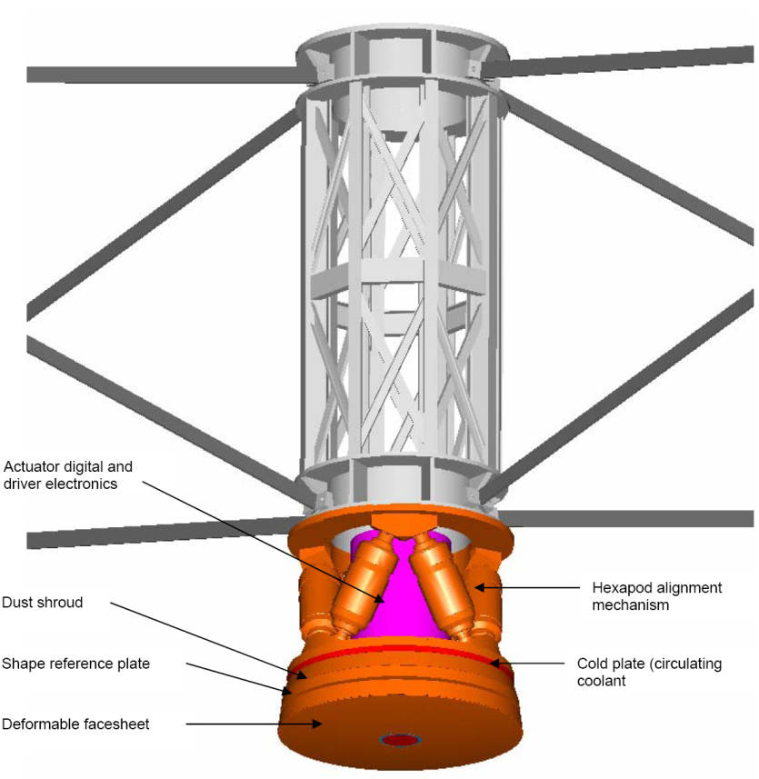
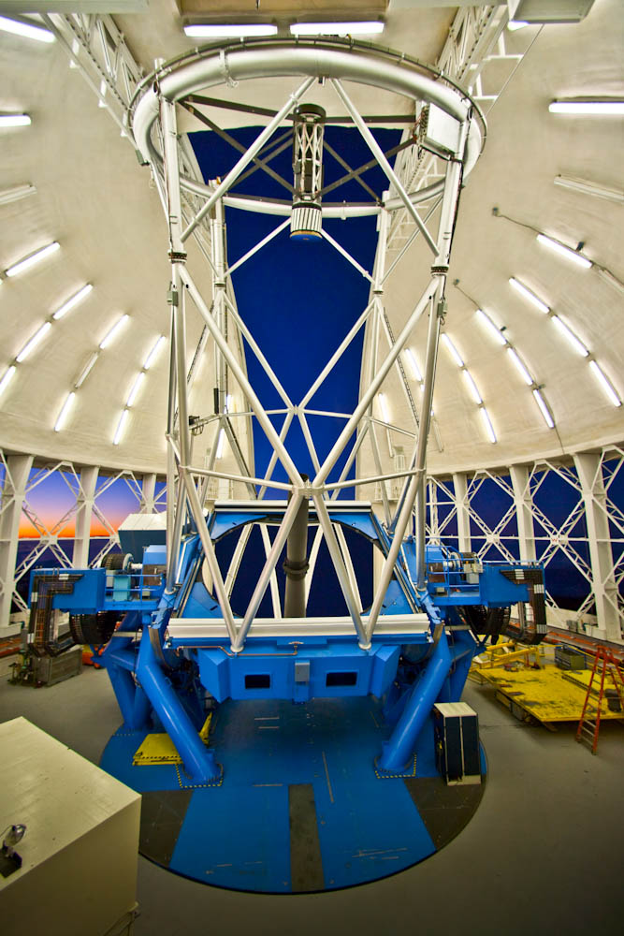
Gemini GLAO Concept
Key components include:
  Adaptive Secondary
  Multi-beacon Na LGS
  New A&G
    LGS/NGS WFS
  Associated RTC, mechanism controls, HLSW, etc.
Facility that feeds all ports with GLAO corrected beam

Slide 26
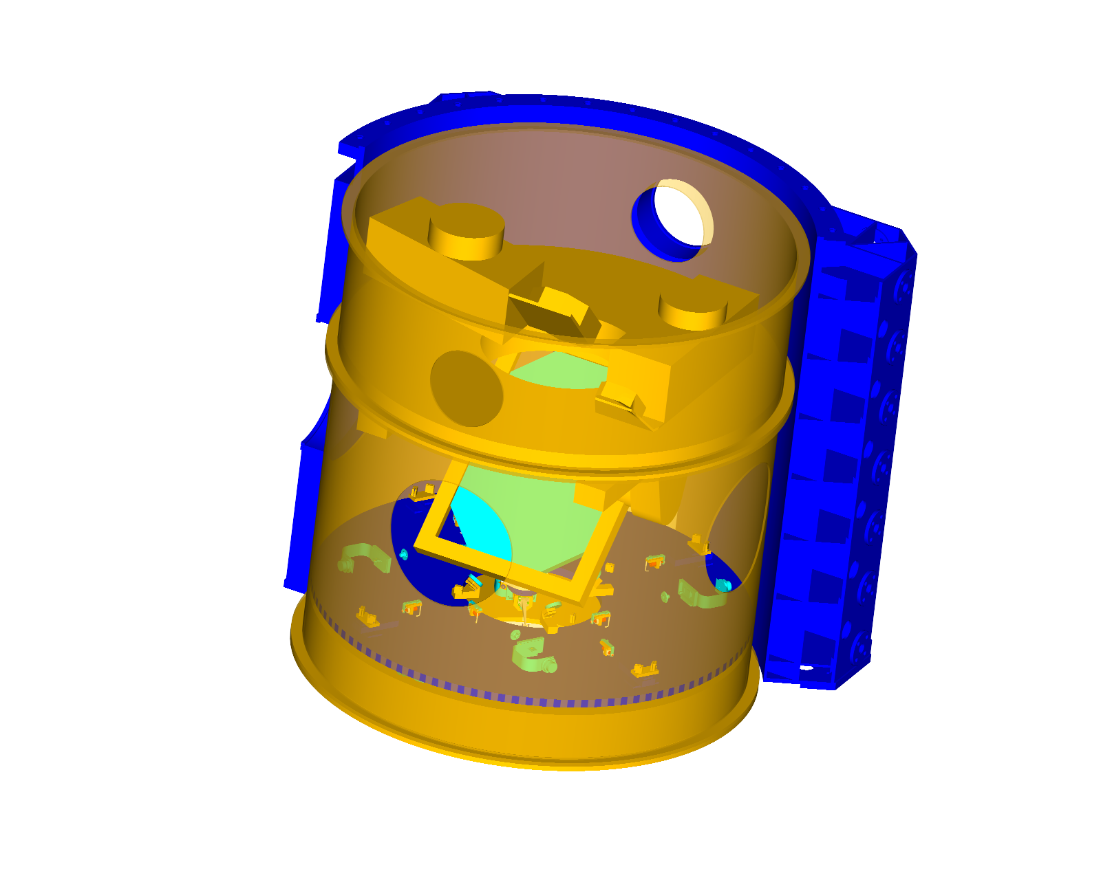
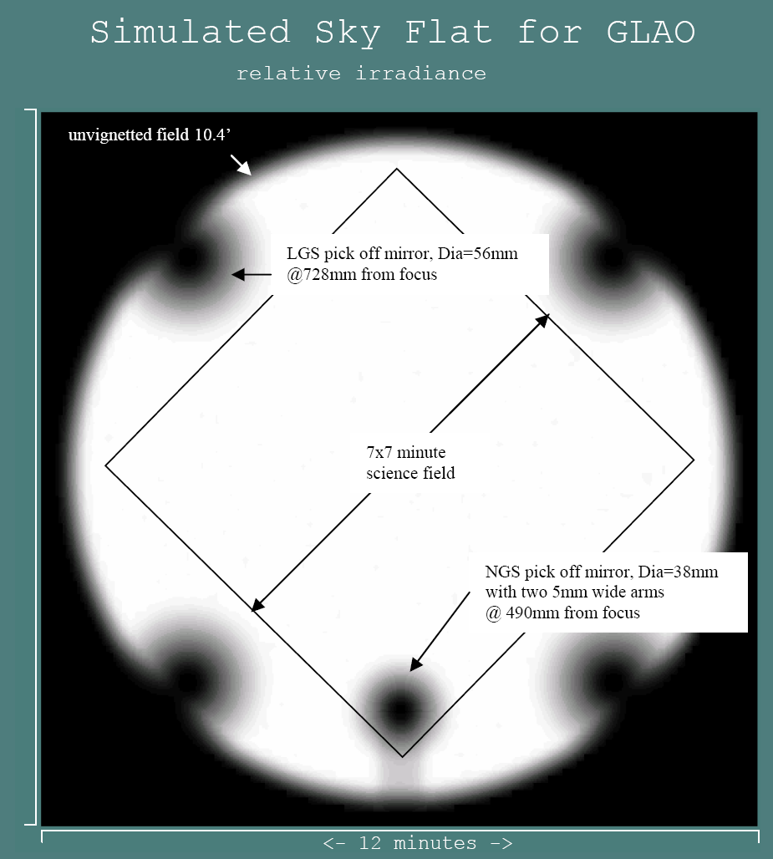
Gemini GLAO Concept
Key components include:
  Adaptive Secondary
  Multi-beacon Na LGS
  New A&G
    LGS/NGS WFS
  Associated RTC, mechanism controls, HLSW, etc.
Facility that feeds all ports with GLAO corrected beam
IR Science Beam
Dichroic
LGS & NGS
Wavefront Sensors
Field through
dichroic

Slide 27
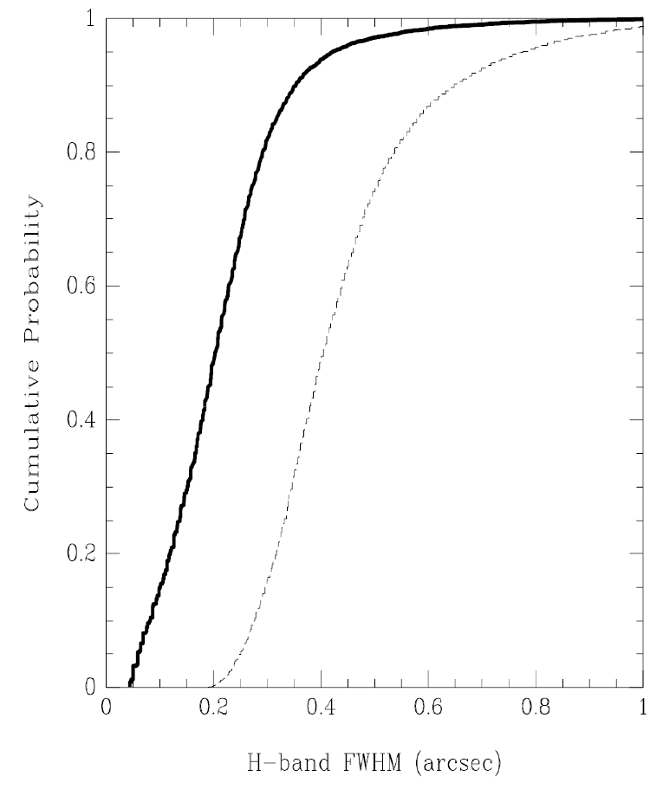
GLAO Model Results
Interim model results, using 7200 measurements from GLAO site testing conducted by Chun et al. on Mauna Kea
In general about half the turbulence power is below 100 m, and low/high altitude turbulence is not correlated
GLAO FWHM basically reduced to ½ its natural seeing size (H-band)
  Improvement drops with wavelength
  NIR implementation at Gemini
GLAO image quality improvement increases as seeing gets worse
GLAO
Natural Seeing

Slide 28
Next Steps…
Gemini’s Science and Technology Advisory Committee (formerly GSC) is leading the evaluation of a range of instrument options for Gemini, a new AO system for Gemini-N among them
Key meetings in 2012 include -
  STAC – April (Hilo)
  Gemini-N AO Workshop – June (Victoria)
  Gemini Triennial Science Conf. and Users Meeting – July (San Francisco)
  STAC – October (La Serena)
Participation by the Subaru community in all of these meetings is encouraged, in the spirit of continuing to explore options for collaborative development of future instrumentation

Slide 29
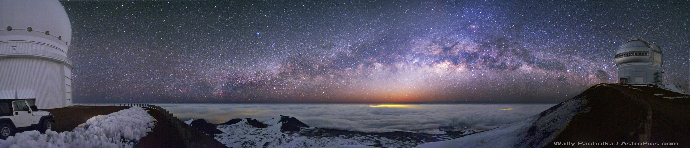
Exploring the Universe, Sharing its Wonders

