Slide 1
Computer and Data Management Division Report
Service Status
  Network
  HSC on-site DA system
  STARS and MASTARS
Replacement of the major system
Junichi Noumaru

Slide 2
Service Status

Slide 3
Network
No major changes since last report.
Summit to Hilo: 1Gbps
Hilo to Mitaka: 1Gbps
Firewall at Hilo will be upgraded to provide ~4Gbps throughput in January 2018. Optical fiber between the Hilo base facility and UH will be upgraded to provide up to 10Gbps throughput by March 2018.

Slide 4
STN4/STN5 network configurations
Modified configurations from ones prepared by Eiji Kyono
Summit
Ethernet (1Gbps) UH
naoj.hawaii.edu domain
Internet
Dedicated Ethernet(1Gbps)
Firewall
Hale Pohaku
Ethernet (1Gbps) UH
naoj.hawaii.edu domain
UH
Dedicated Ethernet (1Gbps)
Mitaka
Hilo
Ethernet (1Gbps) UH
naoj.hawaii.edu domain
subaru.nao.ac.jp domain
Firewall
Dedicated Ethernet (10Mbps)
Internet
naoj.org domain
To be upgraded to provide ~4Gbps throughput in January 2018.
Fiber cable upgrade due in March 2018.

Slide 5
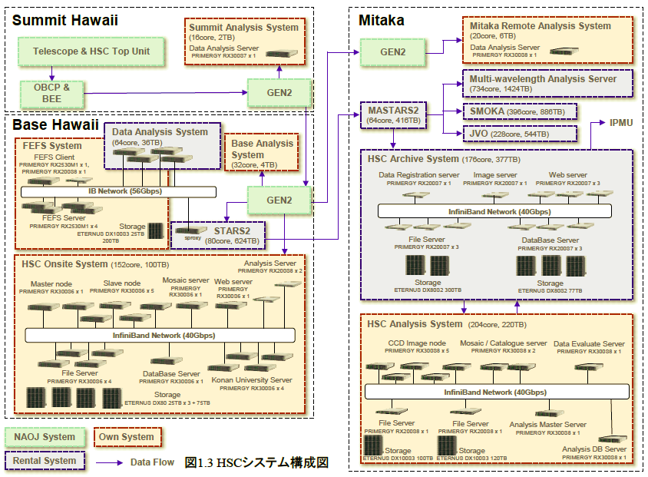
HSC On-site Data Analysis System
CDM continues on supporting the HSC team to keep the HSC on-site data analysis system running.
Fujitsu, the General Meeting Material

Slide 6
STARS and MASTARS

Slide 7
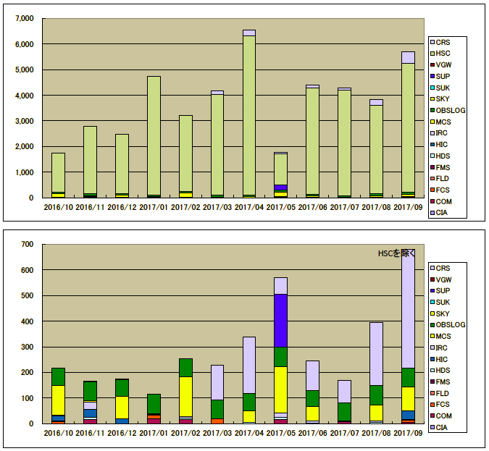
Registered data to STARS in GB
HSC excluded
By Tadahiro Yamamoto, Fujitsu, the General Meeting Material

Slide 8
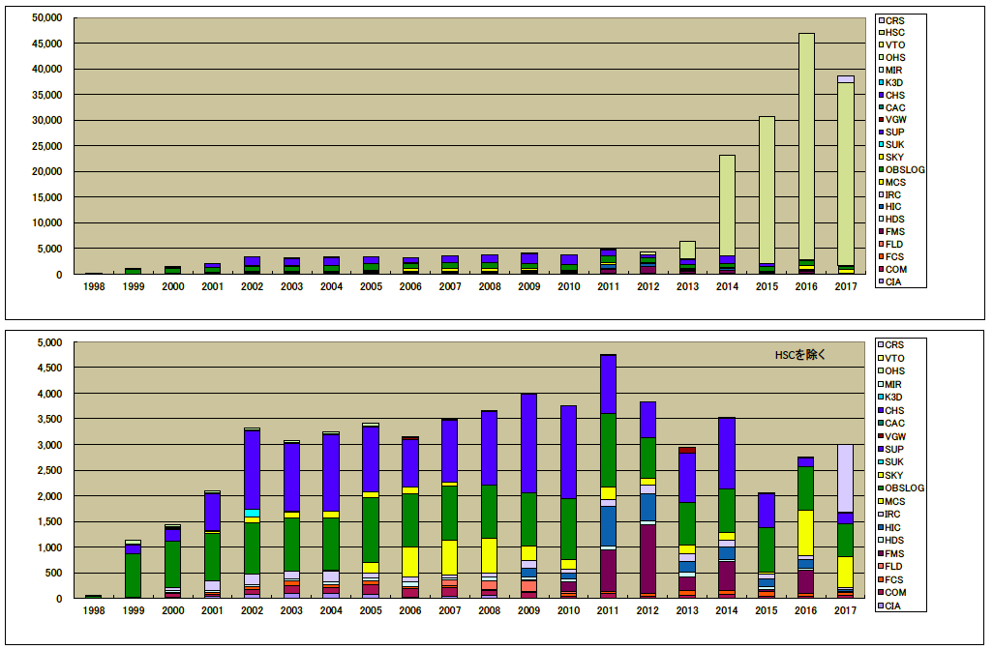
Registered data in GB to STARS to September 2017
HSC excluded
By Tadahiro Yamamoto, Fujitsu, the General Meeting Material

Slide 9
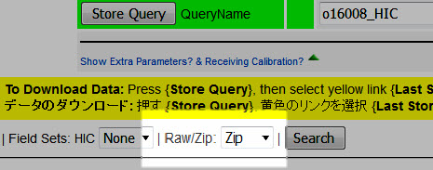
STARS Archive
By Tom Winegar
Archive Statistics
2016-2017
New Download Options
STARS & MASTARS
have HSC Compressed
FPACK (18MB 8MB )
1. NextDay Delivery email
both .FITS & .FZ
2. From STARS Query
Raw / Zip
Reduced observing nights due to mirror recoating made the number of incoming FITS files less.
Certain STARS users download large amount of data.

Slide 10
Mitaka Remote Observation
Since S15B, a requirement that an observer must be at the summit during Mitaka remote observation has been lifted up.
Mitaka remote observation is available for observations using any instrument.
Both the number of Mitaka remote observers and the number of nights of Mitaka remote observation show a big leap after S15B.
HSC users and time dominate Mitaka remote observation.

Slide 11
By Chie Yoshida and Hitomi Yamanoi

Slide 13
By Chie Yoshida and Hitomi Yamanoi

Slide 14
By Chie Yoshida and Hitomi Yamanoi

Slide 16
Replacement of the major computer system
STN4 to STN5

Slide 17
Fujitsu won the bidding and continues to provide the rental service until 2023.
We plan the replacement so that the work minimizes impact to observations.
The functions of STN5 are almost the same as those of STN4. Performance is improved as CPU became faster over the years. Capacity of storage is increased.
STN5 has virtual machine (VM) servers added to the summit system. A few OBCPs (Instrument Control Computers), data analysis machines and instrument support computers are implemented as VM.

Slide 18
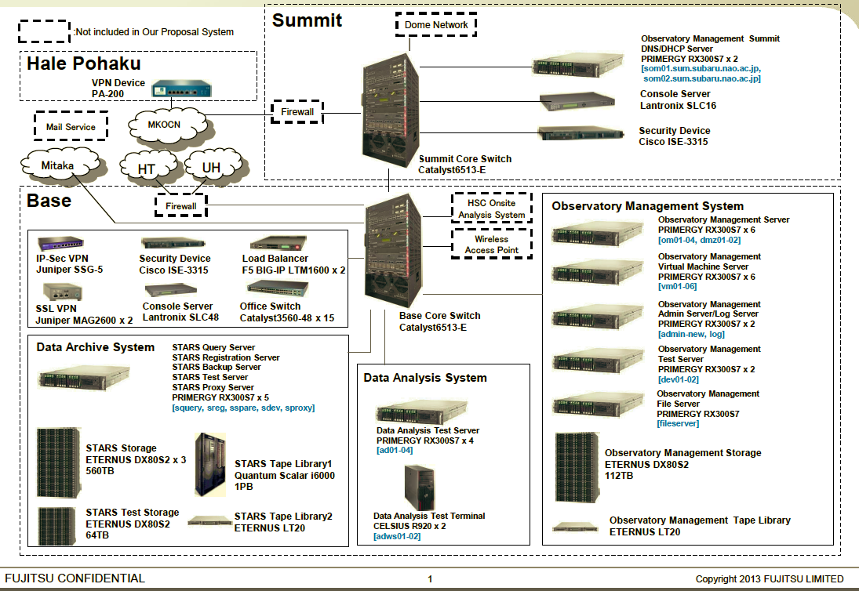
STN4
Not included in STN5 rental system

Slide 19
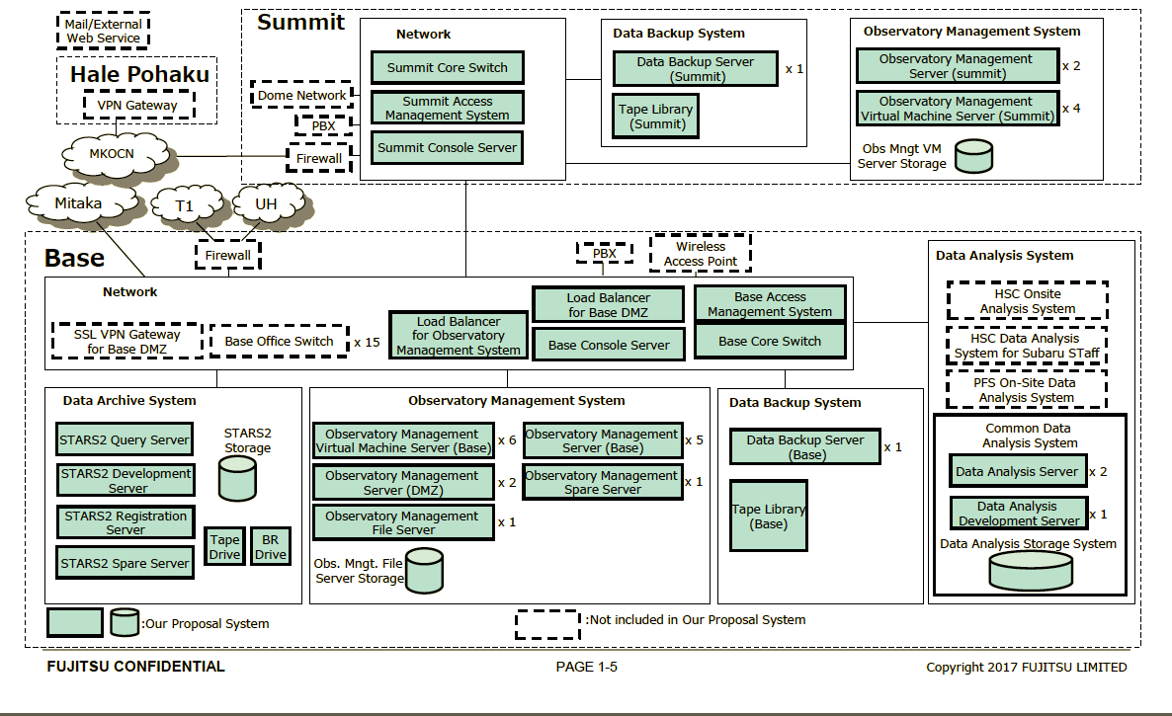
STN5
New to STN5

Slide 20
Milestones
The core switch and servers at the summit will be installed on January 16.
The firewall at the Hilo will be replaced on January 20.
The firewall at the summit will be maintained on January 29.
Replacement of STARS servers, Observatory Management System servers including web servers will take place in February.
All replacement works are scheduled to be done during the daytime and we make sure critical systems for observations will be available during the night time.
New system will take over the existing system except ProMS as of March 1, 2018. ProMS will continue to work until mid April.

