Slide 1
TMT
Progress Report
Tomo Usuda (TMT-J Director)
Outline
1) International Status: Hawaii etc.
2) TMT-J activities

Slide 2
TMT
International Status 〜Hawai’i〜

Slide 3
1) Status of the CDUP*
Reapproval for TMT
Dec 2 2015: The Supreme Court of Hawaii decision on CDUP issued.
Feb 2016: The Third Circuit Court further remands the permit application to the Board of Land and Natural Resources (BLNR) in Hawaii, and as a result, the contested case hearing process is reopened by BLNR.
May 2016: Hearing Officer to preside over the BLNR hearing is selected and actual preparations for the hearing is initiated.
Prehearing conferences (May 16, June 17, Aug 5, 12, & 29) & Oct. 3
Sep 26 2016: Site Visit
Testimony concluded in the Contested Case Hearing (Oct 20 to March 2, total 44 days)
*) CDUP = Conservation District Use Permit

Slide 4
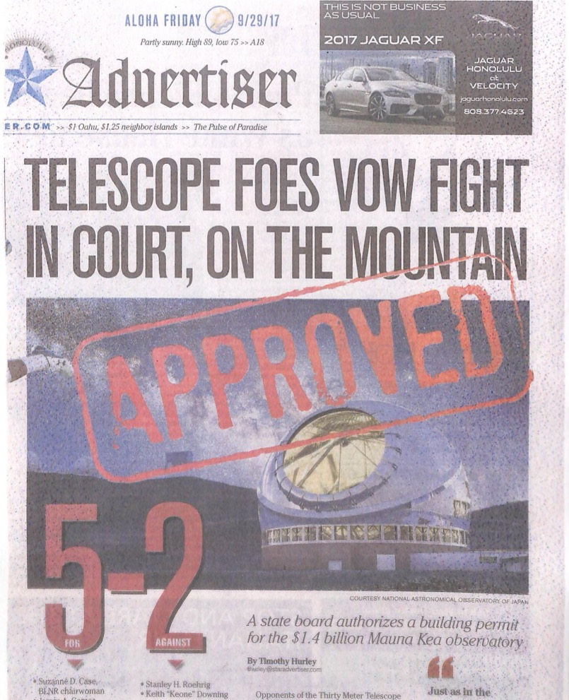
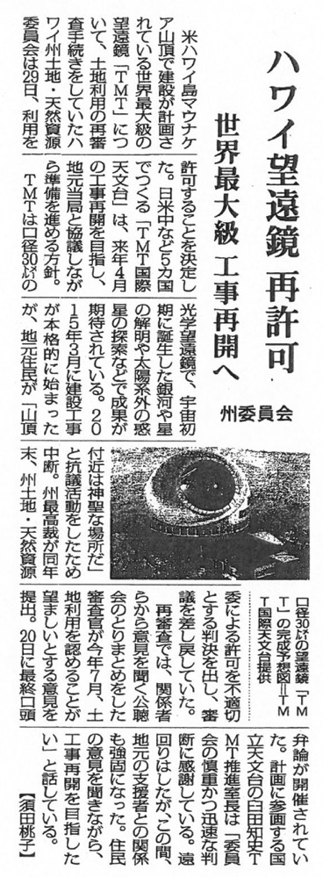
CDUP Approved (Sep. 28th)

Slide 5
1) Status of the CDUP
Reapproval for TMT
Dec 2 2015: The Supreme Court of Hawaii decision on CDUP issued.
Feb 2016: The Third Circuit Court further remands the permit application to the Board of Land and Natural Resources (BLNR) in Hawaii, and as a result, the contested case hearing process is reopened by BLNR.
May 2016: Hearing Officer to preside over the BLNR hearing is selected and actual preparations for the hearing is initiated.
Prehearing conferences (May 16, June 17, Aug 5, 12, & 29) & Oct. 3
Sep 26 2016: Site Visit
Testimony concluded in the Contested Case Hearing (Oct 20 to March 2, total 44 days)
July 27: very Positive Recommendation from the Hearing Officer (Ms. Riki M. Amano)
Sep 28: Decision by BLNR → Approved!

Slide 6
1) Hawaii’s Public Opinion:
CDUP for TMT
(October 2, 2017)
Yes 76%
No 8%

Slide 7
1) Status of the CDUP
Reapproval for TMT
Dec 2 2015: The Supreme Court of Hawaii decision on CDUP issued.
Feb 2016: The Third Circuit Court further remands the permit application to the Board of Land and Natural Resources (BLNR) in Hawaii, and as a result, the contested case hearing process is reopened by BLNR.
May 2016: Hearing Officer to preside over the BLNR hearing is selected and actual preparations for the hearing is initiated.
Prehearing conferences (May 16, June 17, Aug 5, 12, & 29) & Oct. 3
Sep 26 2016: Site Visit
Testimony concluded in the Contested Case Hearing (Oct 20 to March 2, total 44 days)
July 27: very Positive Recommendation from the Hearing Officer (Ms. Riki M. Amano)
Sep 28: Decision by BLNR → Approved!
Oct 17: Appeal to Hawaii Supreme Court → may take ~1 year

Slide 8
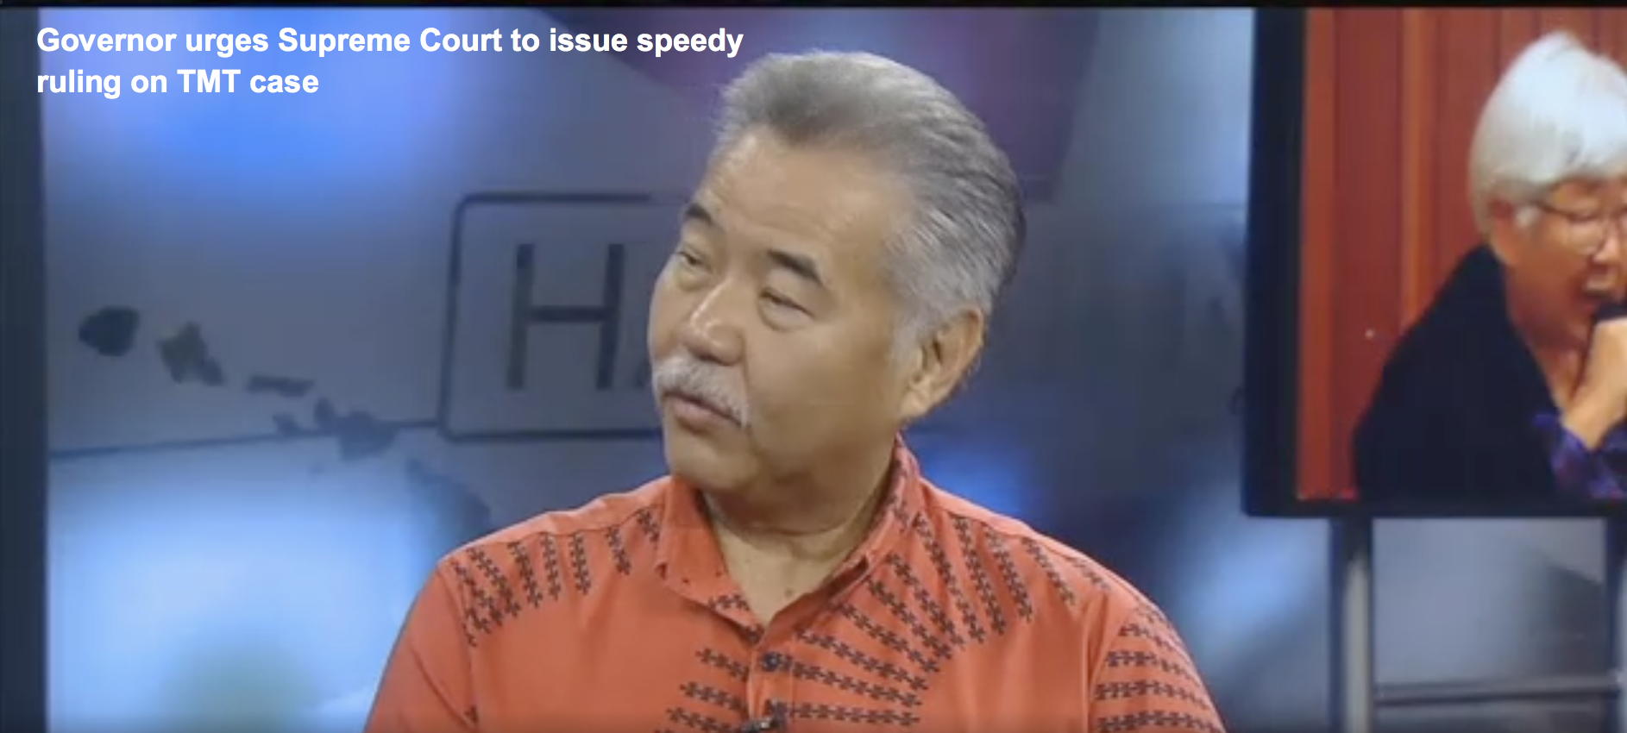
1) Hawaii’s Public Opinion:
We Continue to Support TMT
Gov. David Ige is urging the state Supreme Court to issue a quick decision on the Thirty Meter Telescope case. "They've heard it before. We're hoping they make a speedy decision,” Ige said Tuesday on Hawaii News Now Sunrise.
The governor is hoping the high court will fast track the case because the project faces a looming deadline.

Slide 9
1) Status of the CDUP
Reapproval for TMT
Dec 2 2015: The Supreme Court of Hawaii decision on CDUP issued.
Feb 2016: The Third Circuit Court further remands the permit application to the Board of Land and Natural Resources (BLNR) in Hawaii, and as a result, the contested case hearing process is reopened by BLNR.
May 2016: Hearing Officer to preside over the BLNR hearing is selected and actual preparations for the hearing is initiated.
Prehearing conferences (May 16, June 17, Aug 5, 12, & 29) & Oct. 3
Sep 26 2016: Site Visit
Testimony concluded in the Contested Case Hearing (Oct 20 to March 2, total 44 days)
July 27: very Positive Recommendation from the Hearing Officer (Ms. Riki M. Amano)
Sep 28: Decision by BLNR
Oct 17: Appeal to Hawaii Supreme Court → may take ~1 year
Onsite construction expected to resume in 6 months following CDUP approval. Expected resume date is April 2018

Slide 10

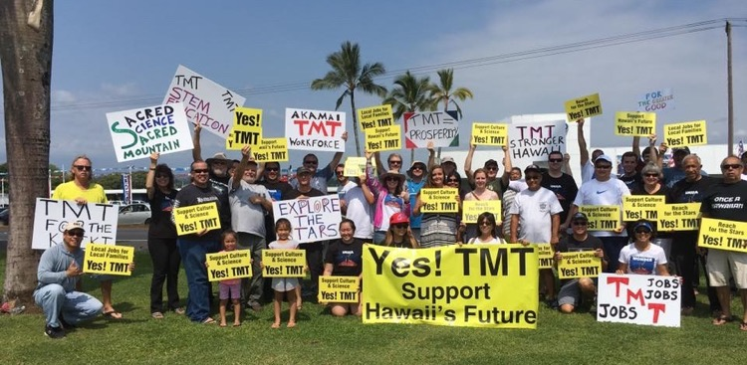
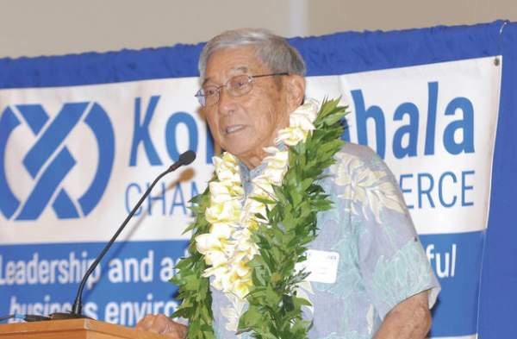
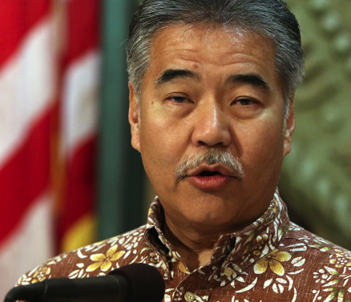
1) Hawaii’s Public Opinion:
We Continue to Support TMT
TMT support campaign
Harry Kim (Mayor), David Ige (Governor), Brian Schatz (US Senator) stated to support TMT and the blockage activity to MK is illegal

Slide 11
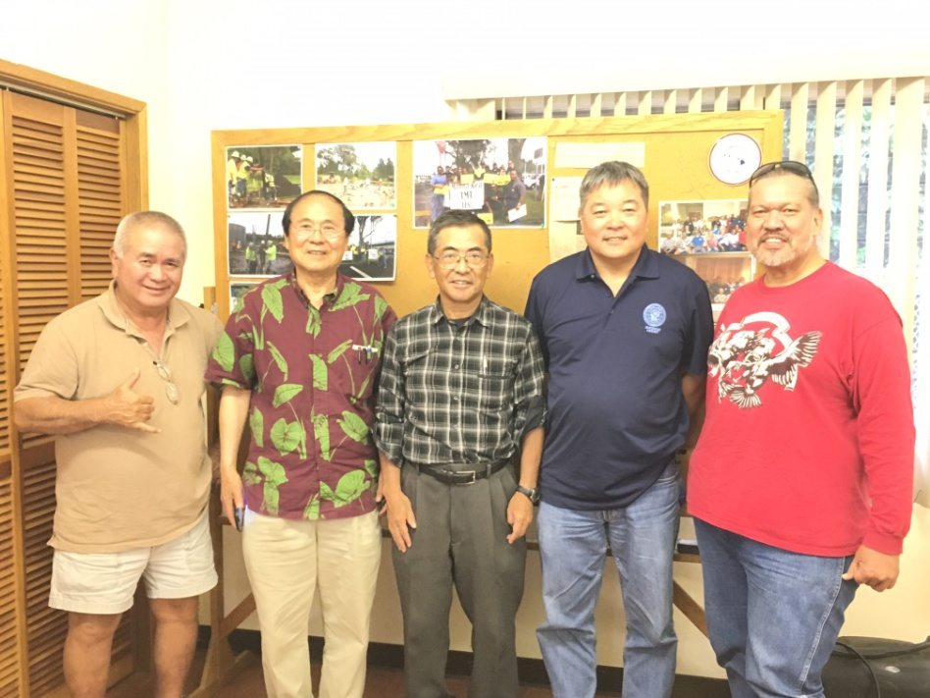
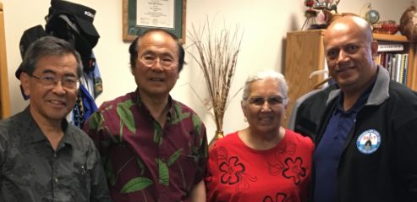
1) Hawaii’s Public Opinion:
We Continue to Support TMT
Communications with PUEO (Perpetuating Unique Educational Opportunities) folks & local key people in Hawaii jointly with Henry Yang.
PUEO
Kumu Lehua (President of Kamehameha School) & Auntie Luana Kawelu (Merrie Monarch Festival director)

Slide 12
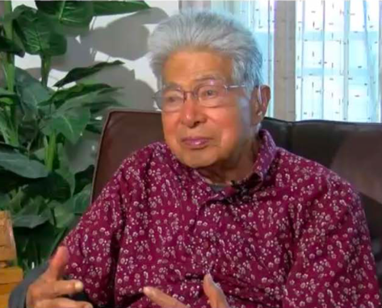
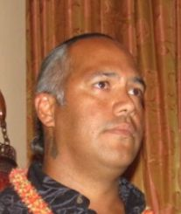
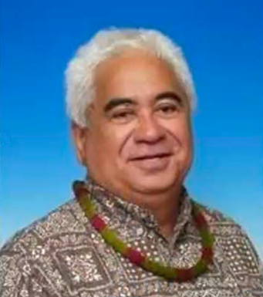
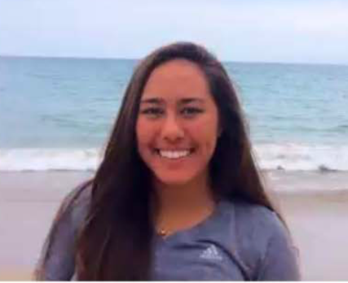

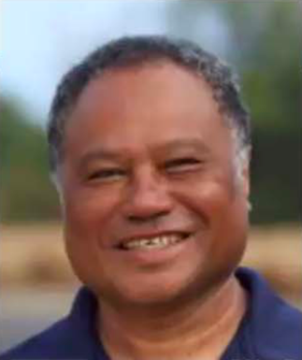
1) Hawaii’s Public Opinion:
We Continue to Support TMT
Daniel K Akaka
(former US Senator)
Keahi Warfield
(President of PUEO : Perpetuating Unique Educational Opportunities)
Robert Lindsey
（OHA trustee）
Mailani Neal
(Efforts collecting 7000 signatures to support TMT)
Heather Kaluna
(First native Hawaiian Astronomer from UHH)
Kalepa Baybayan
(Captain on Hokulea, native navigator)

Slide 13


1) Hawaii’s Public Opinion:
We Continue to Support TMT
Yes
No

Slide 14
1) Hawaii’s Public Opinion:
We Continue to Support TMT
Yes
No

Slide 15
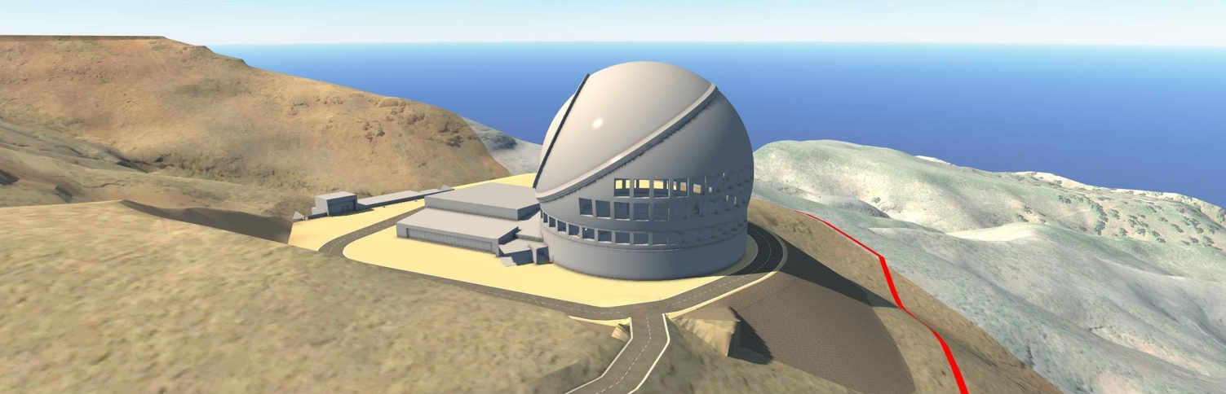



TMT Backup Plan
Site Other than Hawaii
Maunakea (Plan A) remains the first priority site.
Recommendations from TMT-J SAC meeting (Oct 14)
→ Japan supports ORM (La Palma @Spain) as alternative site
Oct 26~27, 2016: TIO Board selected ORM as alternate site
March 29, 2017: TIO and Instituto de Astrofisica de Canarias (IAC) signed Agreement on Hosting the TMT in La Palma
TMT Alternate Site Investigations
Observatorio del Roque de los Muchachos
Site Perspectives

Slide 16
TMT-J activities

Slide 17



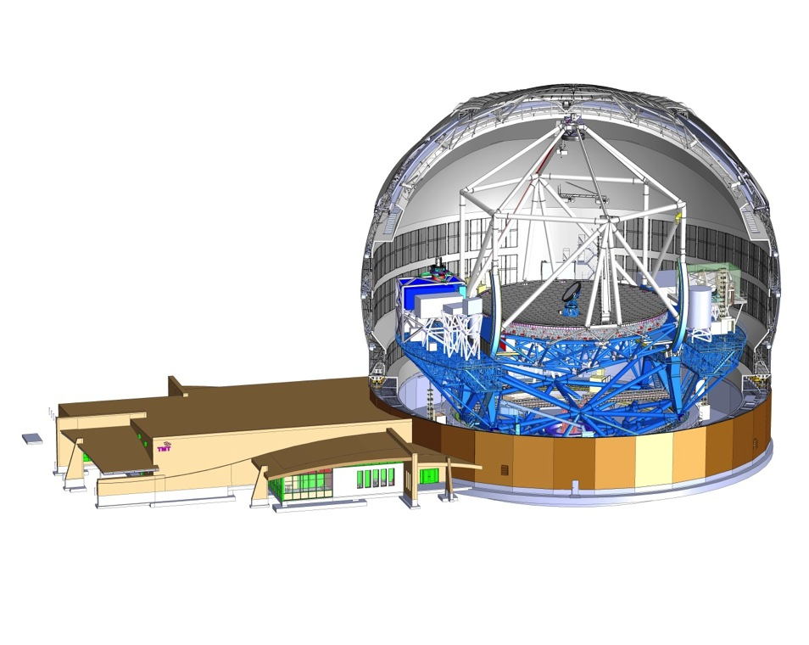



Members’ contributions
Telescope
Enclosure
M1 blank
M1 polish
M2
30％
40％
Instruments
15％
15％
AO
M3
Facility
Control Systems
& Software

Slide 18
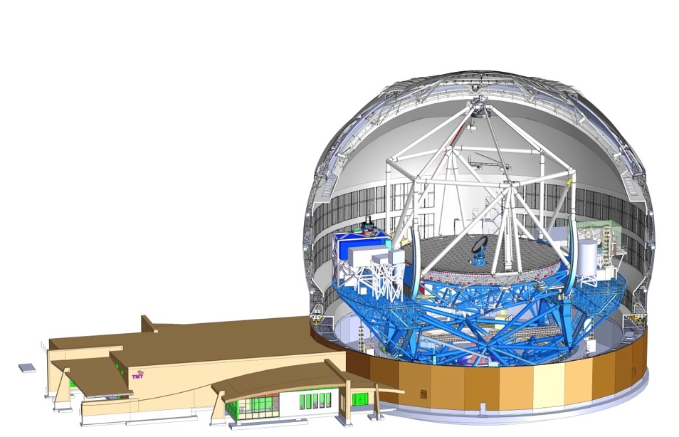
2）Japan’s Contributions
Telescope
M1 blank
M1 polish
30％
Instruments
Design fabrication / installation of the telescope structure,
Providing all the primary mirror segment blanks,
Polishing 30% of the primary mirror blanks,
Developing part of the First Generation Instruments, and
Cash contributions to cover common expenses etc.

Slide 19
TMT-J Budget approved (FY2018)
http://www.mext.go.jp/component/b_menu/other/__icsFiles/afieldfile/2017/12/22/1399821_1.pdf
Promotion of Big Academic Research Project (e.g., TMT)

Slide 20
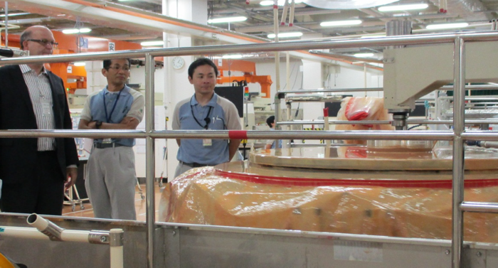
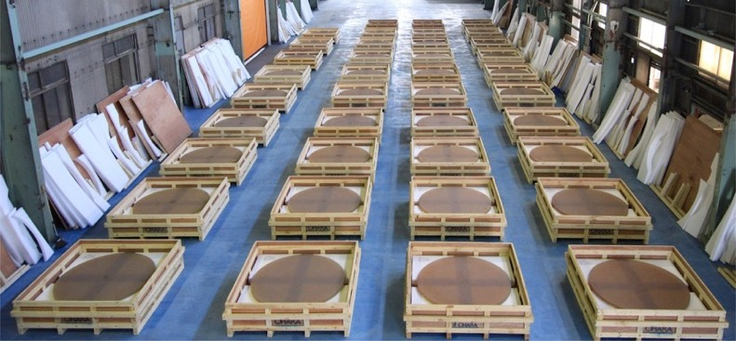



２）TMT-J activities:
M1 Blank & Polishing
Process of works | FY2013 | FY2014 | FY2015 | FY2016 | FY2017 (Plan) | Total
Blank (plano-plano) | 60(29) | 39(0) | 65(31) | 49(21) | 52(36) | 265(117)
Spherical Grinding | 12(0) | 19(0) | 63(29) | 60(52) | 60(36) | 214(117)
Aspherical Grinding | 12 | 16 | 33 | 8 | 0 | 69
Aspherical Polishing |  |  | 6 | 6 | 10 | 22
(#) for partners
50th Blank backside Polished
107 Blanks produced (2015 Oct)

Slide 21
２）TMT-J activities:
M1 Blank & Polishing
Mirror Blank from Japan Successfully Shipped to Bengaluru, India

Slide 22
２）TMT-J activities:
Telescope Structure (STR)
Strengthen Team management including risk mitigation in 2017
Currently at Final Design Phase to prepare for fabrication
  Final Design Review Phase (FDRP) 1, 2, D2, and 3 completed.
Major actions from FDRPs to be completed by FDRC (final design review completion)
Move to Fabrication Phase after FDRC in 2018
Masao Saito became TMTJ-STR-WP manager since 2017 Mar.
Takashi Nakamoto and George Kosugi join the TCS-MCS ICD (telescope-control ICD) discussion
Saeko Hayashi has taken some charge of quality assurance (QA) of STR since 2017 July

Slide 23
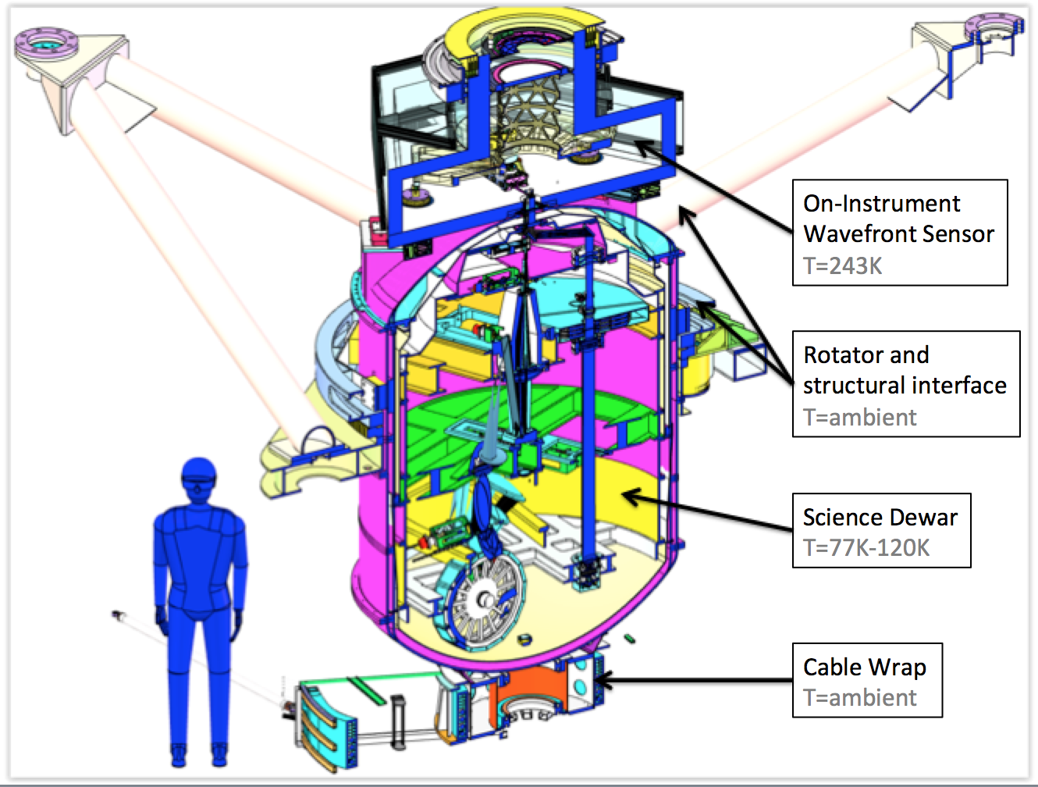
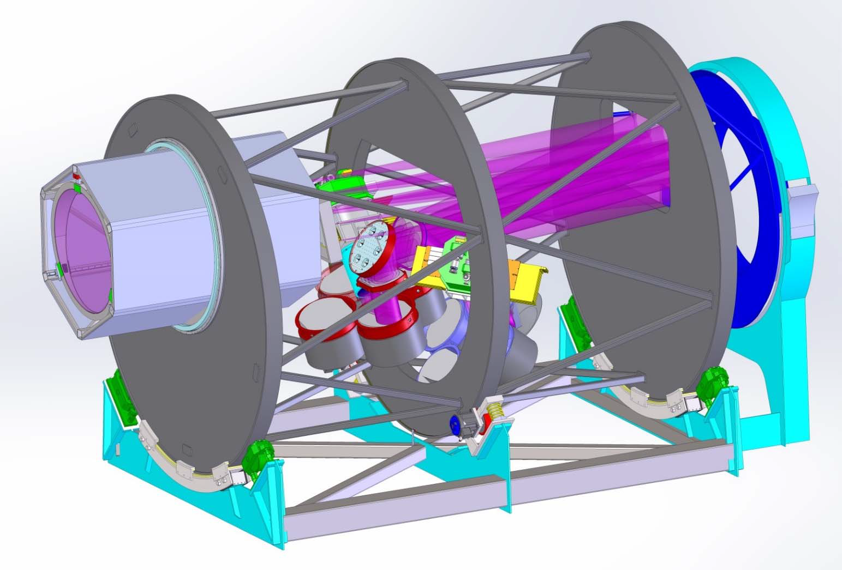

２）TMT-J activities:
Early light Sci. instruments
IRIS (near-IR Imager and Spectrometer):
  λ=0.8~2.4 μm, FOV=34”x34”, R=4000~8000
  Final Design Phase will be started soon
WFOS (Wide-field Optical spectrometer)
  λ=0.31~1.1 μm, FOV=40.3’ squared, R=1000~8000
  Conceptual Design Phase
WFOS
6m

Slide 24

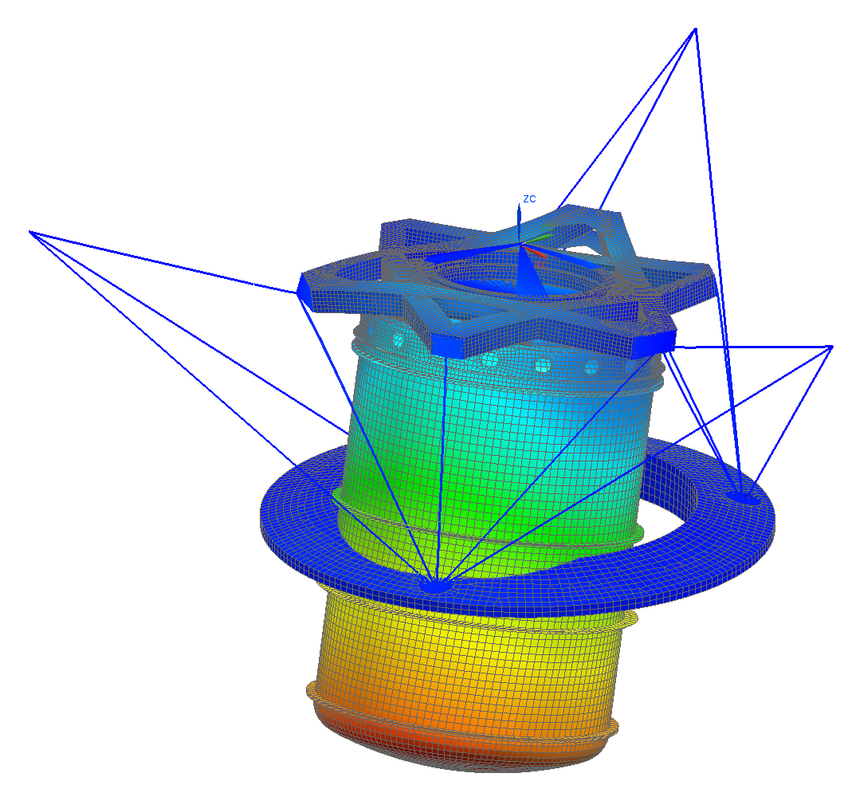
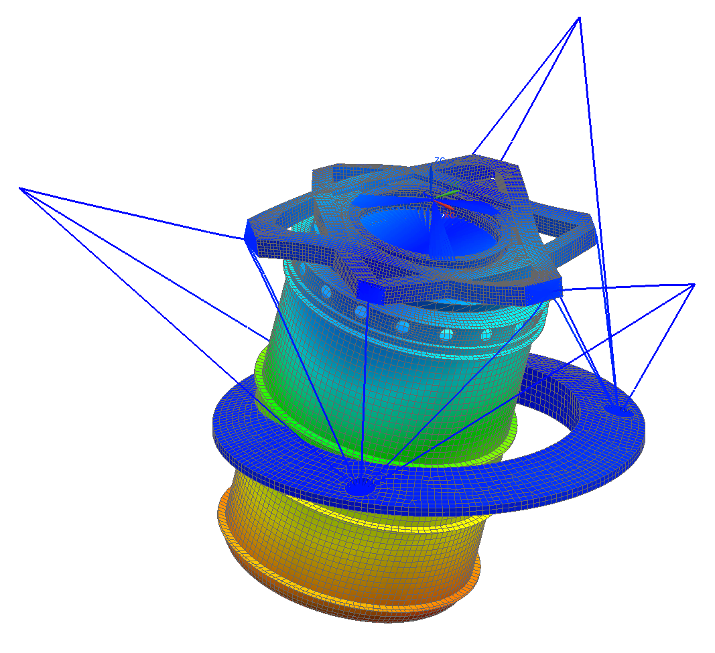
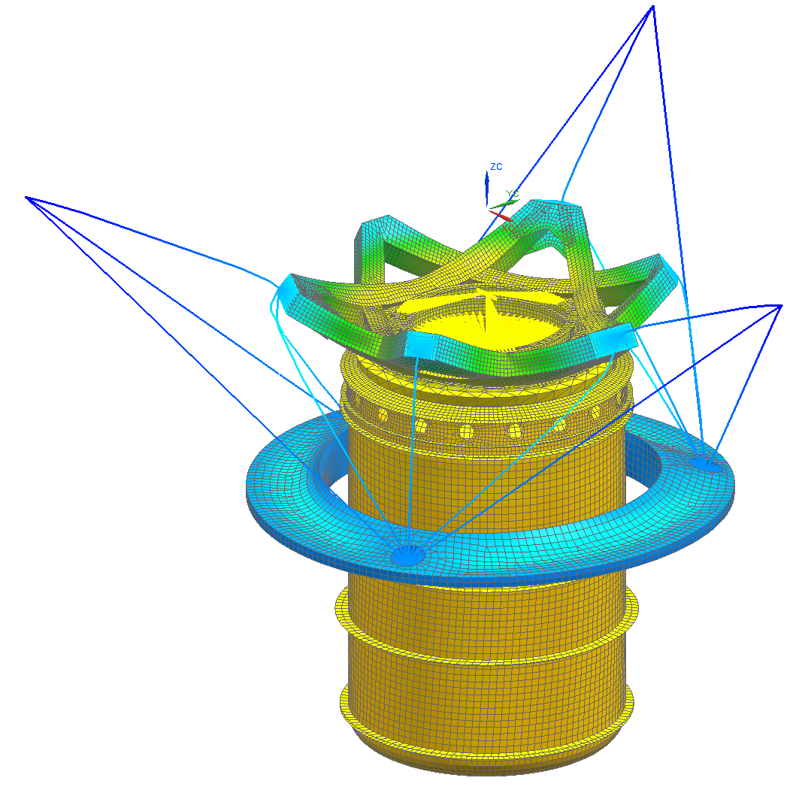
２）TMT-J activities:
IRIS imager design
PDR-1（2016 Nov 17~18）
  Action Items → Analysis & Studies
    Required accuracy for cold stop and pupil alignment
    Effect of inter-pixel capacitance of H4RG
    Mode analysis of IRIS.
PDR-2（2017 Sep 20~21）
  Feedbacks from PDR-1
  Software, Control system (Electronics), QA plan, FMEA, etc.
  Cost
FD phase will be started soon
1st mode 13.8Hz
2nd mode 13.8Hz
3rd mode 20.1Hz
rotation
rotation
translation

Slide 25
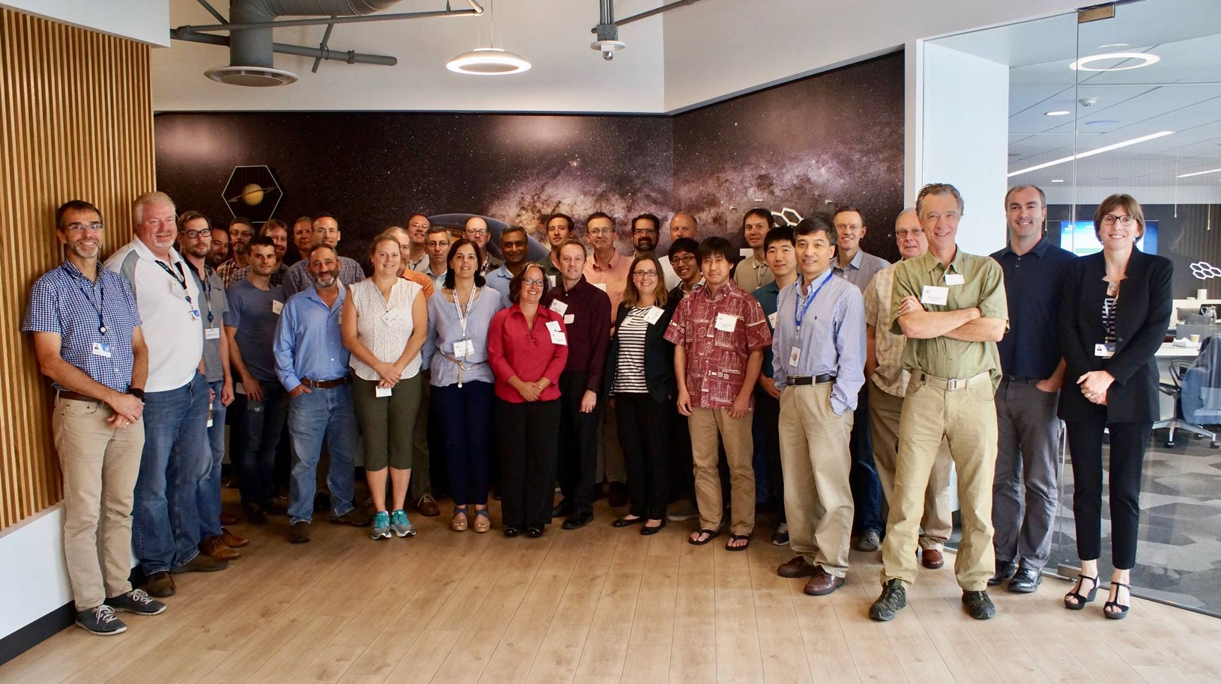
２）TMT-J activities:
IRIS PDR2

Slide 26
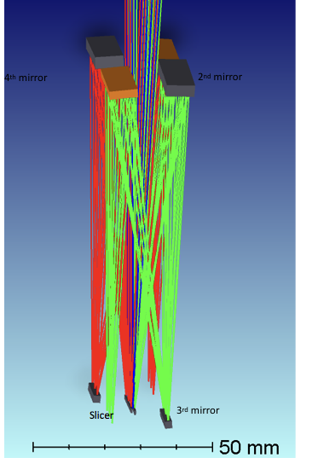
２）TMT-J activities:
WFOS
  WFOS is in the phase of down selection study of two architectures: fiber and multi-slit with slicers
  WFOS-J committed to study optical design of the slicers, conceptual design of the slicer positioner, and the camera design by Spring 2018.
  The slicer design has been mostly completed with a novel 4 mirror system (right).
confidential
New 4-mirror design
Compared with the previous 2-mirror design, its tilt tolerance becomes dramatically loosen

Slide 27
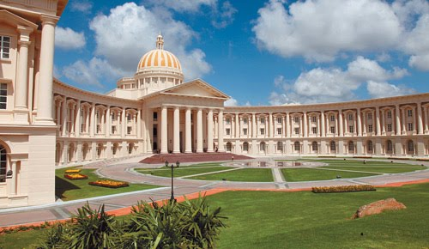

TMT 5th Science Forum
TMT 5th annual Science Forum was held in Nov 7~9, 2017 @ Infosys campus (Mysore, India)
2nd Generation Science instruments’ concepts were discussed.
→ Call for TMT Instrumentation White Papers (Mar 21st)
https://www.youtube.com/watch?v=DQ5Zn8WFavE
Infosys, Mysore

Slide 28
TMT 5th Science Forum
5 splinter sessions:
High resolution spectroscopy (photo)
Near-IR multi-object spectroscopy
Thermal IR (MIR) instrumentation (partially joint w/ High Contrast)
High contrast / ex-AO instrumentation (partially joint w/ MIR)
Broad spectral coverage spectrophotometry/polarimetry (e.g., for time domain follow-up)

Slide 29
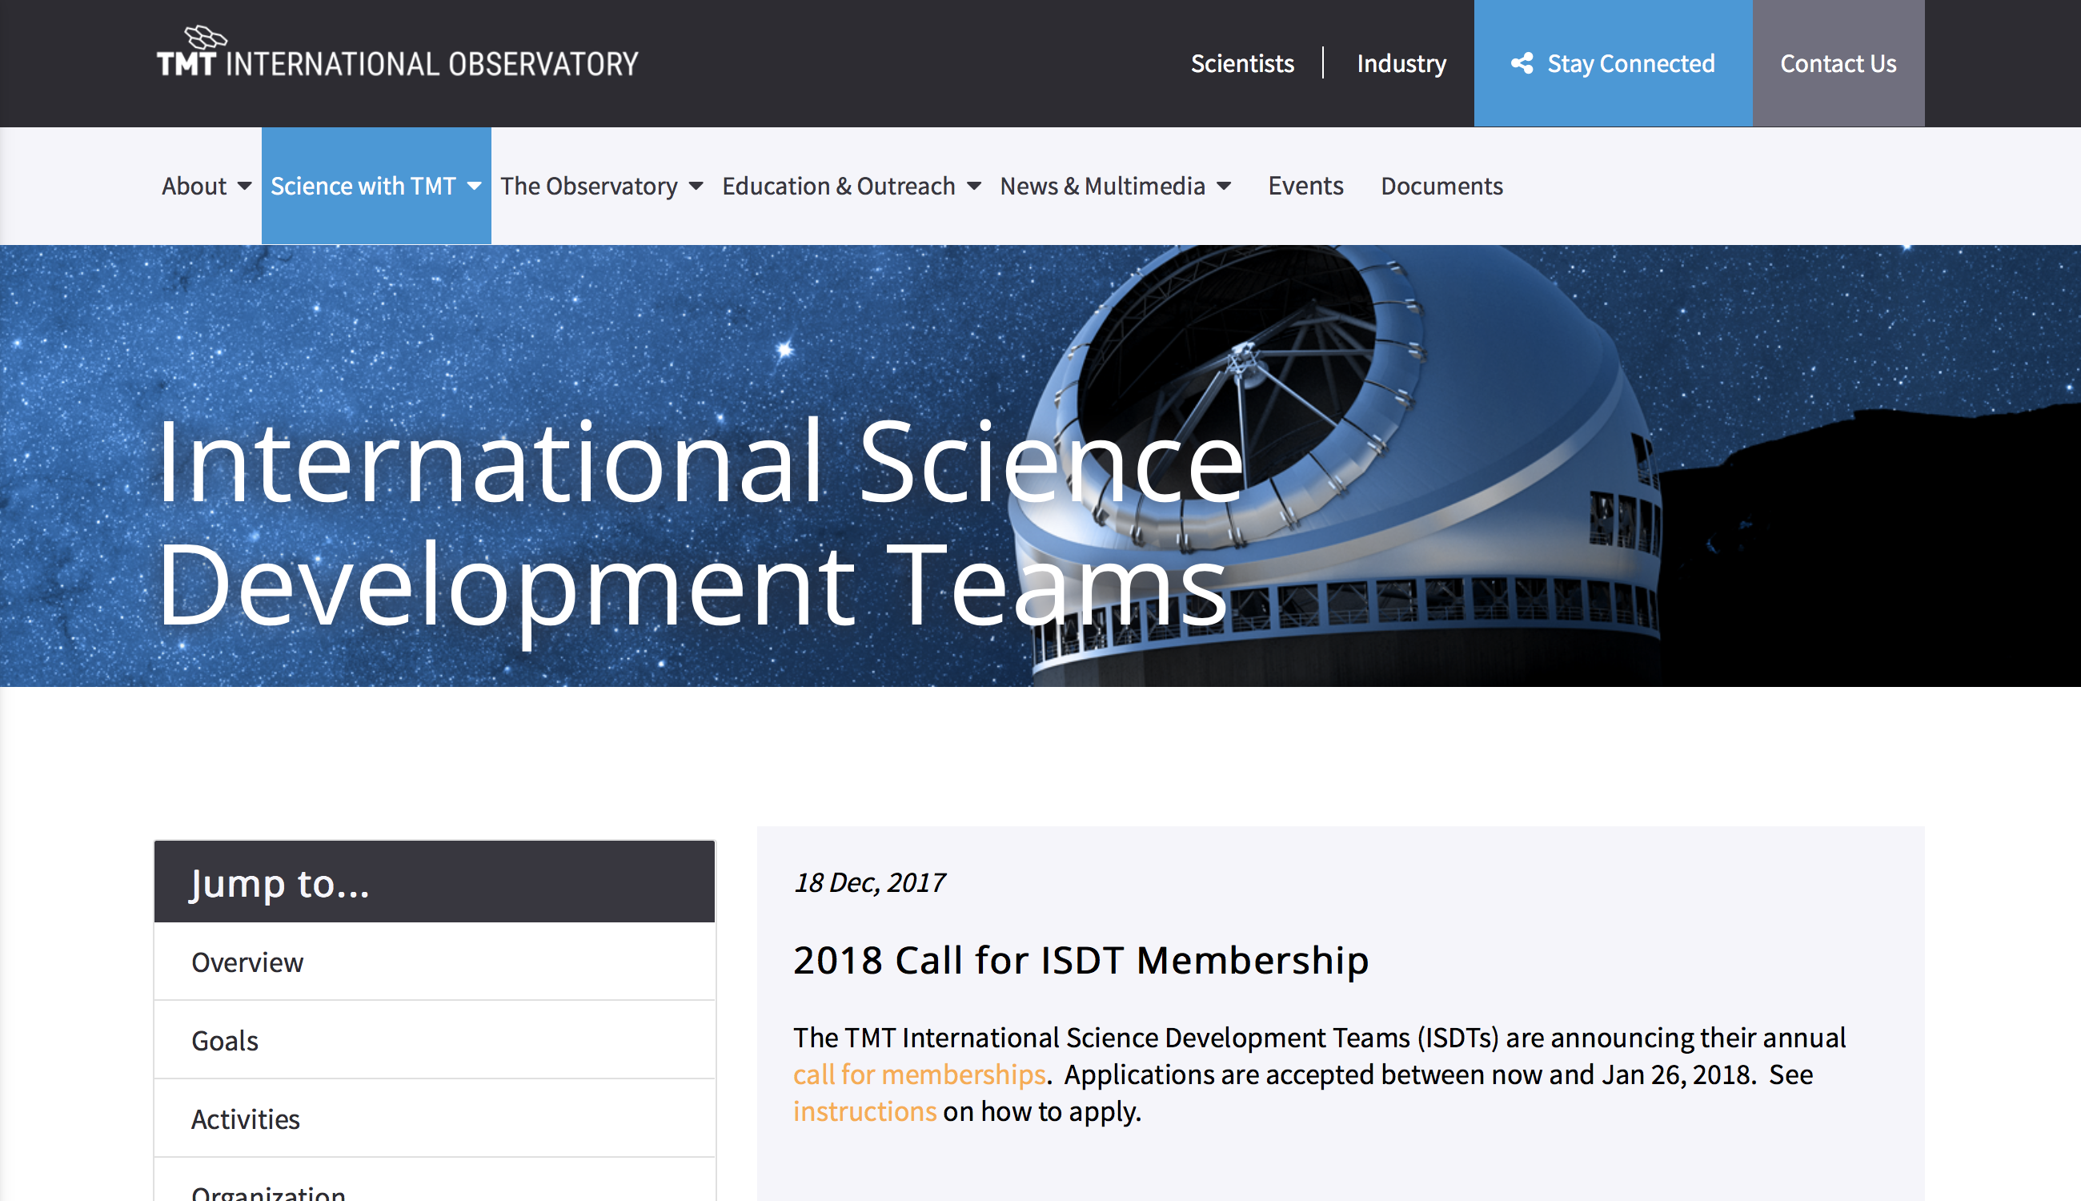
ISDT
Call for ISDT Membership by Jan 26th, 2018

Slide 30
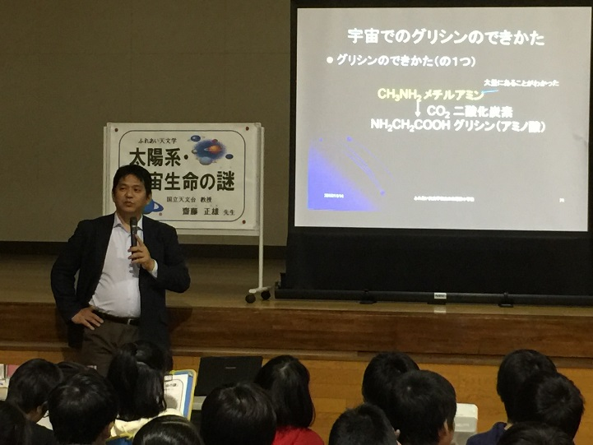
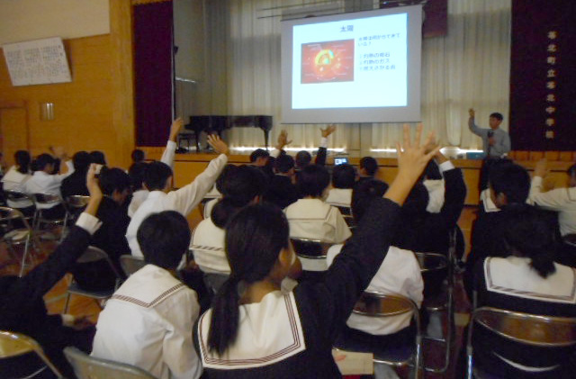
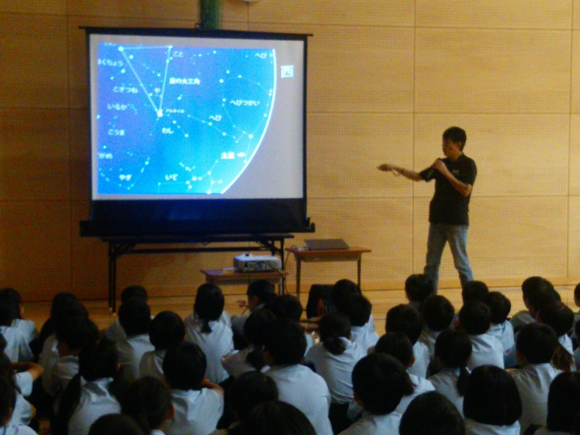
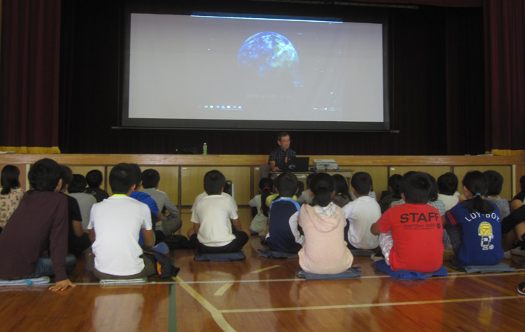
2）TMT-J activities: EPOC
Fureai Tenmongaku
Astronomers visit elementary/junior high schools across Japan
Obihiro, Hokkaido
Kumamoto, Kyusyu
Hachijojima
Oita, Kyusyu
Notes:
講演会 14都府県で43件、ラジオ講演2件

Slide 31
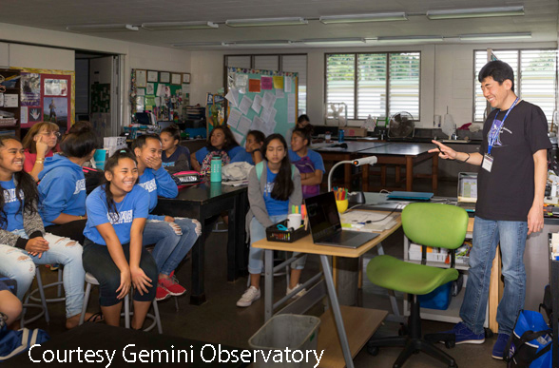
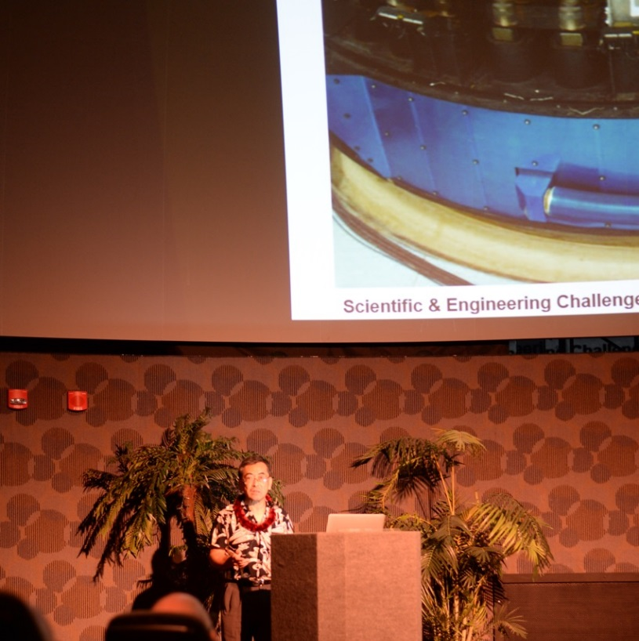
2）TMT-J activities: EPOC
Lectures @Hilo, Hawaii
Journey through the Universe
  TMT-J joined the event since 2014
  This year, Usuda talked about ”Robotics Devices for Subaru Telescope & TMT” at Hilo Intermediate school and Waiakea Intermediate school
Maunakea Sky talk at Imiloa Astronomy Center
Notes:
講演会 14都府県で43件、ラジオ講演2件

Slide 32
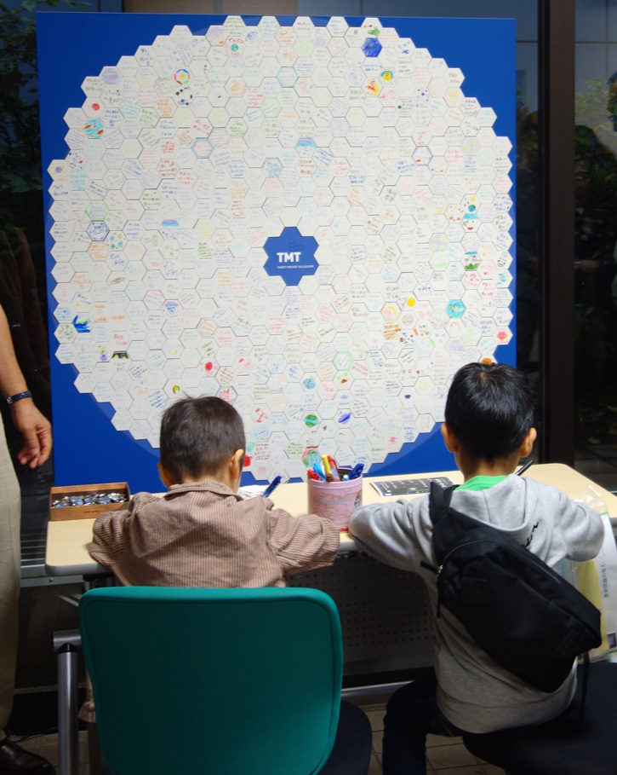
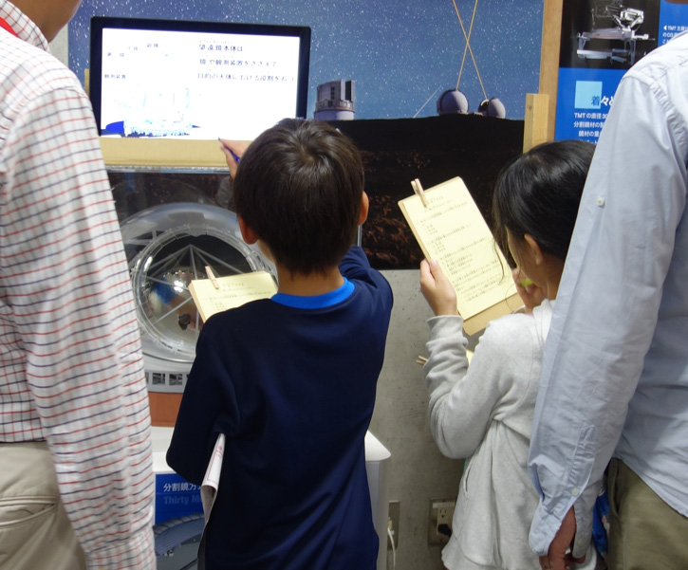
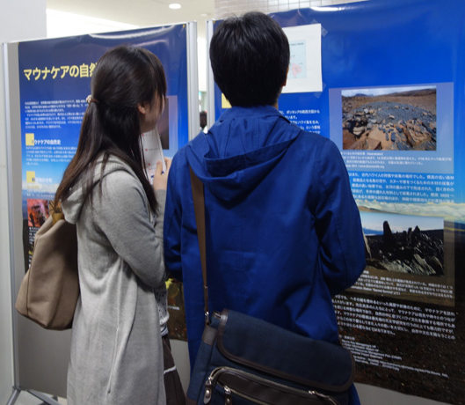
2）TMT-J activities: EPOC
Mitaka Open House Day 2017
TMT Quiz!
Support messages to TMT
on mirror segments
Photoelectric Meridian Circle
Natural and Cultural resource in
Maunakea was introduced
Notes:
講演会 14都府県で43件、ラジオ講演2件

Slide 33
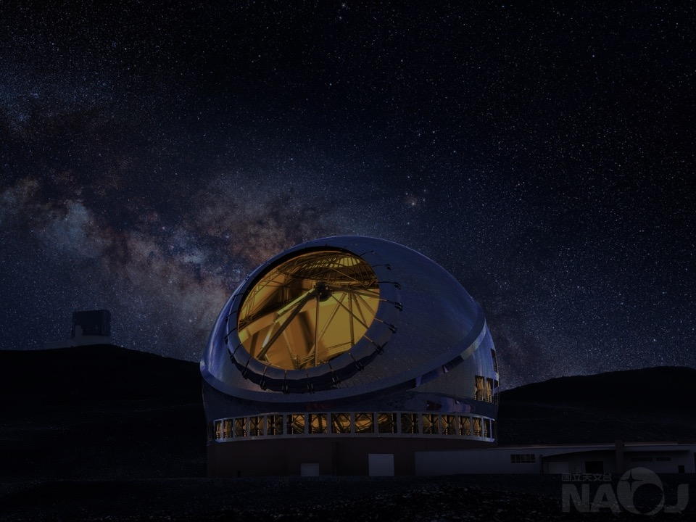
Summary
CDUP re-approved in September 28
Onsite construction expected to resume in April 2018
TMT-J members are working to overcome the current severe situation with TIO, Hawaii community
Japan’s contributions (Primary Mirrors, Telescope Structure, Sci. Instruments, etc.) are on going well
5th TMT Science Forum @India in Nov 7~9
Call for White Paper 2nd Generation Science Instrumentation White Paper (due March 21st )
We appreciate Hawaii for astronomy at Maunakea

