Slide 1

Subaru Access Interests from China
- Response to EAO/Subaru new initiative
Suijian Xue
National Astronomical Observatories
Chinese Academy of Sciences
NAOJ, Mitaka, Jan. 18, 2018

Slide 2
1. Searching for outlying populations in the Milky Way
Galactic stars showing abnormal kinematics and/or chemical compositions, i.e., outlying populations were formed during
  Enrichment of the early generation of SN: metal-poor stars
  Merging history of the halo: moving groups, low-α stars
  Particular nucleosynthesis environments: chemically peculiar stars
Outlying populations constrain the environment and mechanism of their birth and evolution: key to fully understand the history of our Galaxy
LAMOST provides a great opportunity to enlarge the sample

Slide 3
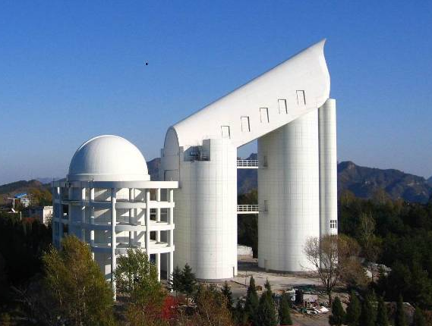
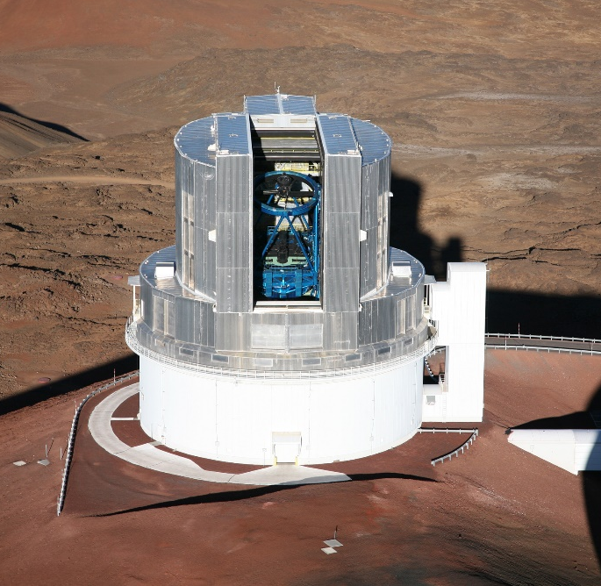
Subaru/HDS follow-up spectroscopy for a large sample of outlying populations found with LAMOST
(PIs: Gang ZHAO & Wako AOKI)
High-resolution spectra are demanded to really understand the nature and origin of these peculiar stars
LAMOST+Subaru joint searching project since 2014
LAMOST
Subaru Telescope/HDS

Slide 4
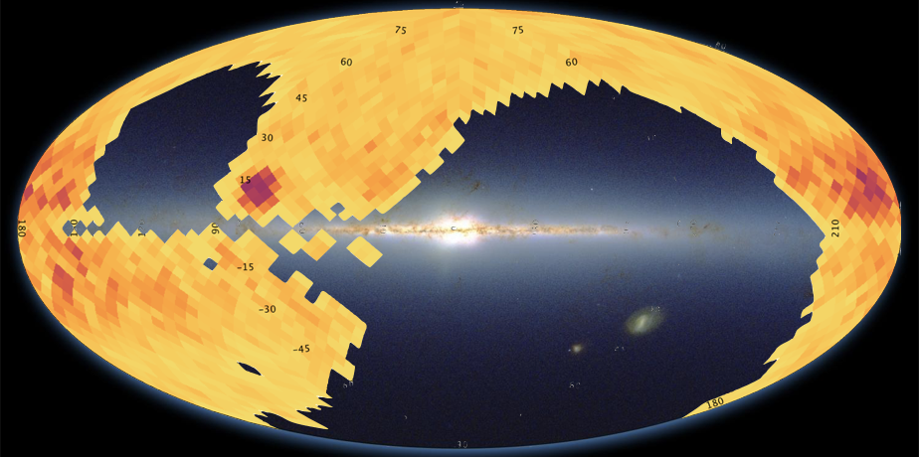
LAMOST data releases (DR5) 06/19
DR5 ~ 7,500,000 spectra (sn>10); AFGK catalogue ~ 5,300,000 stars
Large survey area (North 7700 deg² + South 3500 deg²)
Target selection
Random selection for a given magnitude/temperature range.
suitable for investigating statistics

Slide 5
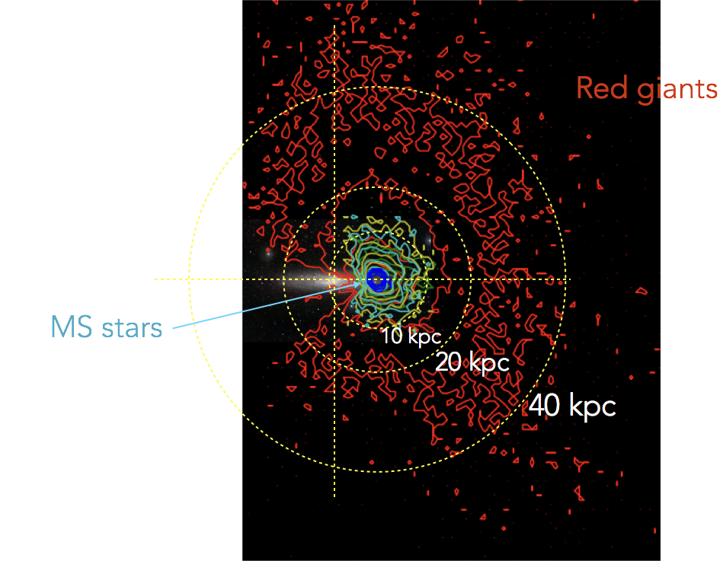
Spatial distribution of the LAMOST samples

Slide 6
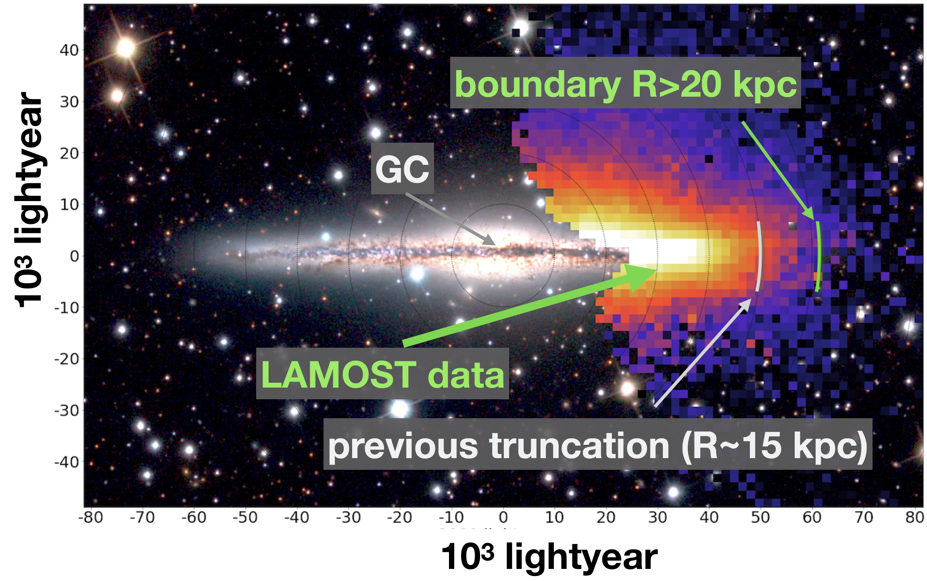
LAMOST reveals a large Galactic disc
LAMOST data shows that the Galactic disc does not truncate within 20 kpc
Liu et al. 2017, RAA, 17, 96

Slide 7
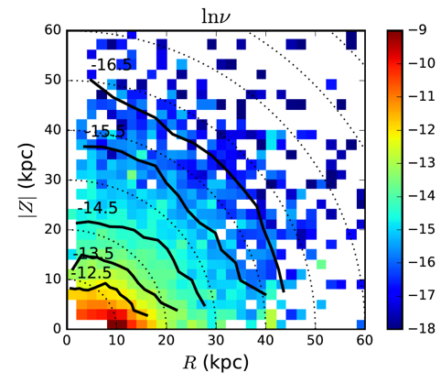
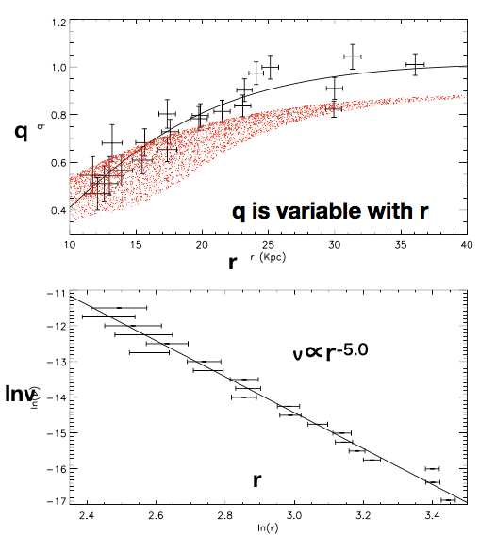
The stellar halo is oblate inside and spherical outside
Xu, Liu et al. 2018, MNRAS, 473, 1244
Liu et al. 2017, RAA, 17, 96
The axis eratio q changes from 0.5(r~12kpc) to around 1 (r~30 kpc)
The density profile follows a single power law with index of-5

Slide 8
Subaru/HDS follow-up spectroscopy for a large sample of outlying populations found with LAMOST
(PIs: Gang ZHAO & Wako AOKI)
Joint proposal for Subaru open-use program
  Normal + Service + Intensive
CAS-JSPS joint project (on-going)
Important results obtained
  Large sample of ~350 very/extremely metal-poor stars
  A dozen (super) Li-rich giants
  A dozen moving group member and low-α stars
A number of refereed papers published
Interests on EAO/Subaru time allocation

Slide 9
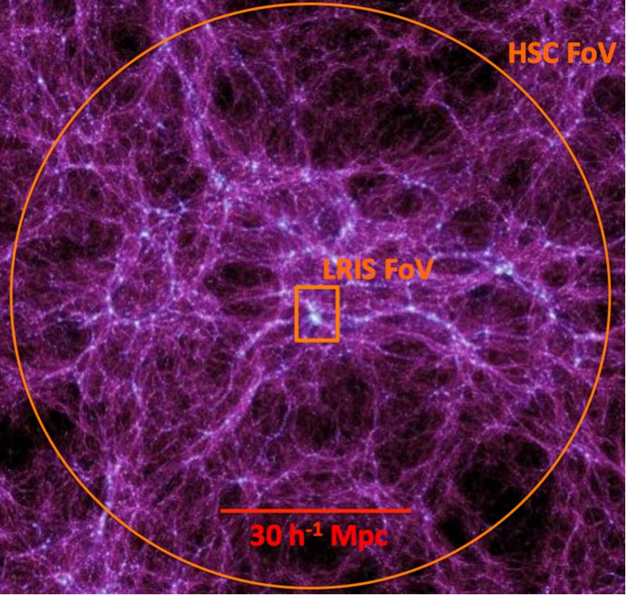
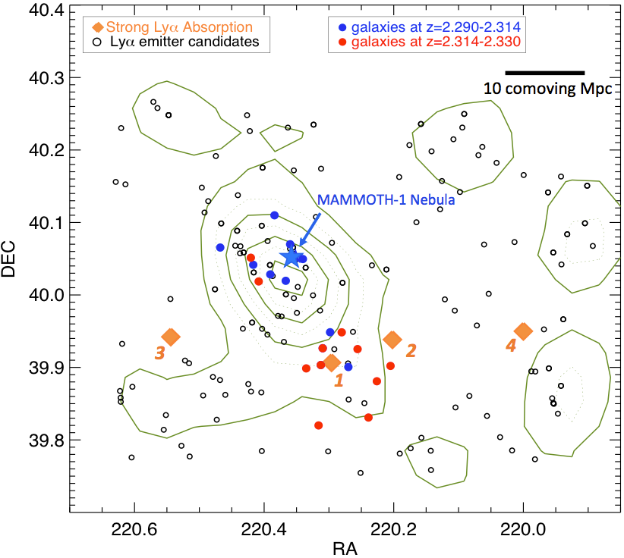
2. MApping the Most Massive Overdensity Through Hydrogen (MAMMOTH)
The most massive protocluster at z=2.3 traced by group of Lya absorption, Subaru/HSC can go much deeper and also go wider area to completely reveal the large-scale structures at high-z
HSC has a
Keck
Cai et al. 2017b

Slide 10
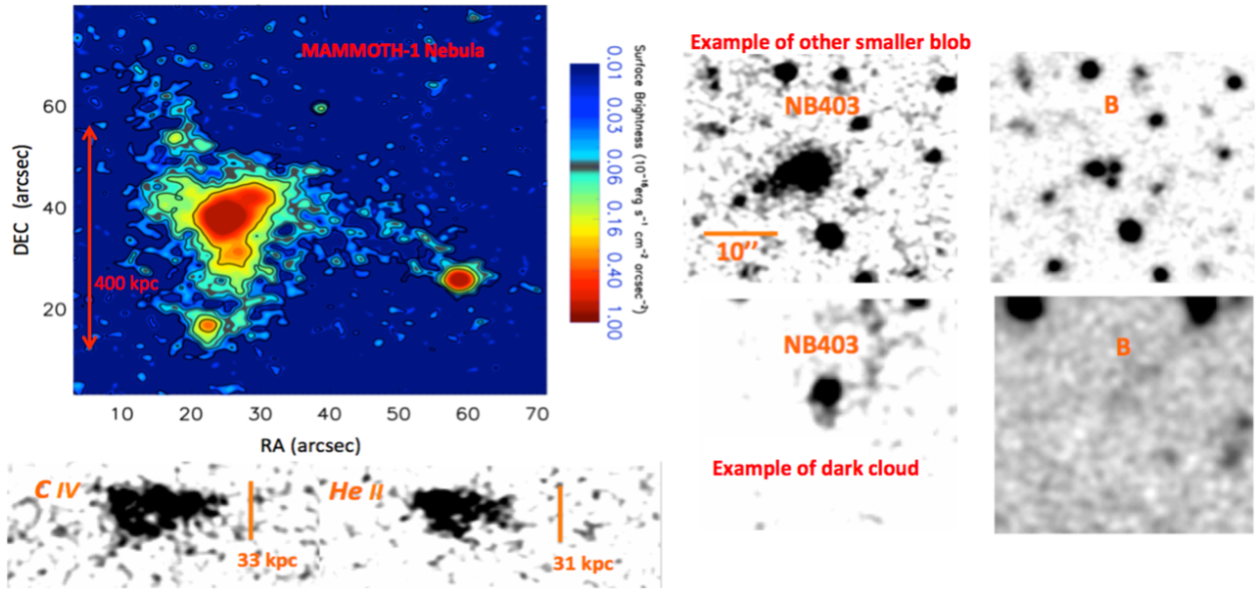
Reveal the intergalactic medium using the Lyman alpha emission utilizing giant Lya nebula in extreme overdensities
largest Lya nebula at z=2.3, Cai et al. 2017a

Slide 11
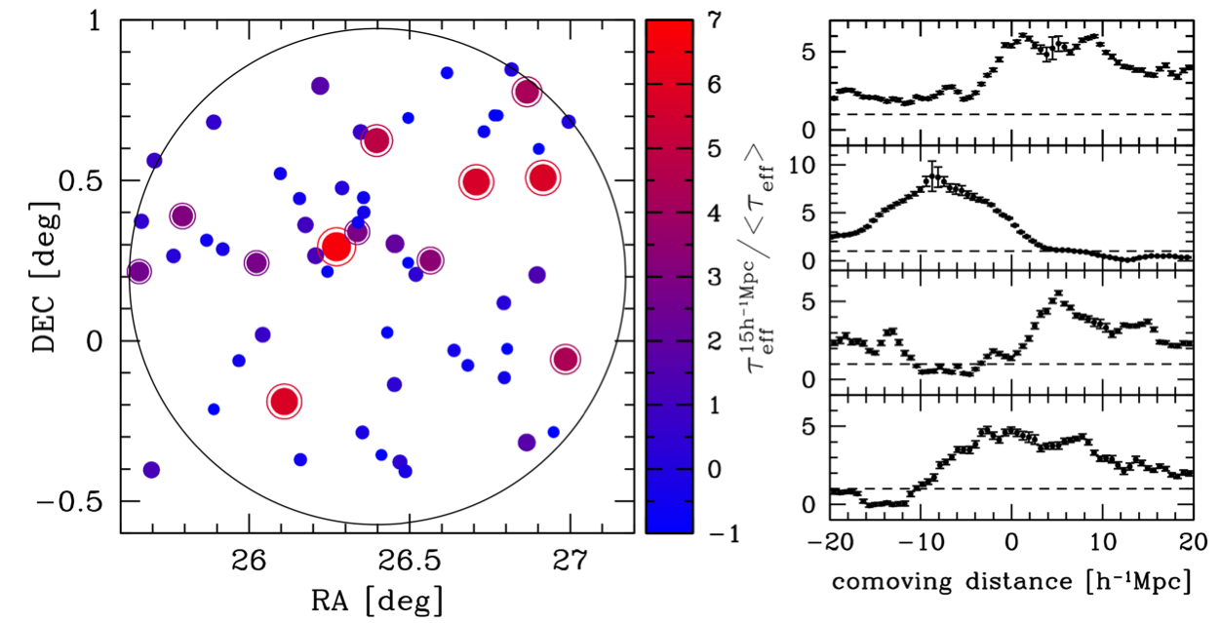
Each Subaru HSC field contains >20 background SDSS QSOs;
HSC will detect LAEs; SDSS-III QSO can provide IGM absorption. Fully probing LAE- HI correlation.
Subaru-MAMMOTH project (3-night in 17B);
PI: Nobunari Kashikawa;
co-PI: Zheng Cai (UCSC/Tsinghua)

Slide 12
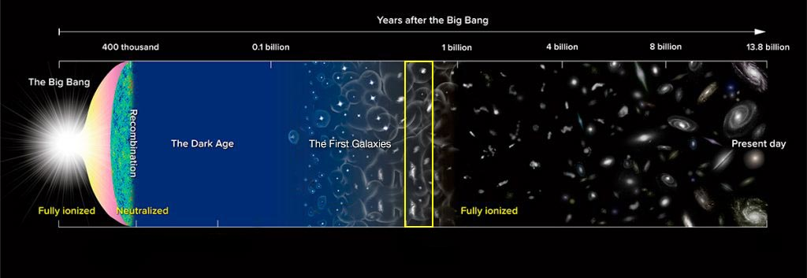
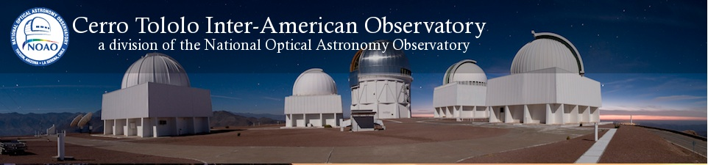
3. Lyman Alpha Galaxies in the Epoch of Reionization (LAGER)
CHINA
USA
CHILE
Junxian Wang (USTC),
Zhenya Zheng (SHAO)
Weida Hu (USTC),
Wenyong Kang (USTC)
Linhua Jiang (PKU/KIAA),
Chunyan Jiang (SHAO),
Xu Kong (USTC),
Xianzhong Zheng(PMO) …
James Rhoads (ASU, NASA),
Sangeeta Malhotra (ASU, NASA),
Alicia Gonzalez (ASU),
Tianxing Jiang (ASU),
Vithal Tilvi (ASU) ,
Steven Finkelstein (U. Texas), …
Leopoldo Infante (LCO),
Huan Yang (LCO)
Felipe Barrientos (PUC),
Gaspar Galaz (PUC),
Franz Bauer (PUC),
Alistair Walker (NOAO-CTIO)
Pascale Hibon (ESO), …
Notes:
Competition from HSC

Slide 13
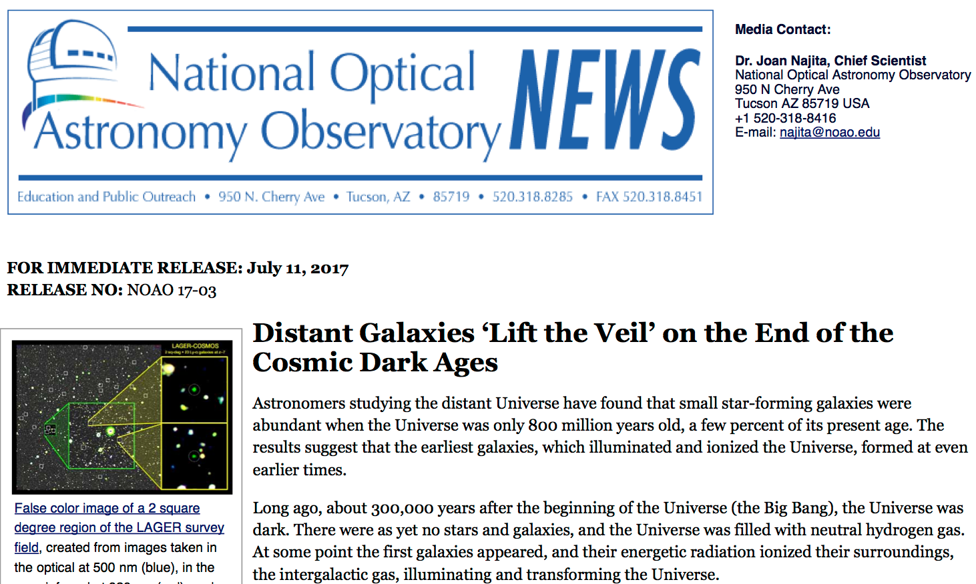
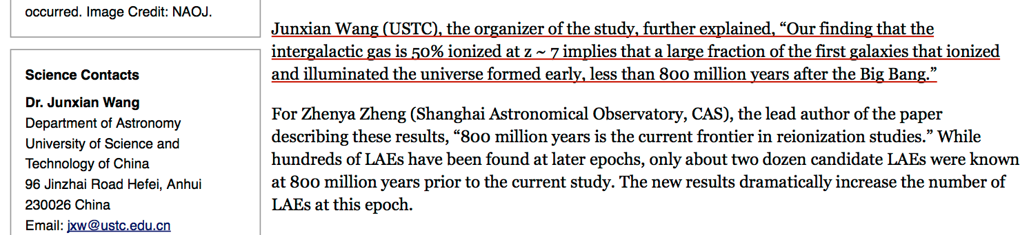
NOAO press release

Slide 14
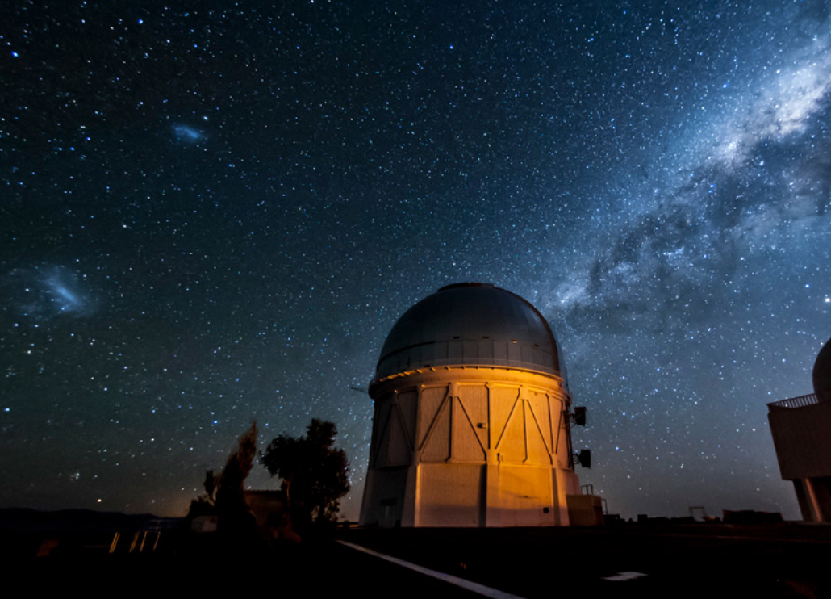
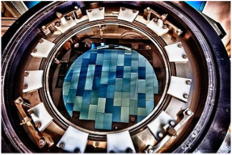
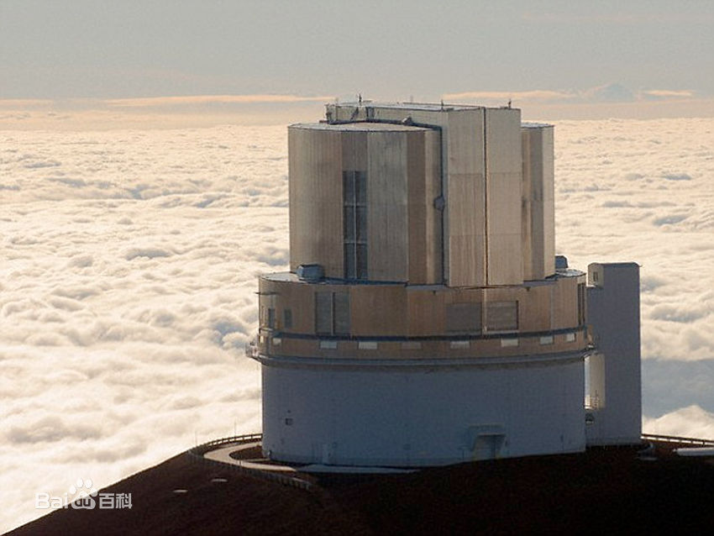
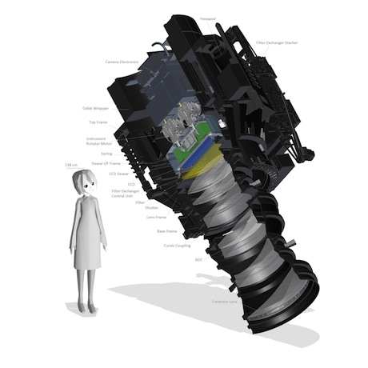
+
CTIO 4m Blanco Telescope
DECam (FOV = 3 sq-deg)
Go deeper and wider
Collaboration!
+
Subaru 8m
HSC, 1.5deg FOV
Notes:
Materion

Slide 15
Summary & suggestion
Strong interests from different groups
Main concern is the expensive cost, one night ~ 100K US$
A suggested solution is the combination of “cash + in-kind”
  e.g. one night charge
  2/3 goes to operation
  1/3 goes to soliciting for manpower, supporting astronomers, engineers, and technicians

