Slide 1

Probing Ionized Gas on Galactic Scale
With Subaru
Junfeng Wang
Department of Astronomy
Taotao Fang
Dean of the College of Physics
Xiamen University, China
Subaru Users Meeting FY17 @ NAOJ, Mitaka

Slide 2
IGM/CGM absorption and emission
(slides provided by Prof. T. Fang)
HSC, PFS
Notes:
First I will introduce his scientific interest mainly focus on IGM/CGM

Slide 3
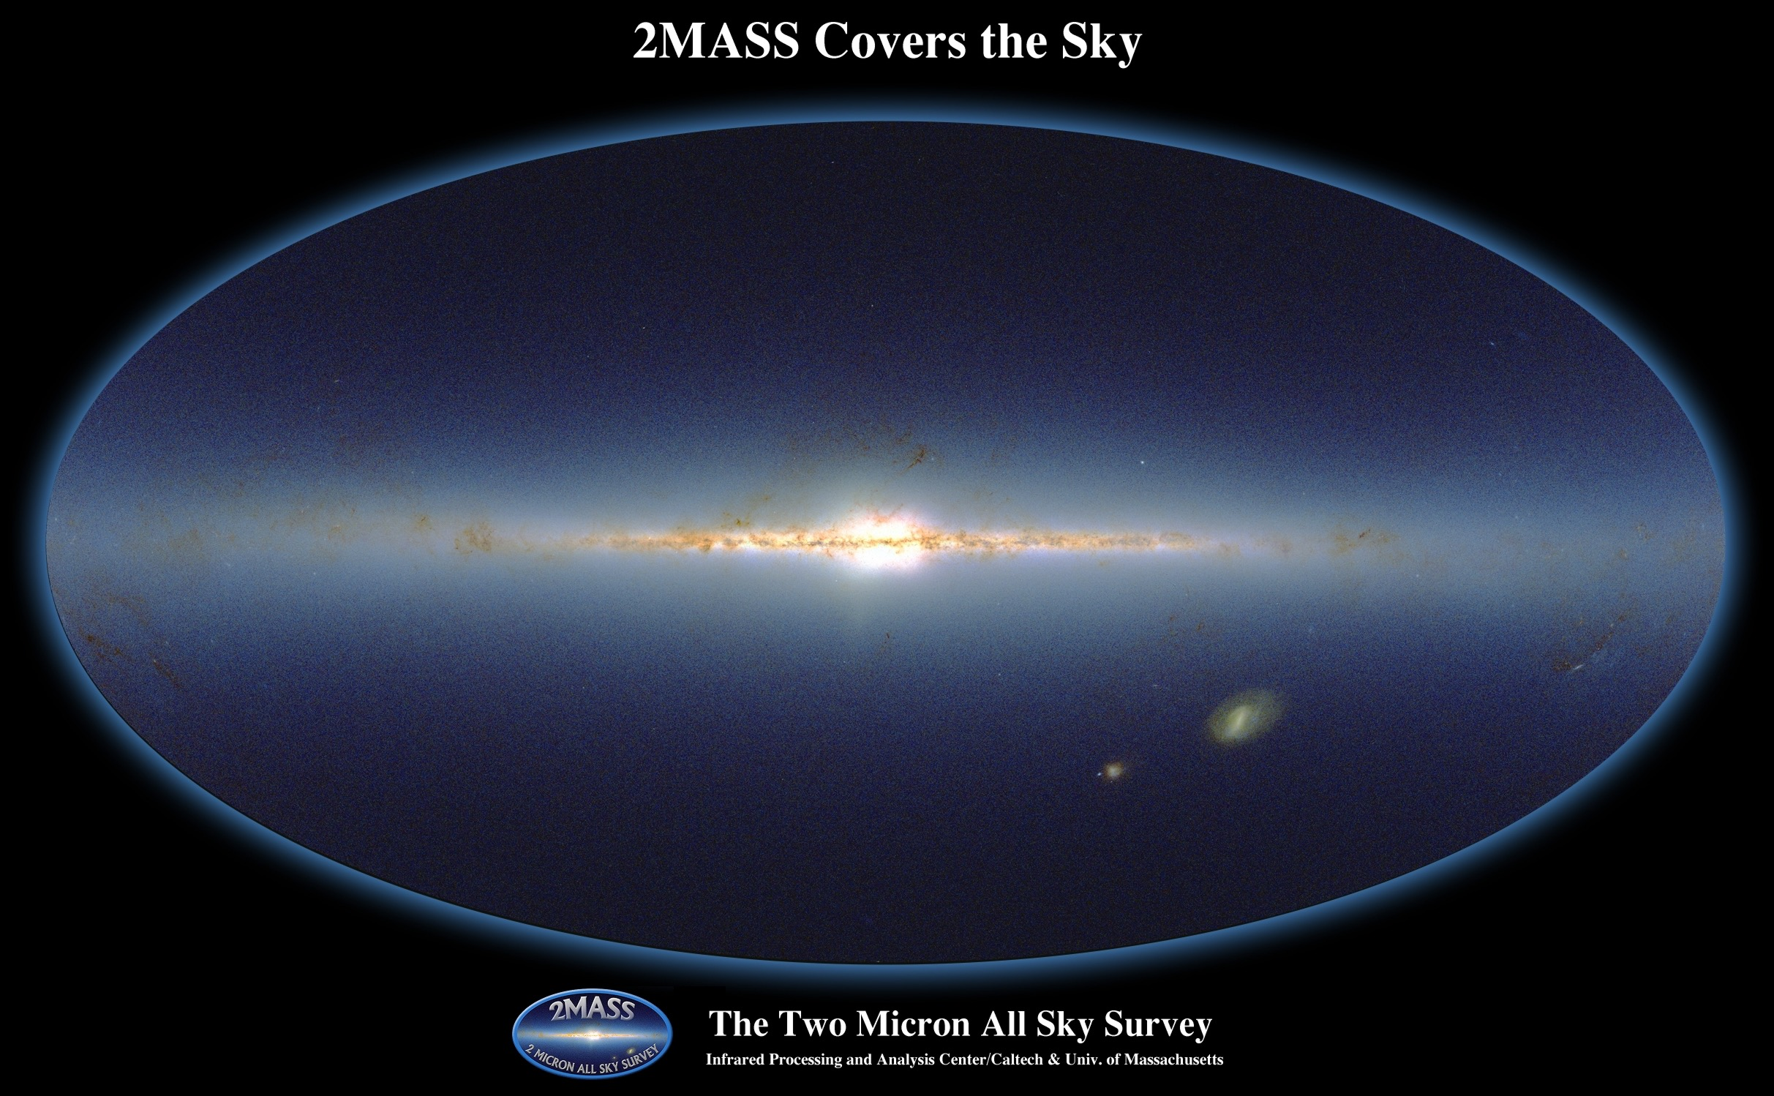
IGM
IGM
CGM
Star + ISM
It is impossible to understand the process of galaxy formation and evolution by studying the stellar component alone; CGM, IGM, as well as the local environment, play vital role in this process
Notes:
For those not familiar with the term CGM

Slide 4
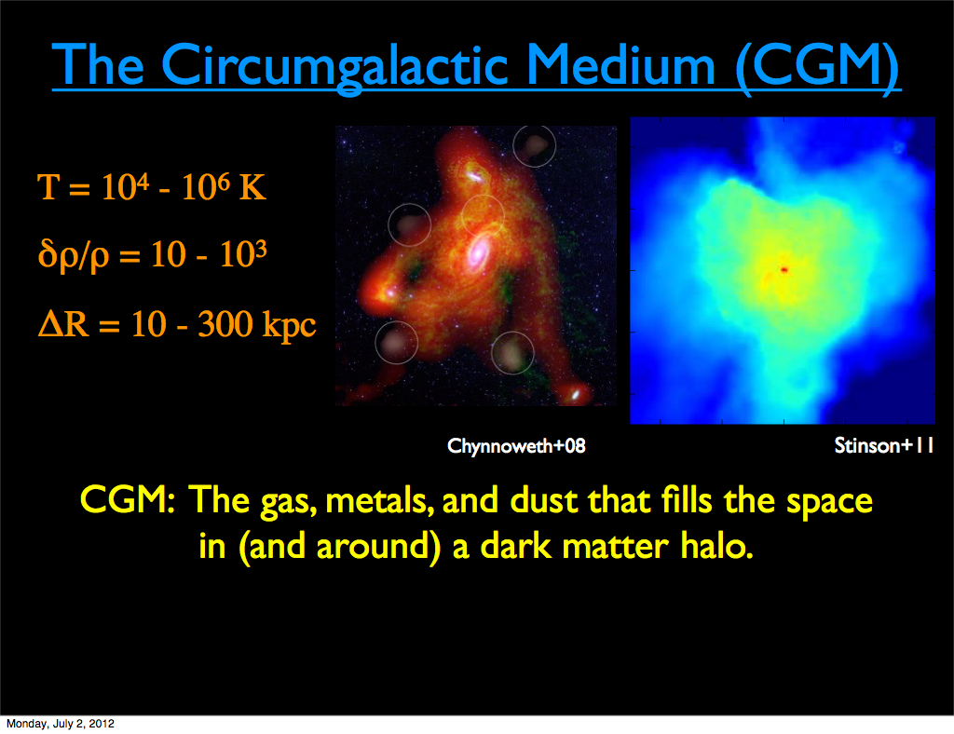
500 kpc
Prochaska (2016)

Slide 5
Detection Method: Absorption
Notes:
Because of the low gas density, most frequently used detection method is via absorption towards a bright background source (typically quasar)
Ions in the gaseous halo would leave absorption lines allowing physical properties of CGM gas metallicity etc.

Slide 6
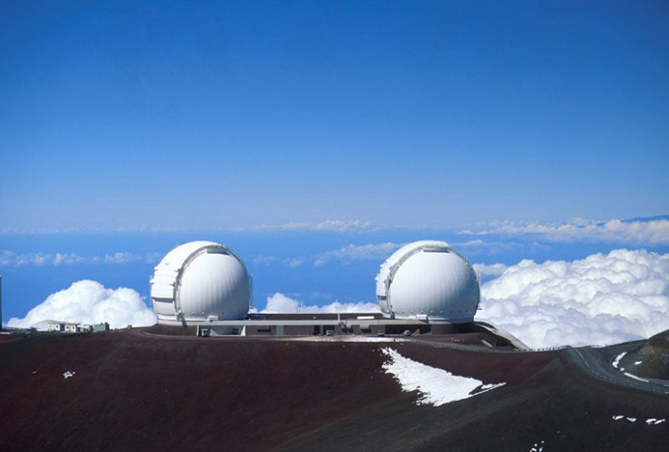
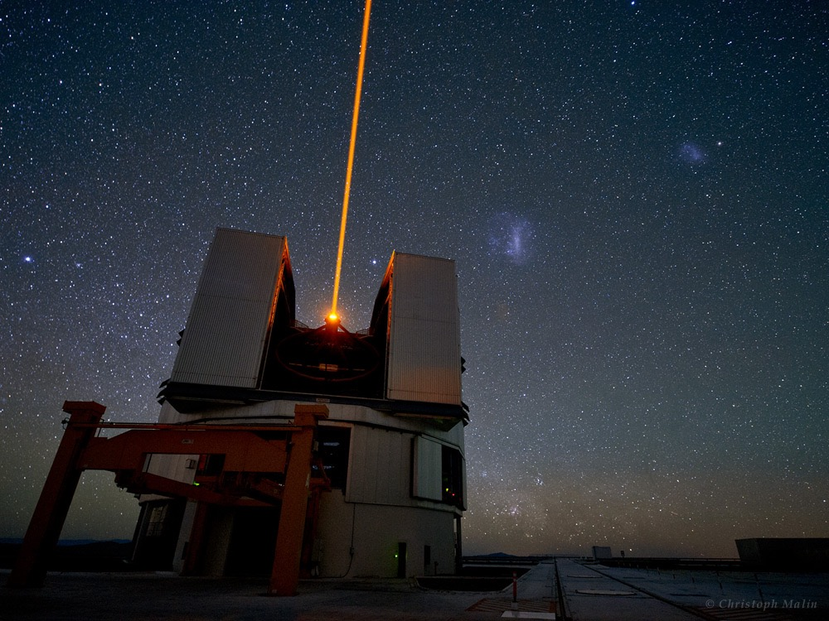
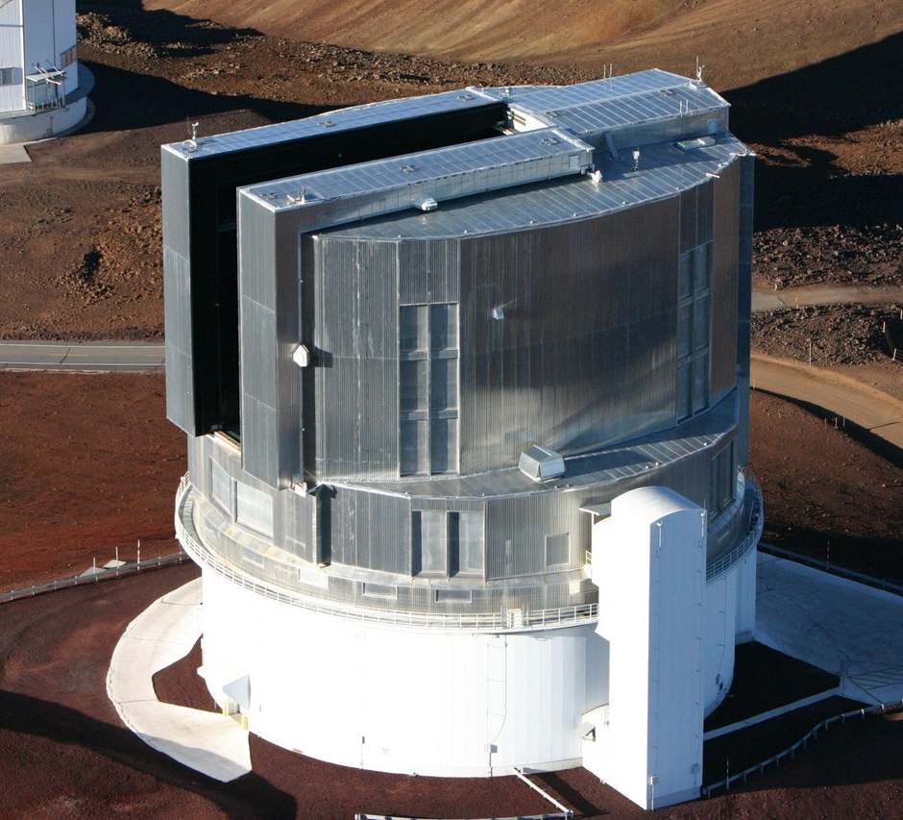
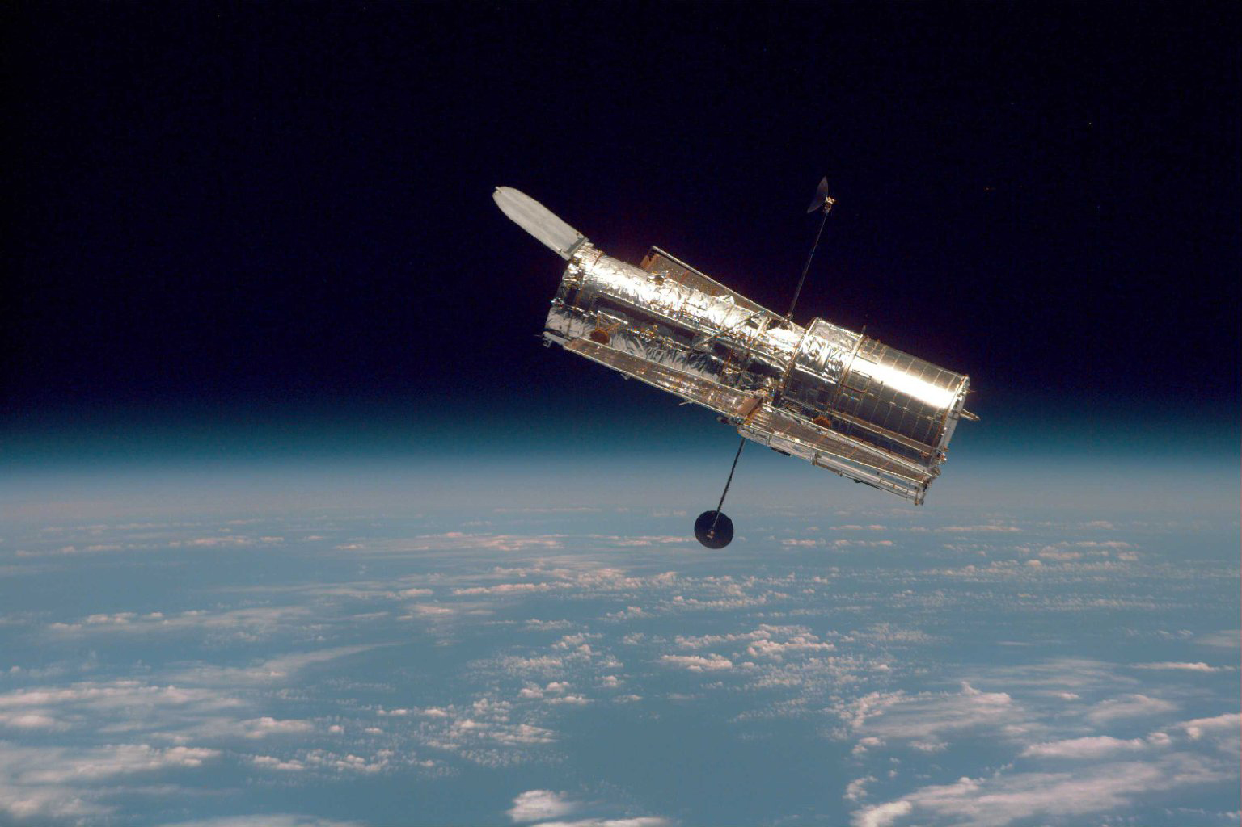
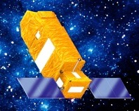
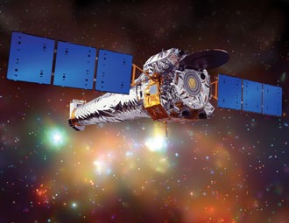
IGM/CGM Study: core science of modern 6-10 meter ground-based and space-based telescopes
Prof. Fang is a member of the PFS collaboration
Keck: HIRES, ESI, KCWI
VLT: UVES, MUSE
Subaru: HSC, HDS, PFS
HST: FOS, GHRS,
STIS, COS
Chandra
FUSE

Slide 7
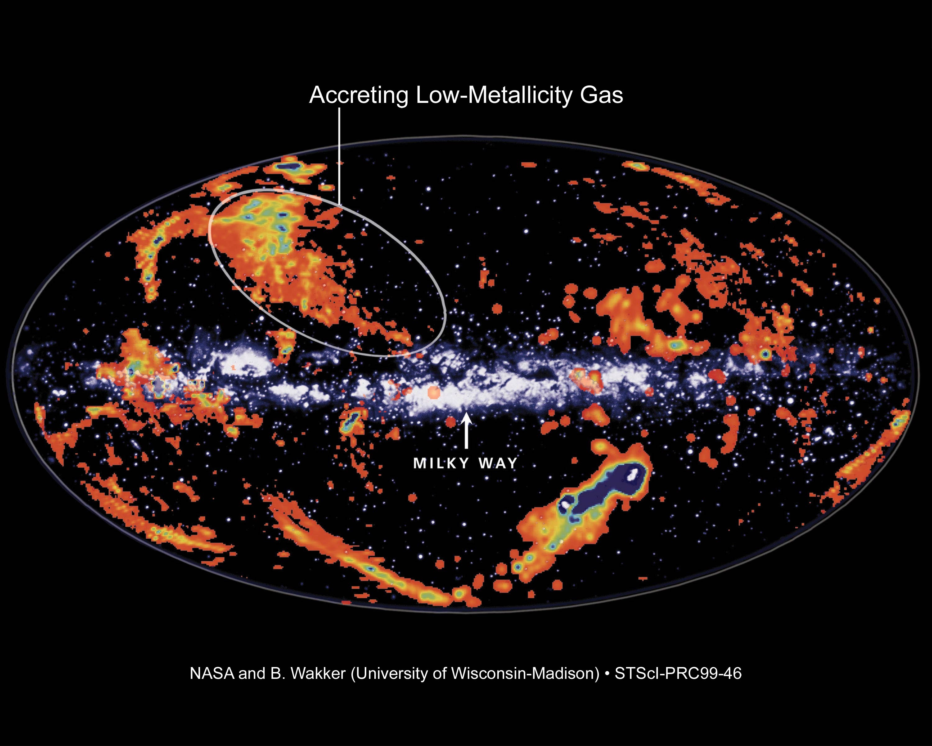
high velocity clouds (hvc)
key question: where are these hvcs, disk or halo?
Notes:
This figure shows the so-called “high velocity cloud” around our Galaxy. These clouds were first observed in 21-cm emission and later were observed in absorption in the spectrum of background AGNs. These gas clouds get their name because their velocities deviate significantly from the values suggested by the differential galactic rotation.
The origin of these clouds remain a mystery for many years, although people suspect they might be inflow accreting gas from the distant halo.

Slide 8
HST/COS observations of halo stars vs AGNs
Lenher & Howk (2011)
Notes:
Recently, Lenher & Howk did a survey of halo stars with within a distance of a few kpc, and they tried to compare the HVCs detected in the UV spectra of these halo stars with those from AGNs.

Slide 9

AGN
Halo Star
Halo stars: distance between 3 and 20 kpc
None of the halo stars show HVCs at > 170 km/s, suggesting:
  HVCs at < 170 km/s: located in the neighborhood of the disk, supplying the on-going star-formation in the disk
  HVCs at > 170 km/s: located at larger distances, maybe the next wave of infalling material
More important: these are ionized HVCs, suggesting a large amount of mass that is enough to maintain the star formation in our Galaxy!
Richter+(2009)
Lenher & Howk (2011)
Notes:
Very interestingly, they found a significant differences between the two type of spectra. Left panel is a typical AGN spectrum, and the right panel is a spectrum from a halo star.
None of the halo stars shows any HVCs at > 170 km/s.

Slide 10
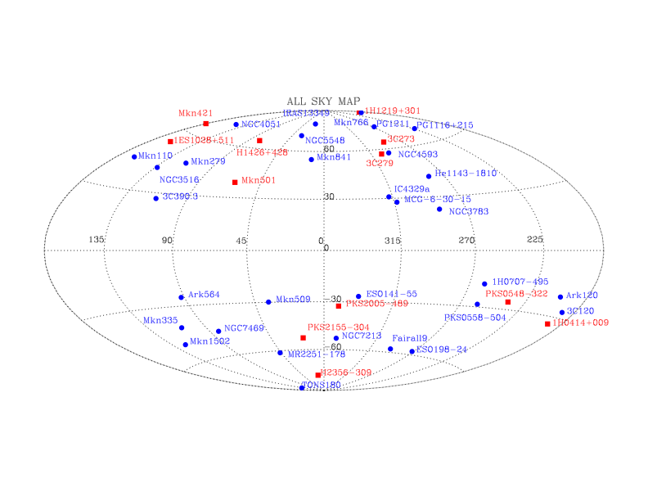
X-ray OVII absorption
Fang et al. (2015)
Notes:
Recently, we did a comprehensive survey of extragalactic, X-ray bright targets, to systematically study the local X-ray absorption lines.

Slide 11
Hα Absorption in MW Halo: From SDSS
Zhang & Zaritsky (2017) Nature Astronomy
SDSS DR12, stacking of 750,000 galaxies
Detecting z=0 observer’s frame Hα absorption line
Width suggest a velocity matching the escape velocity of the halo
Notes:
The combined, continuum-normalised, line of sight spectrum in the region of rest frame Hα for over seven hundred thousand SDSS galaxy spectra.
The apparent motion of the absorbing gas as a function of longitude as measured from the Hα and 6496 A absorption lines.

Slide 12
What about external galaxies?
Long-standing puzzle in quasar absorption line study:
Where are these absorbers? Galaxies or the IGM?
COS-Halos Survey
39 QSOs at redshift around 0.5
44 foreground galaxies with R < 150 kpc, with z between 0.15 and 0.35
28 star-forming galaxies, 16 passive galaxies
Tumlinson et al. (2013)
Notes:
One of the main science goals of the cosmic origin spectrograph is just to solve this puzzle. The advantage of COS is its extremely high sensitive, so one of the key projects, COS-halos project, is to use background QSOs to probe the halo, or CGM region of the foreground galaxies.
In the COS/halo project. A total of 39 QSOs at redshift 0.5 were selected as background sources, and 44 foreground galaxies were identified within an impact distance of 150 kpc. These galaxies have redshift ranges between 0.15 and 0.35
The 44 foreground galaxies include 28 …
This picture shows the projected distance, or impact parameter of each QSO in the foreground galaxies. The left shows the passive galaxies, and the right shows the star-forming galaxies.
这里我简单提一下一个COS-Halos巡天项目，就是利用39个背景QSO来研究位于前景的星系晕内气体。
这39个类星体都在红移0.5左右。沿着这39个视线方向上他们选择了44个前景星系，红移在 0.15 到 0.35 之间。视线方向到星系中心的impact distance在150kpc以内。
这44个前景星系包括28个star-forming galaxies，16个passive galaxies。

Slide 13
Absorbers are associated with galaxies!
Tumlinson+ 2013
Notes:
The first result they found is that there are absorptions everywhere, and the absorbers are indeed associated with individual galaxies! This is the plot shows the HI absorption line column density as a function of projected distance from galaxy center. The green ones are … and the red ones are …
This is Mg II …
他们首先发现到处都有吸收线系统，并且这些吸收线系统的确是和星系联系在一起。这个图显示的是中性氢的柱密度，as a function of the impact parameter，即到星系中心的距离。
图中蓝色标记 star-forming galaxies，红色表明 passive galaxies。

Slide 14
Absorbers are associated with galaxies!
Tumlinson+ 2013

Slide 15
Absorbers are associated with galaxies!
Tumlinson+ 2013

Slide 16
And highly ionized OVI are associated with star-forming galaxies!
Tumlinson+ (2013)
Notes:
Another extremely interesting discovery is that they found highly ionized metals such as OVI are in general associated with star-forming galaxies. Passive galaxies typically show very little or no OVI absorption lines.
The left plot shows the OVI column density as a function of projected distance. Again, the green ones are … the red ones are …
The right panel shows the OVI-absorber line center velocity as a function of the host galaxy mass. These two curves show the escape velocity. It is clear that these absorbers are bounded to the galaxies.
另外一个非常重要的发现是他们发现。高度电离的金属离子，比如OVI，一般而言是和 star-forming星系联系在一起。
这张图显示的是 OVI 吸收线柱密度和 impact parameter 的关系。蓝色是 star-forming 星系，红色是 passive 星系。实心表明有探测，空心表明没有探测到，只是上限。我们可以看到，大部分star-forming 星系是实心，而大部分passive 星系是空心。
右边这张图显示的是OVI吸收线速度和星系质量的关系。这上下两个曲线代表星系的逃逸速度。这些探测到的吸收线大部分位于逃逸速度之间，表明这些吸收线系统的确是被星系引力束缚住的。

Slide 17
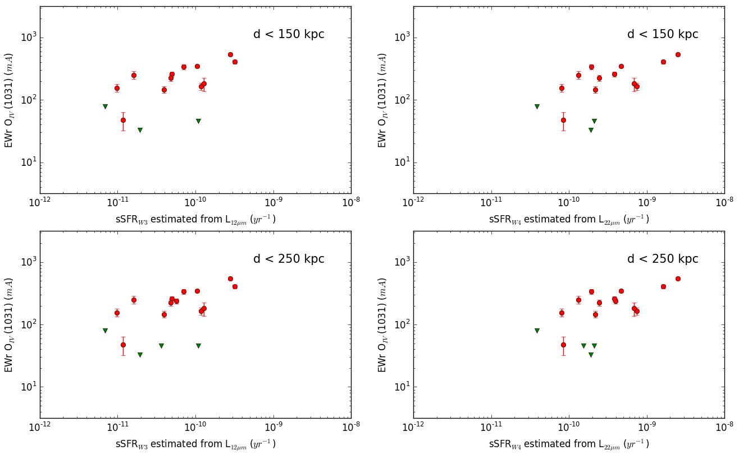
EW of OVI vs. sSFR
Xue & Fang (in preparation)

Slide 18
BH-Galaxies Coevolution/“Feedback”
* AGN outflow – Host interactions
* Mergers and Binary AGNs
HSC
IRCS
FOCAS
Kyoto3DII
(please see Chen, Akiyama-san et al. poster for example)
(talk by Kawaguchi-san for example)

Slide 19
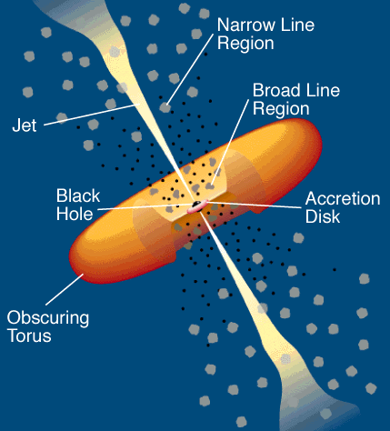
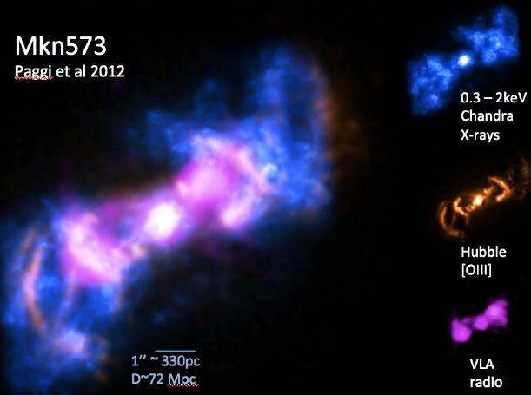
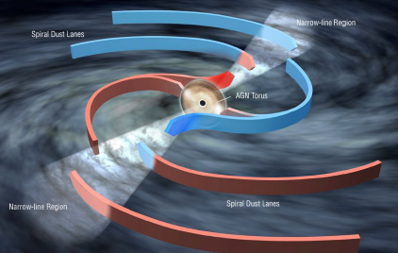
Agn—host Galaxy Interaction In Nearby Seyfert Galaxies
ionization cones
Narrow line region outflows
Paggi, Wang+(2012)
Fischer et al. (2017)
X-ray observations crucial for a complete view of the multiphase outflow
Need complementary Optical/IR data to better understand morphology/ionization/kinematics
Notes:
Our approach

Slide 20
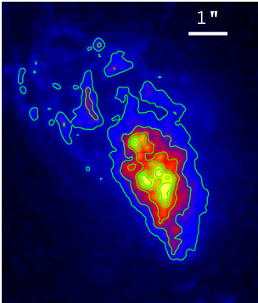
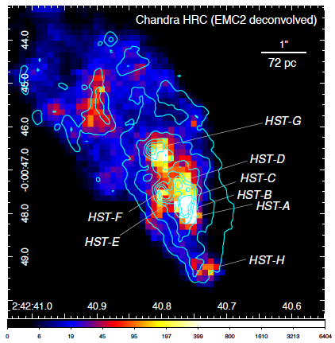
X-ray View of Jet-cloud Interaction in NGC 1068
HST/WFPC2 [OIII]
Chandra/HRC+HST [OIII] contours
Wang+(2012)

Slide 21
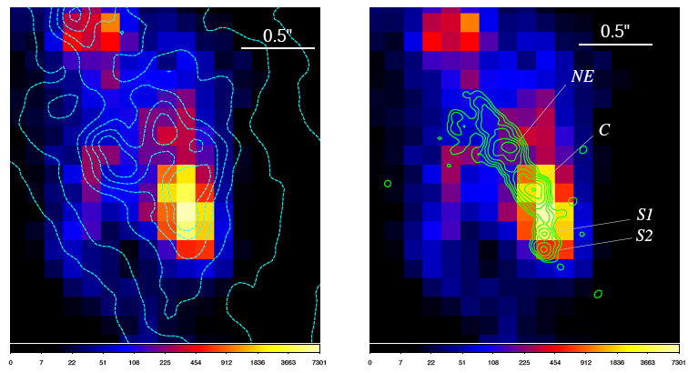
Inner-most 100 pc
HRC+HST [OIII]
HRC+MERLIN 1.4 GHZ

Slide 22
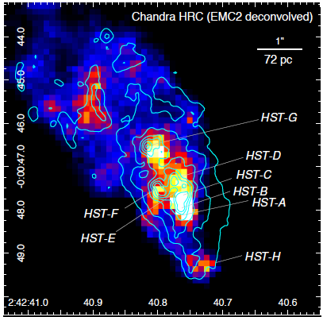
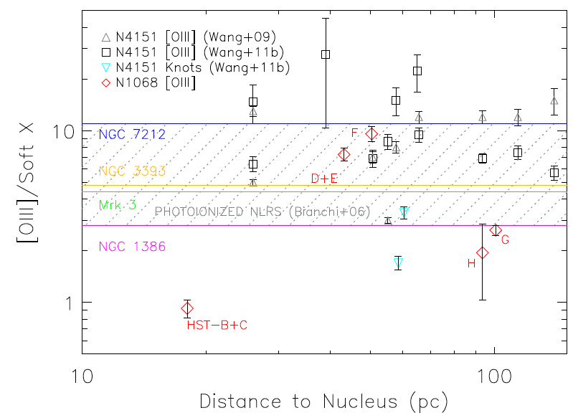
Identifying the Soft X-ray Excess due to Shock Heating
S-knot
Three locations show evidence for jet-cloud collision

Slide 23
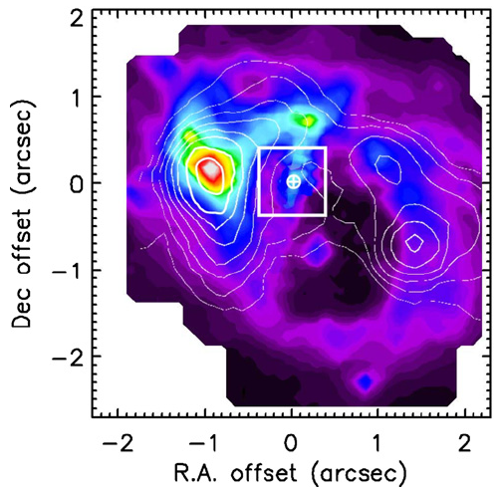
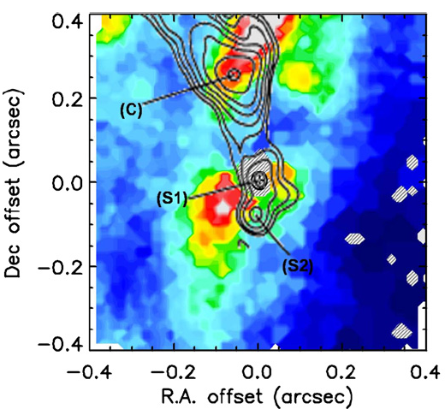
VLT/SINFONI H₂ 1-0 S(1)
Jet-cloud Interaction in NGC 1068
Müller Sánchez, et al. (2009)

Slide 24
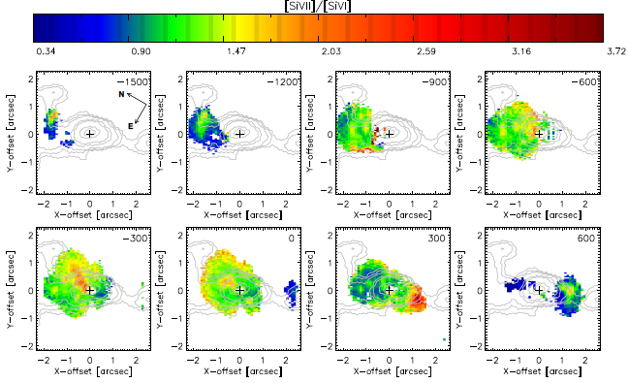
The X-ray Identified Shock Locations (HST G and H) Confirmed to Show Higher
[Si vii] /[Si vi] Line Ratios
Gemini NIFS coronal line emission study of NGC 1068
by Mazzalay et al. (2013) supports that radio jet plays an important role in the kinematics as well as structure of NGC1068

Slide 25
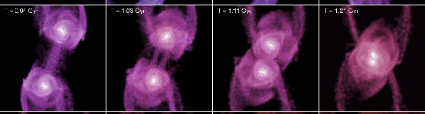
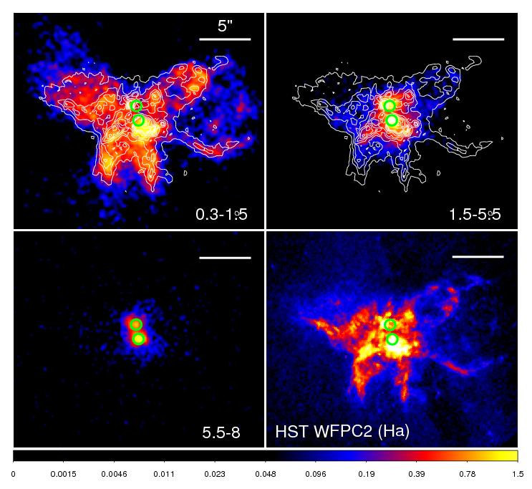
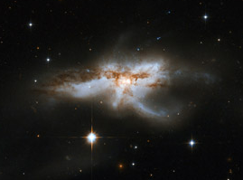
The Galaxy Merger NGC 6240:
Resolving The Starburst And The AGN
(Ultra)luminous Infrared Galaxy L_{IR}=7x10¹¹ L⊙
Merging galaxy with dual compton thick AGN
z=0.0245; D=106 Mpc
2.5 kpc
(keV)
Wang et al. (2014, 2018)
HST/ACS

Slide 26
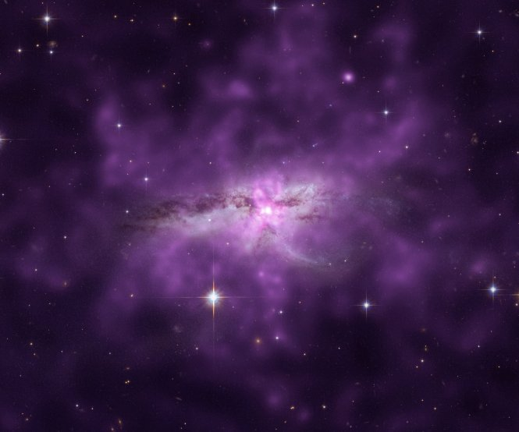
Deep Chandra Imaging of
NGC 6240
Reveals a Soft Halo
50 kpc
HST+Chandra image/NASA/CXC
NGC 6240 Nardini, Wang+2013; Wang+14
Notes:
Overview of highlights

Slide 27
Huge extended Hα emission up to 90 kpc
The overall morphology of the nebula is dominated by filamentary structures radially extending from the center of the galaxy
Remarkable coincidence with the soft X-ray emission
Yoshida et al. (2016)
Subaru/Suprime-Cam

Slide 28
Thoughts on International Partnership within my pay grade
Young active researchers from abroad recruited by many universities in China, generously supported with start-up grants
Broadly interested in 6-8 meter class telescopes, not limited to astronomers in OIR wavelengths
Ready to collaborate and produce good science using Subaru
Subaru International Workshops + Science Theme (e.g. Metal Poor Stars Subaru+LAMOST; EA-AGN): an effective way
Notes:
Thank Don Trump

Slide 29


XMU

Slide 30



Welcome to visit us at Xiamen!
Likely future TMT Subaru PFS meetings because of Prof. Fang’s involvement
Ranked the most beautiful campus in China
Department of Astronomy
11 faculty members
- High energy astrophysics: accretion disks, GRBs
- Galaxy formation and evolution, CGM/IGM
Thanks!
jfwang@xmu.edu.cn

