Slide 1
Future
Science Operation Modes
Tae-Soo Pyo
Science Operation Division, Subaru Telescope
2018/1/19

Slide 2
Background: Current and near Future
Significant reduction of operation budget from government
Reconfiguration of instruments with wide-field survey type instruments
  HSC, PFS, ULTIMATE-Subaru will be the main instruments (Queue mode)
Reduce the operation cost
Efficient survey type operation
Queue mode operation
Reduce Users travel costs(3千万円)
Reduce traffics to summit
Reduce HP expenses (2千万円)
Limited number of open-use nights
Increase observer’s role

Slide 3
Future Operation Modes
Full Remote Observation
No summit attendant
Queue mode
Survey (SSP: HSC, PFS, ULTIMATE)
Observers at Mitaka/Hilo/Other sites
SA/Operator at Hilo
IRD <-> SCExAO/CHARIS or IRCS
SA(1)+OSA(1) operation

Slide 4
Transition….
1-3 Observer
1 Operator at Hilo
1 SA (help)
1 SA
1 Operator
1-3 Observers
Classical (Full Remote)
1 SA
1 Operator
Operation at Mitaka/Hilo
Queue mode
Operation at summit
Operation at Hilo

Slide 5
Benefits
Reduce workloads of SAs
Reduce summit traffic
Con.
Difficulty of troubleshooting
Reduce travel/HP expenses
Accommodation/food service in Hilo
Difficulty of communication with observers
Data quality control
Needs more work for staffs (Queue Coordinator, FQA staff, IQA by SA)
Efficient survey observation
Allow Time Series observation (Cadency, Variable,...)
Needs easy UI for observers (soft wares)
Full Remote
Queue

Slide 6
Queue Mode Operation: HSC, PFS, NsIR
Currently only HSC since S16A.
  Open Use (several nights) + HSC SSP (several nights)
  Based on observational constraints: Seeing, Transparency, Moon phase and separation angle.
  Observational block shorter than 100 minutes.
  → SA (1) + OSA (1) operation
PFS operation is planning to do queue mode operation.
NsIR platform: SCExAO <->CHARIS<->IRD (between PI instruments)
  IRD requests hour base observational planning.
  SCExAO/CHARIS necessary very good seeing condition.
  The switching between instrument is take just a few minutes.
  Support staff must know how to handle all SCExAO/CHARIS/IRD instruments.

Slide 7
Queue Mode Operation for Various Instruments
  Difficult to adequate queue mode to the various instruments.
Other instruments
  There are requests for the other facility instruments.
  IRCS+AO188 <-> IRD, SCExAO/CHARIS <->IRD
    A beam switcher project at NsIR is on going as a technical collaboration with AAO, which will allow to switch among all instruments at NsIR.
  IR M2: switch between foci (~ 20-30 min)
    NsIR: IRD, IRCS or SCExAO/CHARIS
    Cs: MOIRCS or COMICS
    NsOpt: HDS
  Requirements
    SA/Operator must know how to handle multiple instruments on the foci.
    Queue software
    Policies for operation

Slide 8
What do we need to do…
Feasibility study about technical requirements
  Telescope inspection and repairing → TED + DC
  Dome inspection and repairing → TED + DC
  Revise Instrument operation → SciOP + InstDiv
  Monitoring system → TED + CDM +InstDiv
  Remote control network system → CDM + OCS
  Operation software: Gen2 → OCS + SciOP
  Observer support tools → SciOP + OCS
  Operation Policy and Procedure → SciOP + TED
  NsIR Queue mode → NewDiv + SciOP
  Study other observatories cases (Gemini/CFHT/UKIRT…) → SciOP+OCS+TED

Slide 9
Full Remote Mode: Technical Requirements
Remote control of TWS and monitoring of Local Control Units (LCUs) is technically possible since the end of Sep. 2017 by TED.
Need modifications of the telescope / enclosure / instrument / infrastructure etc. to correspond to the plan
Increasing webcams, sensors, and additional all sky monitor camera
Emergency plan for loss of network, power and serious mechanical/electrical failures
Remote places : Mitaka and Hilo
  Additional remote sites: what are the minimum requirements?
    The same VNC system with Mitaka or Hilo?
    Certification from Subaru? How to do maintenance?

Slide 10
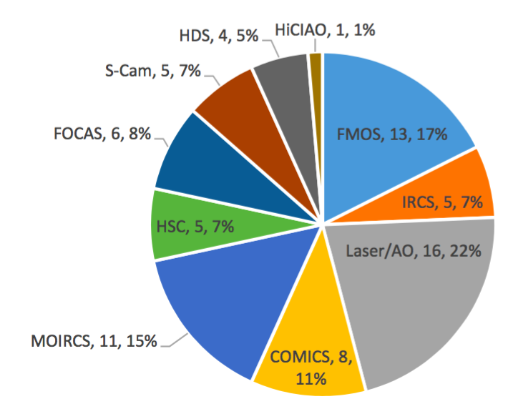
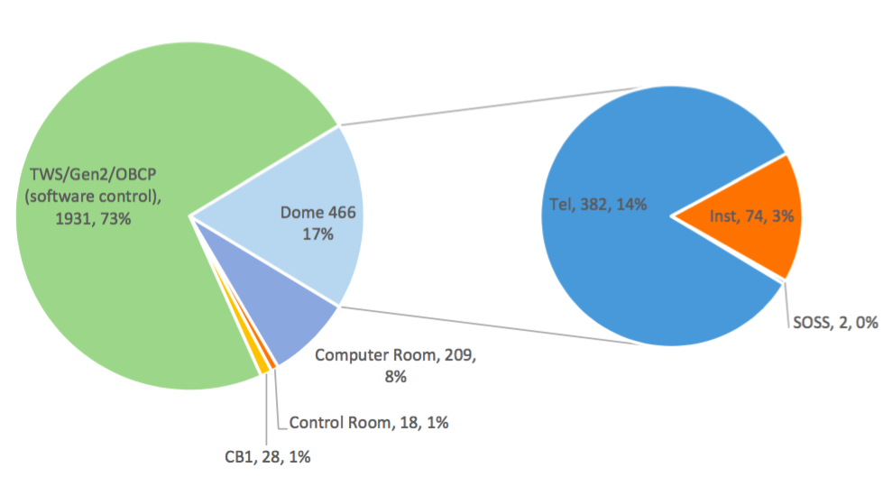
Trouble Recovery (2012-2017)
: Frequency of access to dome
Report by Michael Letawsky (2017)

Slide 11
Overcome Difficulties of Troubleshooting
Stability of telescope and instrument is essential.
Enhance the checking procedure of the instrument readiness at several days before the observation.
Revise pre-check procedures with DC2 – OCS -- SA/OSA
Clear any potential trouble points of telescope/instruments
Communication between DC2s/TED and OSAs at the shift time.
Checking dome status with cameras and sensors.

Slide 12
Role of OSAs and SAs: Current Visiting mode
Operator
Telescope Operation
A part of instrument set up and shutdown
SA
Full support for whole observation period
Observer
Preparation of observation planning
Preparing observation script before observation (except HDS)
Support at summit
Support at summit
Support observation planning
Support making observation scripts
Monitoring/watching operations of observation by SA/OSA
At summit/Hilo/Mitaka
Instrument operation by Gen2 Integral GUI
Dome pre- and post-check
Check readiness of instrument

Slide 13
Changing the Role of OSAs
Common Role: Telescope Control, Managing instrument operation manuals
OSA | Support Place | Role | Cf.
Current | Summit | Dome Pre- & Post Check (partly) Instrument set up / shutdown
 | Summit with an assistant | Dome Pre- & Post-checks Assist telescope and instrument troubleshooting
Full Remote Operation | Hilo | Telescope remote control Gen2 Integral GUI control Knowledge of observation modes of instrument | Dome Pre- & Post-Checks by DC2 & DC1 SA should give guide to OSAs about the observation modes of instruments

Slide 14
Changing Role of SAs
Common Role: TA of proposal TJ, Support observer for observation planning,
preparing of observation script (OPE), Instrument troubleshooting during night observation
SA | Support Place | Night support hour | Role
Current | Summit | Whole observation period | Operation of Gen2 Integral GUI Instrument operation Readiness check for instrument
 | Hilo | Whole → partly | Instrument Operation → Guide observer for instrument operation Gen2 Operation → Guide OSA for Gen2 Integral GUI operation
Full Remote Operation | Hilo/Mitaka/ Remote sites (Network) | 1st half night Complicate operation support Part of observation period | Guide observer for instrument operation Instrument troubleshooting in the night time Help instrument set up Lead development of user support tools, data analysis (pipe line), efficient procedures Readiness check for instrument

Slide 15
Changing Role of Observers
Common Role: Preparation of observation plan and observation script (OPE) with consulting with SA,
Decision making during observation, Checking observing data, Data Analysis
Observers | Place | Role | Cf.
Current | Summit/Mitaka/Hilo | (partly) operation of instrument Modification of observation script
 | Hilo/Mitaka | Operation of Instrument with guide of SA
Full Remote Operation | Mitaka/Hilo Other remote sites | Operation of Instrument Modification of observation script Communicate with OSA

Slide 16
Go Forward to Full Remote Operation…
As the first phase:
  OSA + assistant or 2 OSAs at summit
  Increase observer’s role at the summit (obeservation)
    Operation of instrument with guidance of SAs
  Allow the control from Mitaka remote room.
    Telescope moving should be under OSAs permission
      Modification of SETUPFIELD/TELMOVE command (add dialog for confirmation of OSA)
      For HSC, a few degree dithering observations, OSA confirmation approve for a while.
  Gen2 Integral GUI under OSA control
    The script and command should be time sequence and easy to select (understandable).
Hilo remote room improvement (+TWS, +Weather watch,...)
Instrument to Instrument has different situation
  Necessary to adjust the implementation for instrument to instrument.

Slide 17
Time Line of Science Operation Modification
S18A
S18B
S19A
Mitak/Hilo remote is main operation mode with 1 OSA + 1 Assistant at summit
Preparing for guide documents for each instrument from the manuals for (1) OSA and (2) Observers (SciOP)
Hiring additional OSAs
partly starting Hilo/Mitaka remote with 2 OSAs or 1 OSA + 1 Assistant at summit
Hiring three assistants
Revise SETUPFIELD command for confirmation of OSA
Preparing for Ope file checker program (SciOP + OCS)
Improvement of Hilo remote room
…
SA support 1st half night at Hilo and Observer has responsible in instrument operation

Slide 18
To Observer (お願い)
Involvement of Observer in instrument operation is essential.
SA role changing
  Support and operation for full observation period
    → Support 1st half night and standby at phone call
    → Help instrument troubleshooting
    → Guider/Supporter
    → More for user support: tools, data analysis, procedures, user manuals
Mitaka and Hilo remotes will be default choices from S19A from available instruments.

Slide 19
Thanks!
Let us know your opnions!

Slide 20
Appendix

Slide 21
Agenda
Background
Future Operation Modes:
  Full Remote mode and Queue mode
What are the necessary tasks to do
Time line
Announcement(お願い)

Slide 22
Revising Instrument Operations
Instrument | Concerns | Possible measurements
HSC | Careful operation of Filter Exchange Complicate procedure of HSC setup and shutdown | OSA does Filter Exchange procedure not observer. Simplify the procedure with batch scripts. For a while, SA give guide to observer and OSAs.
FOCAS | MOS mask replacement (every evening/morning) | Need to arrange daytime work at summit
COMICS | Need to watch TWS at remote sites. | Add TWS clone or VNC at Hilo and Mitaka.
IRCS+AO188 | Emergency Button at control room for Laser stop | Emergency Button at Hilo? OSA operate the emergency button
SCExAO+CHARIS | Instrument exchange with crane just after observation | Scheduling enough time for instrument exchange at NsIR.
HDS | Manual installation of Image Slicer | Avoid changing mode between image slicer and normal slit modes during a night
MOIRCS

Slide 23
Accommodation/food service in Hilo
Prepare accommodation lodge for OSAs and SAs
  Calm and clean environment
  Okayama observatory system?
    provide bed cover sheet and pillows to staffs

Slide 24
Tasks for preparation…
Check | Tasks
 | …
 | Make emergency plan for trouble of telescope/dome/instrument
 | Revise operation procedure for telescope moving remotely
 | Revise pre-check procedure
 | Establish the procedure of checking instrument readiness in daytime before observation night
 | Hire assistants (full time job)
 | ….
 | Improvement Hilo remote room (+ TWS, + Weather Watch,…)
 | Make a tool program for observers to make observing script
 | Prepare accomodation lodge at Hilo for operators and SAs
 | Prepare check list table for each observing mode
 | Prepare check list table for instrument operation procedure

Slide 25
Current Operation Status
Visiting Mode
Observation at Summit (Major mode)
Hilo Remote Observation
Non-Visiting Mode
Service Mode
HSC Queue Mode
Mitaka Remote Observation

Slide 26
Visiting Mode (Current Main Mode)
Observers + Operators (OSA) + SA at Summit (Majority)
SA’s full support at summit:
  SA is at summit with observers at summit/Hilo/Mitaka for full observational period.
Operator at summit : Telescope + (a part of instrument setup/shutdown)
For the safety, two staffs should be on summit.
Mitaka Remote Observation is steeply increasing
  Not allow any telescope moving operation at Mitaka in the current safety policy even though it is possible technically.
Hilo Remote Observation
  Staffs operate in Hilo remote room sometimes.

Slide 27
Non-Visiting Modes (Current Minor Mode)
No observers. SA and Operator execute the observation.
Proposers should submit detail observation information
  Service mode: information sheet and finding chart
  HSC Queue mode: Phase 2 sheet (preparation of observation block)
Execution
  Service mode: in schedule dates
  HSC Queue mode: in scheduled dates, based on the observational constraints
Status
  Service mode is for only short programs (< 4 hrs)
  HSC Queue mode is now developing (stage II), just only several nights for open use and SSP programs.

Slide 28
Roles of OSAs and SAs: Full Remote Mode
Goal
Operators (OSAs)
SAs
Telescope Operation
Basic knowledge for observational modes of instrument.
User support for observation planning
Instrument Troubleshooting
Gen2 Integral GUI operation support
1st night support
Observers
Preparation and modification of observation scripts during observation
Complex operation support
Telephone standby for the rest observation period
Preparation observation plan
User support for making observational scripts (OPE)
Basic knowledge for the observational mode and function of the instrument
Support at Hilo or remotely
Operate at Mitaka or Hilo or Other remote sites
Support at Hilo

